Slide 1
Mt Comfort Road Corridor
Presented to the coalition for smart growth

Slide 2
Background: Coalition for Smart Growth
Coalition including: Town of Cumberland; Town of McCordsville; Hancock Health; Nine Star Connect; Hancock Community Foundation; Hancock County Economic Development, the Indianapolis Airport Authority and more.
Starting 8/20, the Veridus Group was brought on for project management.
In November Stantec and Thomas P Miller & Associates were chosen for Land Use Plan & Housing Plan.
Applied Economics completed their Economic Impact Analysis for catalyst sites.
Goal to have recommendations endorsed by towns and county as addendum to current Comprehensive Plan, and included in the upcoming new County Comprehensive Plan.

Slide 3
Land Use Management
Create nodes of density, promote walkable and connected centers across the corridor
Provide places to work, live, educate and recreate
Protect Quality of Life for residents
Mixtures of land uses with different types of housing and businesses
Follow nature, use natural water courses as pathways and connectors
Preserve agricultural uses on the edges of the corridor to increase density in nodes
Focus roadway improvements in strategic corridor-wide manner

Slide 4
Land Use: Zone 1

Slide 5
Land Use: Zone 2

Slide 6
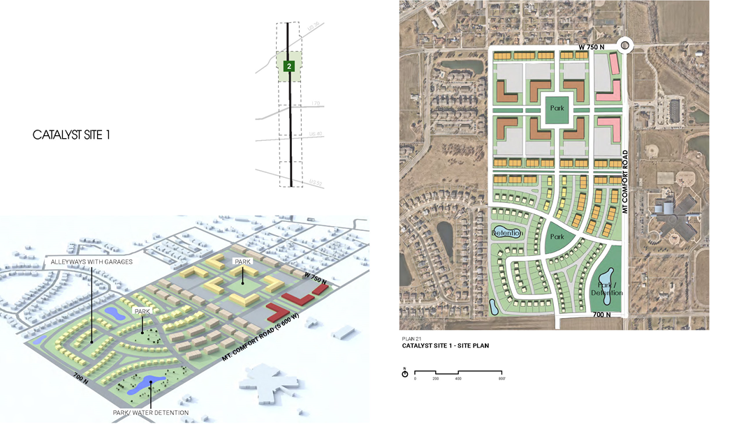
McCordsville Catalyst Site

Slide 7
Land Use: Zone 3

Slide 8
Land Use: Zone 4

Slide 9
Land Use: Zone 5

Slide 10
Land Use: Zone 6

Slide 11
Corridor Recommendations:
1. Create an Overlay District
Layer of oversight & guidance to development coming on the Corridor.
Stop-gap protection for community until Comprehensive Plan can be adopted in 2022.
Plan Commission in towns & county retain autonomy and make ultimate approval or disapproval.
Functionally, serve as addition to Technical Advisory Committee for projects in Overlay.
Working group to write ordinance and build out overlay development standards could begin work upon approval of plan.

Slide 12
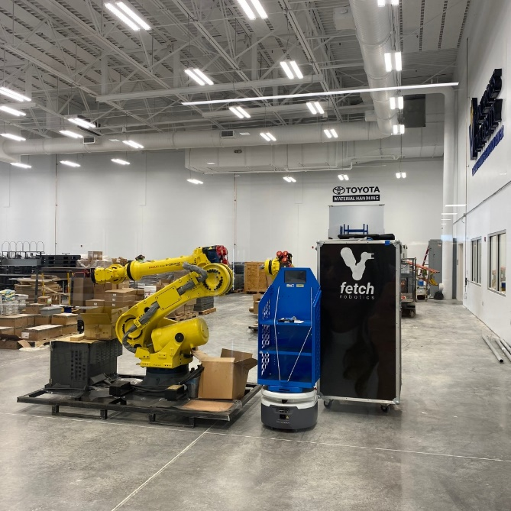
Corridor Recommendations:
2. Pursue Target Industries
Current County target industries: Manufacturing, Agribusiness, Life Science, Logistics
Proposed Corridor target industries: Information Technology, Bio-Life Sciences, Manufacturing, Logistics.
Partner with regional and State partners: Conexus, BioCrossroads, TechPoint, Indy Partnership, IEDC, etc
Use BRE Report & existing data to identify current industries & supply chains.
Develop Incentives Matrix to reflect community priorities.
Set aside real estate options for target industries.

Slide 13
Corridor Recommendations:
3. Workforce Development
Continue & grow Business Retention & Expansion efforts.
Transit / Mobility : work with private and public partners to develop transportation solutions for existing and expected workforce.
Post-Secondary / Career & Technical Education (CTE) : Work with local school leaders, employers, and other stakeholders to understand the needs for expansion of post-secondary education and CTE in the county.
Innovation & Education Center initiative.

Slide 14
Workforce / Post-Secondary / CTE Models
MADE @ Plainfield (Plainfield, IN)
Columbus Learning Center (Columbus, IN)

Slide 15
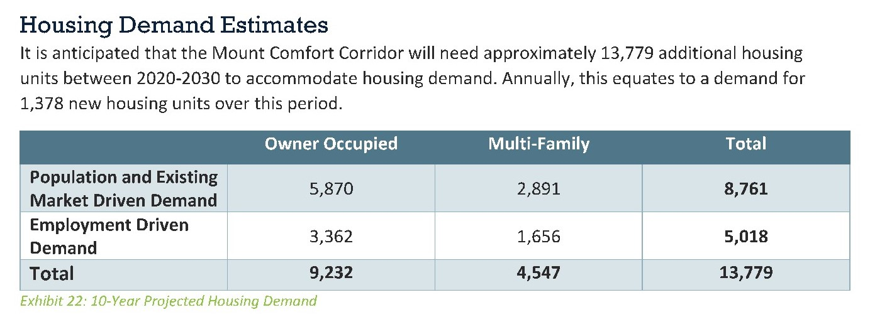
Corridor Recommendations:
4. Address Existing & Expected Housing Gap
Current housing stock meeting 66% of demand for owner occupied, 33% for renter occupied (TPMA).
By 2030: Market Driven Demand 8,761 units; Employment Driven Demand 5,018 units;
TOTAL of 13,779 units

Slide 16
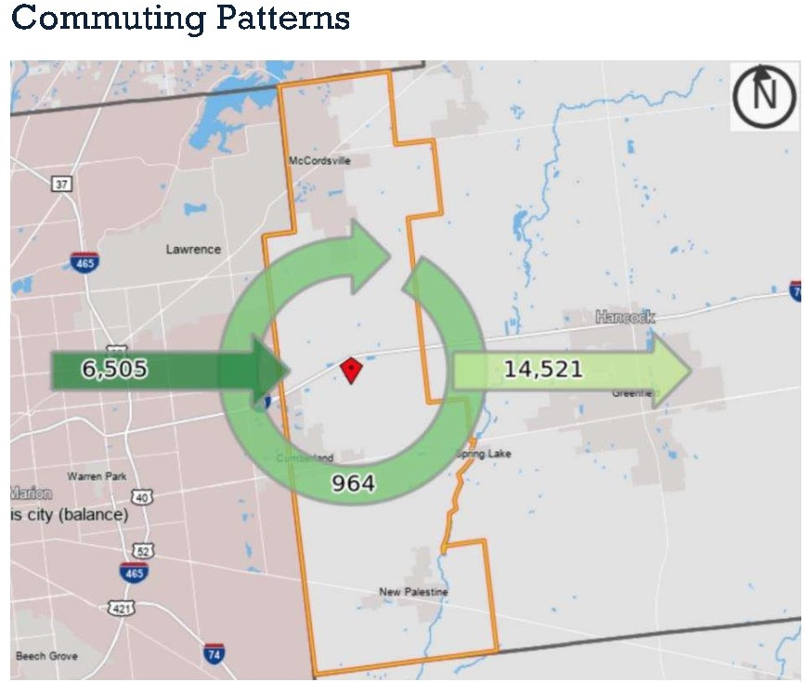
Corridor Recommendations:
4. Address Existing & Expected Housing Gap (continued)
Primary residential development all single family, $250,000 +. Majority of current residents work outside of the county. Jobs existing and expected along the corridor won’t allow workers to afford existing housing.
Communities and county should engage directly with developers to help them understand the priorities and needs along the corridor.
Priority land set aside for residential uses.
Attainable Housing incentives program.
Development Standards expectations clarified and updated.

Slide 17
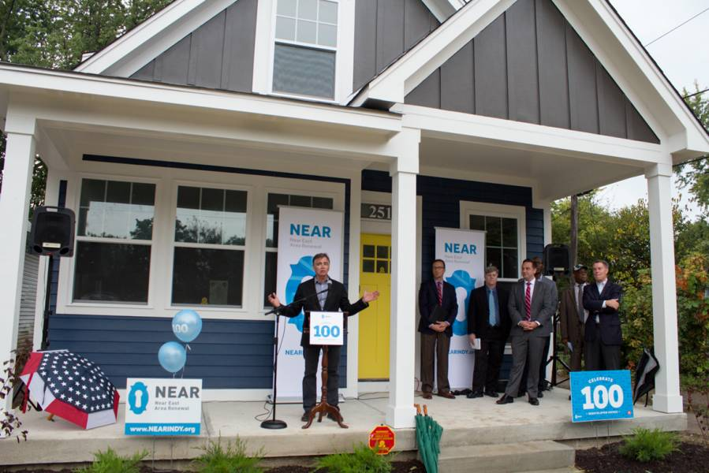
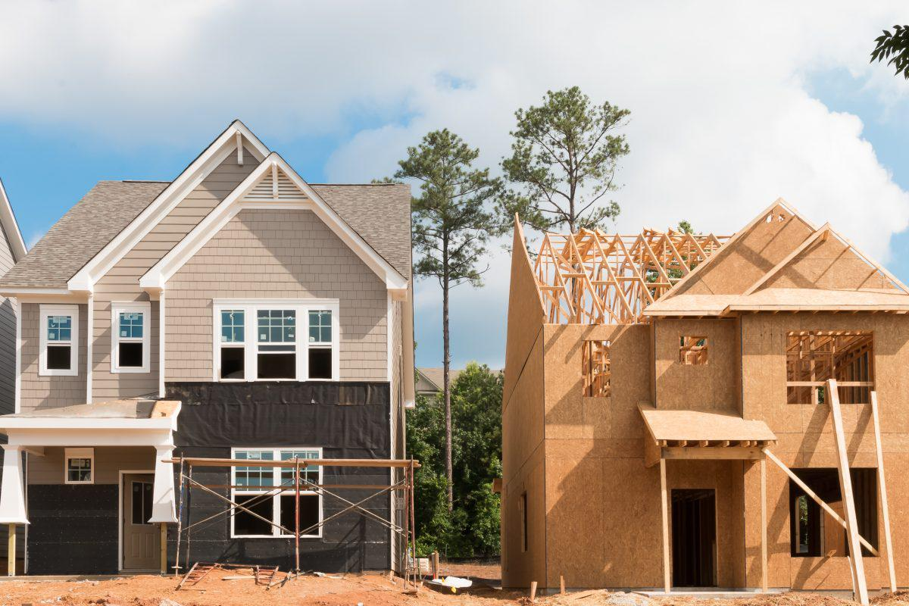
Corridor Recommendations:
4. Address Existing & Expected Housing Gap (continued)
“The National Standard for workforce housing is in the $150,000-$250,000 range for owner-occupied units or $850 to $1,600 per month for renter-occupied units. These products should be attainable by the service and production employees of the community – firefighters, teachers, nurses, production workers, and others who have been priced out of higher market rate housing options. This term can refer to any form of housing, including ownership of single-family or multi-family homes, as well as rental units.”

Slide 18
Corridor Recommendations:
5. Continued Corridor Management
Quarterly Corridor Congress, bringing Coalition together to give updates on goals, planning, increase communication and collaboration.
Designate clear points of contact within the Coalition – positions, not individuals.
Continued Transportation Planning in conjunction with Comprehensive Plan
Create Action Plan with Near, Medium, and Long Term Goals.

Slide 19
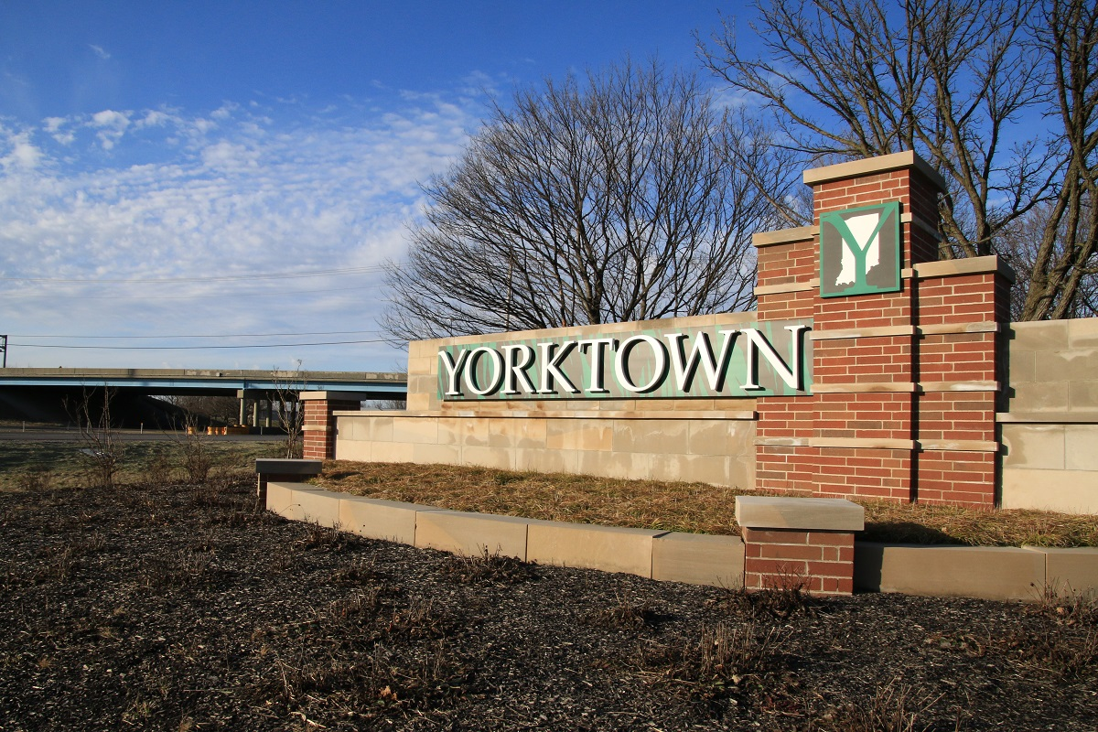
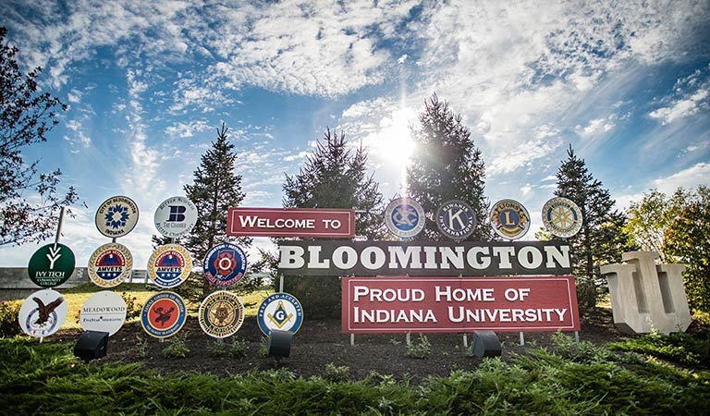
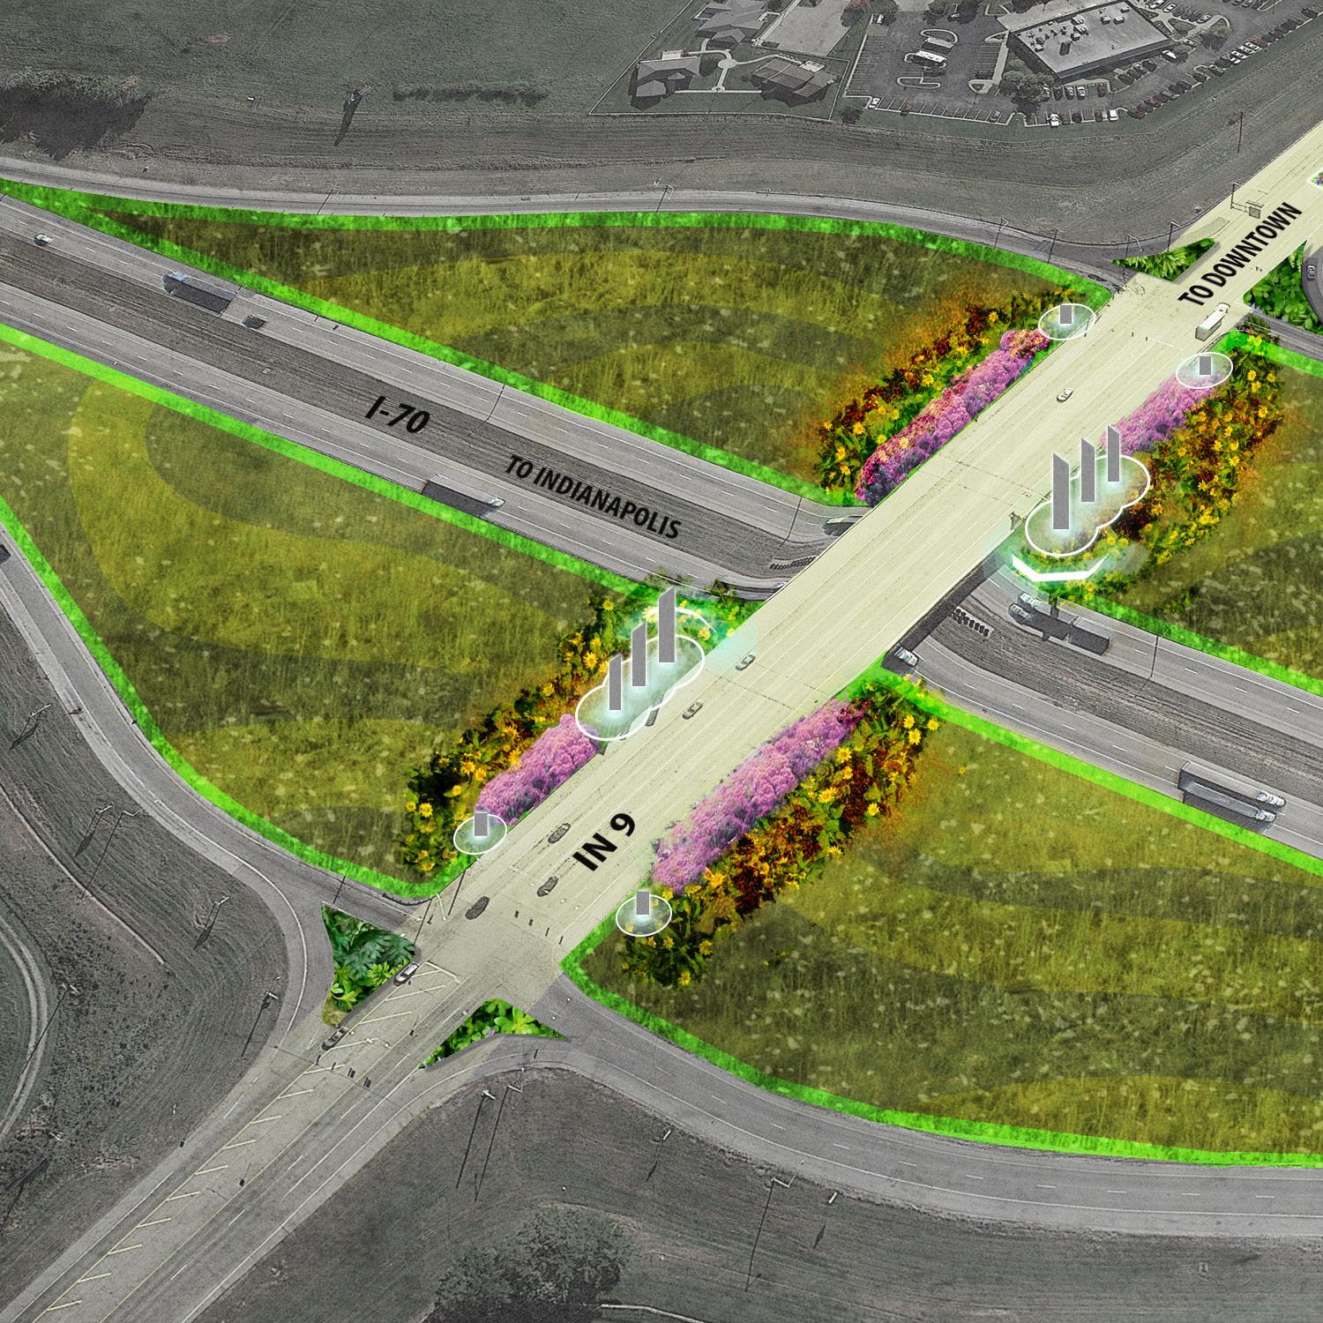
Corridor Recommendations:
5. Continued Corridor Management (continued)
Utilize existing website for data, information for residents, potential residents, businesses, real estate professionals, government entities and more.
Beautification / Branding: Gateway Bridge / Signage at I-70; Elevated Design Standards; Signage / Wayfinding.

Slide 20
Economic Impact Report (Applied Economics)
Projected construction expenditures $645.9 million over the next 10 - 15 years, generating over 7,200 direct construction jobs, close to 1,800 additional indirect jobs in Hancock County during construction period. The total construction impact is estimated at $885.0 million.
Businesses in these five nodes could generate annual economic impact of $446.0 million, including direct, indirect and induced operations impacts of the tenant businesses.
The office, retail, restaurant, health care, public and hotel uses envisioned for the development nodes could directly employ an estimated 3,900 people. In addition, these businesses could support an estimated 930 indirect and induced jobs at other local businesses in Hancock County.
$151.2 million in direct labor income or earnings and $183.2 million in total direct and indirect and induced labor income generated annually at build out, creating the potential for significant local expenditures by employees and their families.

Slide 21
Economic Impact Report (Applied Economics)
Residential could result in 6,390 new residents with combined annual household incomes of $204.8 million.
These residents have potential to support $184.3 million in annual household spending on retail and services within the development nodes and elsewhere in the region.
$15 million in local income, property, innkeepers and food and beverage taxes per year to the towns, townships, school districts in the corridor and the county.
Additional income and property tax revenues from employees working in these development nodes and living in Hancock County are estimated at $1.5 million per year at built out. These revenues would be distributed to local governments in the communities where the employees live.

Slide 22
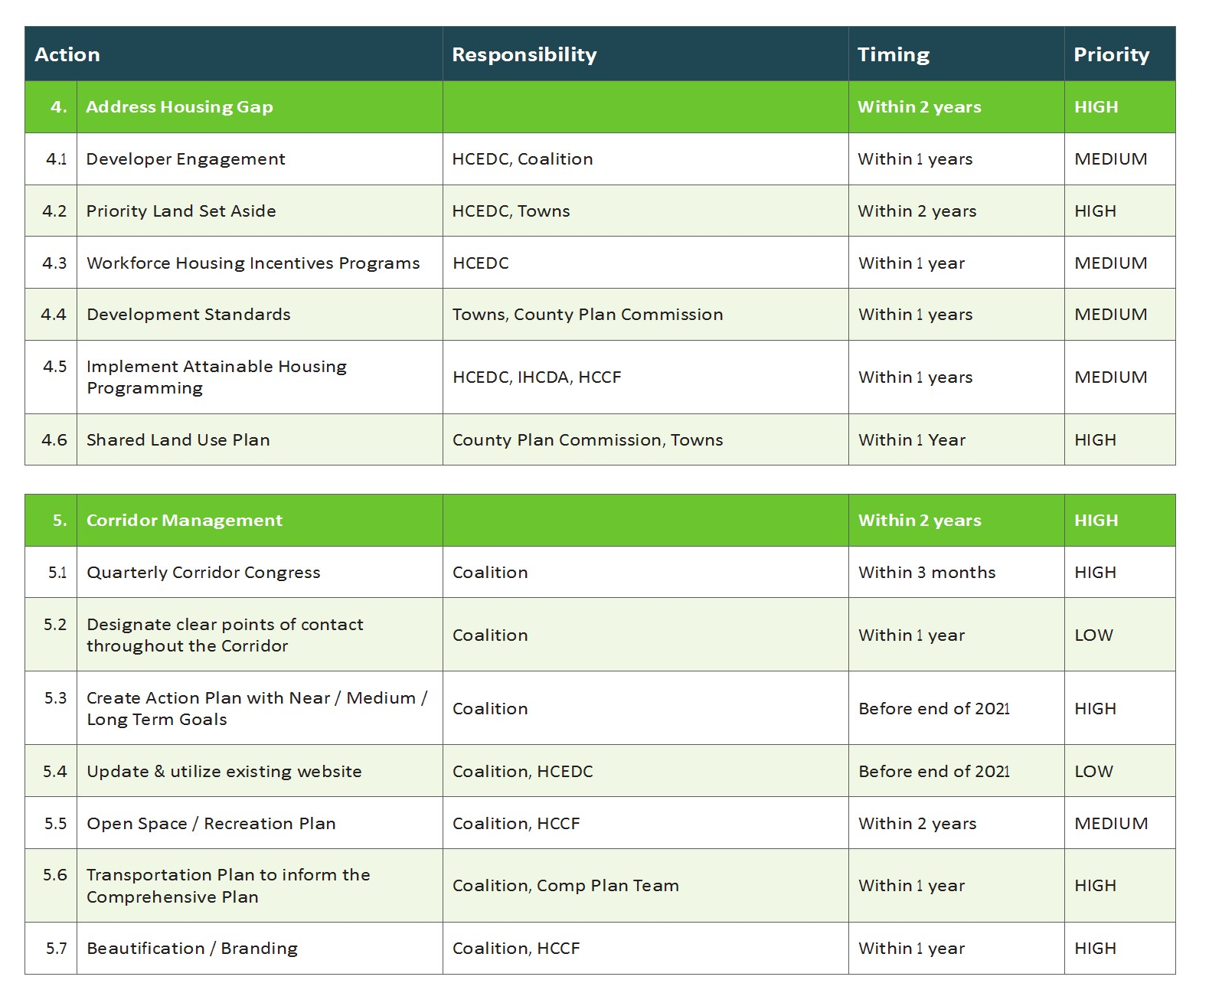
Responsibility Matrix:

Slide 23
Next Steps:
Plan Commission Hearing to Approve Land Use Plan: 10/26//21
County Commissioners – Vote to Endorse: 11/16/21
Corridor Congress meeting?

