Slide 1
McCordsville Market Analysis
January 2019
Infographics by Chris M Brock
Notes:
This market analysis focuses on the types of retail sectors that would be considered desirable in a Town Center environment.
The Subcommittee for this Market Analysis was established at the beginning of the project to provide overall guidance and leadership. Comprised of leaders from the public and private sectors who were deeply engrained in the Town Center Design project. Charged with reviewing and providing feedback for data and recommendations, the Subcommittee will be finalizing and approving the action steps outlined in this Market Analysis.
The Veridus Group and SLE Analytics facilitated the process and provided research – both quantitative and qualitative– to the Subcommittee. In addition to the stakeholders listed below, our team thanks the citizens and business leaders who participated in focus groups and a web survey.

Slide 2
KEY FINDINGS AND RECOMMENDATIONS
McCordsville | Market Analysis | January 2019

Slide 3
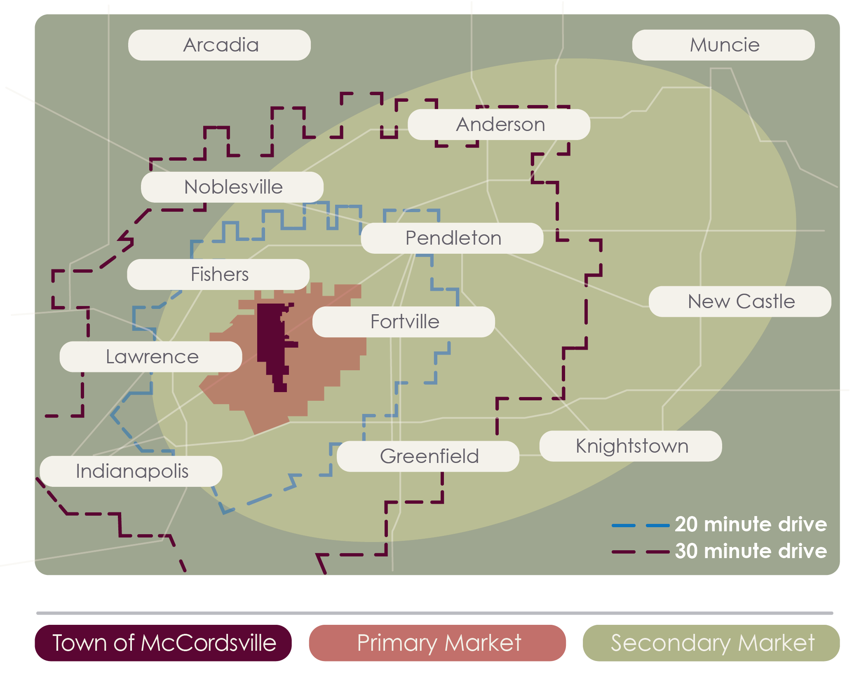
Market Area
3
McCordsville | Market Analysis | January 2019
Notes:
The market areas that McCordsville’s Town Center may reasonably draw consumers from are outlined below.
The Primary and Secondary Market areas were established based on a variety of factors, including drive time radius, average commute time, and anecdotal evidence provided by the Market Analysis Subcommittee. These regions of analysis were further validated via survey responses regarding commute time and willingness to travel to dine or shop.
Primary Market (74 sq. mi.) The area within a 10 minute drive from West Broadway and 600 West/Olio/Mt. Comfort Rd, including:
The entire political boundary of the Town of McCordsville
Parts of the City of Lawrence and the Town of Fortville
Note: The Town of McCordsville accounts for only 10.1% of the population in the Primary Market
Secondary Market (1,062 sq. mi.)
The area within 20 minutes’ drive, plus all or parts of communities that are likely to either:
Visit McCordsville periodically
Draw consumers away from McCordsville
The Primary Market is a subset of the Secondary Market, which means the Demand, Surplus, and Leakage of the two markets cannot be added together to obtain a “total” amount.

Slide 4
Key Findings
The Town of McCordsville is in a strong position to attract retail to its new Town Center based on the Primary Market area’s demographics, consumer preferences, and unmet retail demand.
The following retail sectors are recommended for the Town Center:
1st Tier |  | 2nd Tier | 3rd Tier
Restaurants & Other Eating Places | Grocery Stores | Department Stores | Health & Personal Care Stores | Beer, Wine & Liquor Stores
4
McCordsville | Market Analysis | January 2019
Notes:
The Primary Market could support nearly any type of retail industry, including small or boutique businesses. In many retail sectors, there is additional unmet retail demand (also known as “leakage”) in the Secondary Market, which further reinforces the market for the Town Center.
Marketing and incentives should be directed towards attracting the 1st tier targets to serve as anchors in the Town Center. Once those businesses are established, 2nd and 3rd tier retail is likely to follow based on foot traffic and increased market demand.
Given the trends in online retail and the Town’s proximity to other major, desirable markets, the Town Center will need to develop unique, experiential retail and the feeling of a destination in order to draw consumers from their established behavior and patterns.

Slide 5
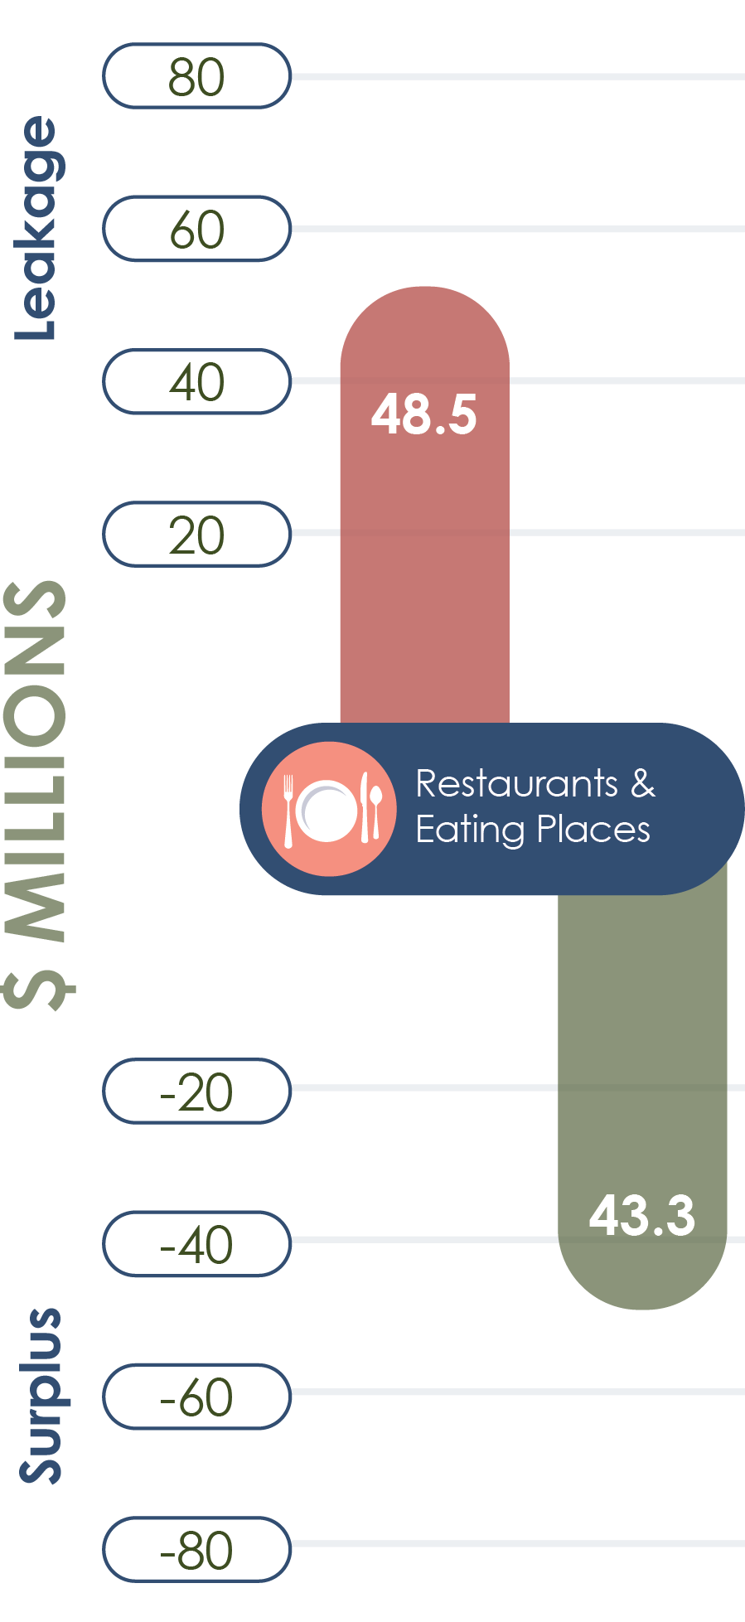
1st Tier Target: Restaurants & Other Eating Places
Rationale:
Significant retail demand
Significant leakage
Evidence of local demand
Local Consumer Preferences:
Locally-owned and family-friendly
Upscale or experiential dining options
Market Trends and Considerations:
Restaurants are a strong market, especially trendy concepts
Important as anchors for commercial development
5
McCordsville | Market Analysis | January 2019
Notes:
NAICS 7225: This industry comprises establishments primarily engaged in: (1) providing food services to patrons who order and are served while seated; (2) providing food services to patrons who generally order or select; or (3) preparing and/or serving a specialty snack and/or nonalcoholic beverages for consumption on or near the premises.
Significant retail demand
$102.3 million in the Primary Market
$721.3 million in the Secondary Market
Significant leakage
$48.5 million in the Primary Market. While there is a surplus in the Secondary Market, the demand and leakage in the primary market is more than enough to sustain several businesses
Evidence of local demand
81% of survey respondents eat out 1-3 days a week
94% of survey respondents currently drive more than 10 minutes to dine at a good restaurant (87% drive to Hamilton County)
Locally-owned restaurants are preferred, as are family-friendly restaurants, sandwich delis, breakfast & brunch places, brewpubs and wine bars, and farm-to-table
May prefer more upscale or experiential dining options:
Approximately 38% of survey respondents typically spend between $51- $150 to dine out
Local consumers spend an average of 34% more on food and 59% more for entertainment & recreation than a typical US household
Restaurants are a strong market, especially trendy concepts, such as farm to table, healthy fast food, brewpubs, and mom & pop joints
Restaurants are increasingly important as anchors for commercial development

Slide 6
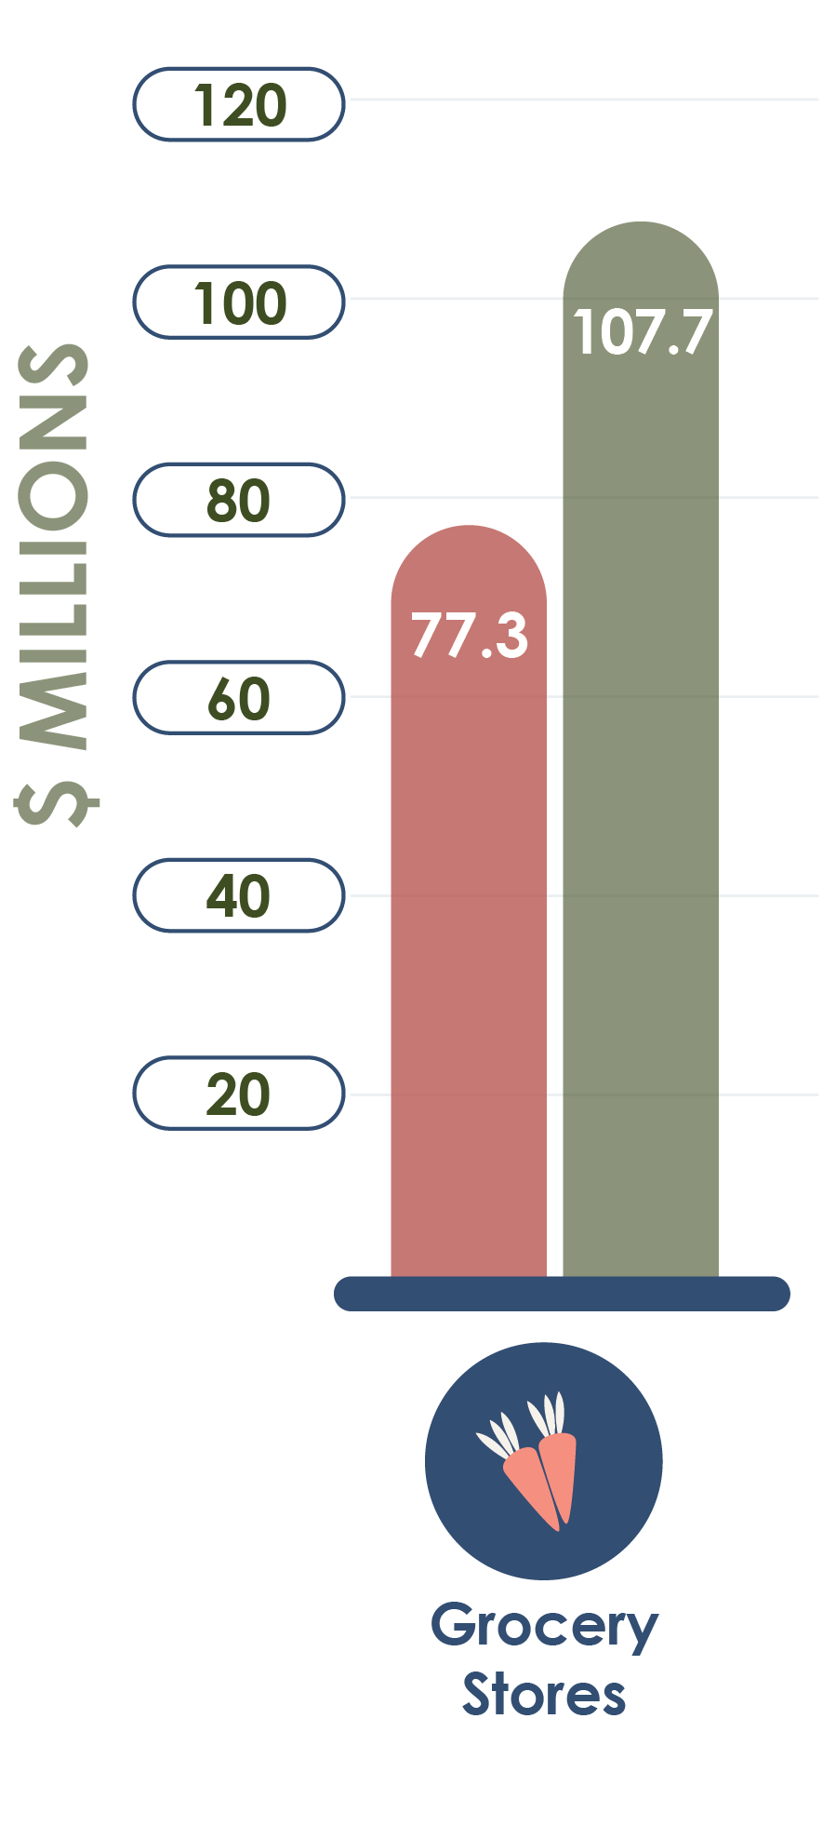
1st Tier Target: Grocery Stores
Rationale:
Significant retail demand
Significant leakage
Evidence of local demand
Local Consumer Preferences:
Upscale brands, specialty items, or organics
Currently shop at Kroger, Sam’s Club, and Fresh Thyme
Market Trends and Considerations:
Experiential shopping
Technology increasingly important
Alignment with community values
6
McCordsville | Market Analysis | January 2019
Notes:
NAICS 4451: This industry group comprises establishments primarily engaged in retailing a general line of food products
Rationale:
Significant retail demand
$144.4 million in the Primary Market
$1.1 billion in the Secondary Market
Significant leakage
$77.3 million in the Primary Market
$107.7 million in the Secondary Market
Evidence of local demand
73% of survey respondents go out of McCordsville for groceries
Local Consumer Preferences:
May prefer more upscale brands, specialty items, or organics, as local consumers spend an average of 34% more on food than a typical US household
Survey respondents indicate they prefer to shop at Kroger, Sam’s Club, and Fresh Thyme
Market Trends and Considerations:
Experiential shopping
Specialty and boutique markets
“Old World” or farmer’s markets “on steroids” featuring multiple and/or rotating vendors selling a variety of produce, meats, and prepared foods
Themed markets, such as Eataly (a Italian marketplace with grocery, retail, and restaurants with locations in New York City, Chicago, Los Angeles, and Boston)
Technology, in the form of online ordering with either pick up or delivery options and checkout-free shopping apps
Options that align with community values, such as local, organic, ethical, sustainable

Slide 7
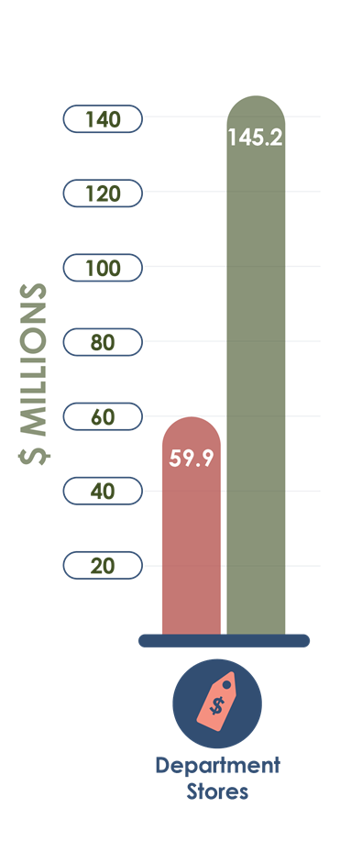
2nd Tier Target: Department Stores
Rationale:
Significant retail demand
Significant leakage
Evidence of local demand
Local Consumer Preferences:
Higher quality goods and clothing
Currently shop at national brands such as Target and Kohls
Market Trends and Considerations:
Unique, experiential shopping options
Should be carefully phased-in with conservative incentives
Technology increasingly important
7
McCordsville | Market Analysis | January 2019
Notes:
NAICS 4521: This industry comprises establishments known as department stores primarily engaged in retailing a wide range of the following new products with no one merchandise line predominating: apparel, furniture, appliances and home furnishings; and selected additional items, such as paint, hardware, toiletries, cosmetics, photographic equipment, jewelry, toys, and sporting goods. Merchandise lines are normally arranged in separate departments.
Rationale:
Significant retail demand
$129.3 million in the Primary Market
$920.1 million in the Secondary Market
Significant leakage
$59.9 million in the Primary Market
$145.2 million in the Secondary Market
Evidence of local demand
90% of survey respondents go out of McCordsville for Clothing and Accessories
75% of survey respondents go out of McCordsville for Household Goods
59% of survey respondents go out of McCordsville for Furniture
Local Consumer Preferences:
May prefer higher quality goods and clothing as local consumers spend an average of 28% more on Apparel & Services than a typical US household
The majority of survey respondents shop at Department Stores such as Target and Kohls
Market Trends and Considerations:
Unique, experiential shopping options, such as pop-up shops, clusters of themed shops, retail-less stores that provide previews of goods or personalized shopping (e.g. Wayfair, Nordstrom)
Given the ongoing changes in the market, retail should be carefully phased-in retail and incentives should be conservative
Online ordering and pick-ups are becoming increasingly important for brick and mortars in order to compete with online retailers

Slide 8
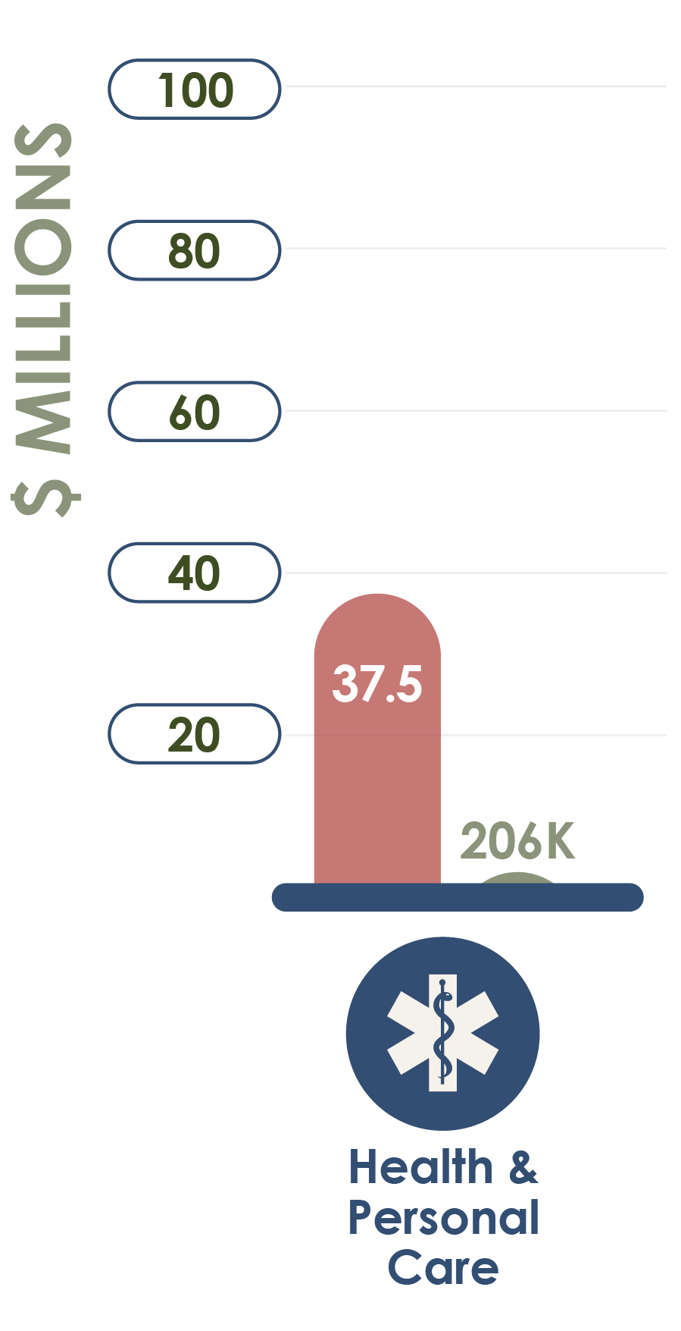
3rd Tier Targets: Health & Personal Care; Beer, Wine & Liquor Stores
Rationale:
Significant retail demand
Significant leakage
Consumer Preferences:
Upscale brands
8
McCordsville | Market Analysis | January 2019
Notes:
NAICS 4461: Industries in the Health and Personal Care Stores subsector retail health and personal care merchandise from fixed point-of-sale locations.
Rationale:
Significant retail demand
$60.3 million in the Primary Market
$44.4 million in the Secondary Market
Significant leakage
$37.5 million in the Primary Market
$206 thousand in the Secondary Market
Consumer Preferences:
May prefer more upscale brands, as local consumers spend an average of 57% more on Healthcare than a typical US household
NAICS 4453: This industry group comprises establishments primarily engaged in retailing packaged alcoholic beverages, such as beer, wine and liquor.
Rationale:
Significant retail demand
$14.4 million in the Primary Market
$101.5 million in the Secondary Market
Significant leakage
$11.2 million in the Primary Market
$34.4 million in the Secondary Market
Evidence of local demand
51% of survey respondents cited going outside of McCordsville for beer, wine, or liquor
Consumer Preferences:
May prefer more upscale brands, specialty items, or organics, as local consumers spend an average of 34% more on food than a typical US household

Slide 9
Additional Recommendations
Define an Authentic Identity
Increase Staff Capacity
Strengthen Marketing Initiatives
Boost Communication Efforts
9
McCordsville | Market Analysis | January 2019
Notes:
Based on anecdotal evidence from focus groups, individual interviews, and the web survey of community stakeholders, Town staff, businesses, investors, and civic leaders, the Veridus team offers the following recommendations to enhance business investment into the downtown area and throughout McCordsville.
Define an Authentic Identity
When stakeholders were asked for their vision of a future Town Center, the overwhelming response indicated a strong need for defining McCordsville’s identity. A community certainly cannot define its future without understanding its past and present character. The Town Center Design project, led by Context Design, will facilitate a visioning process to help McCordsville leaders and staff define its authentic identity and develop a roadmap that pays homage to such characteristics.
Increase Staff Capacity
Based on feedback from focus groups, the web survey, and individual interviews, stakeholders emphasized the need for additional Town staff. Pairing this anecdotal evidence with the population projections of the Primary Market (i.e. within a 10 minutes drive) over the next five years indicate a 72% increase, it is critical for the McCordsville leadership to proactively plan for this growth and investment opportunity by adding capacity to their staffing levels. Enhanced capacity would bolster economic development, marketing, and communication with internal and external audiences.
Strengthen Marketing Initiatives
Stakeholders identified a need to increase marketing efforts. Such comments included the desire to promote the strong Mt. Vernon School Corporation, friendliness, and safety. Others identified a need to revamp its image in order to compete regionally with nearby communities. One example included renaming local roads to align with regional neighbors and, thus, changing the negative perception of McCordsville being located too far from commerce centers and amenities.
Boost Communication Efforts
Participants in the focus groups and survey valued the Friday Blast email as a great communication tool, stakeholders still identified a robust desire for more frequent and transparent communication to residents and businesses both locally and regionally. Efforts to potentially add additional staff and/or increasing marketing and communication partnerships with organizations across the community is recommended.

Slide 10
MARKET AREA CHARACTERISTICS
McCordsville | Market Analysis | January 2019

Slide 11
Market Area Demographics
The demographics of the both the Primary and Secondary Market Areas are favorable for retail. The Primary Market is particularly strong, as it is:
Fast-Growing
Relatively Affluent
Densely Populated
Highly-Educated
11
McCordsville | Market Analysis | January 2019
Notes:
The adage “Retail follows Rooftops” indicates the importance of population growth, household characteristics, and income growth in determining retail demand. While both areas are fast-growing, densely populated, and affluent relative to the State, the Primary Market appears to
be particularly strong, as it is:
Population growth of 72% from 2000 to 2023.
Projected increase of an nearly 8% over the next 5 years.
Average household income is over $110,000, with more than 41% of earning more than $100,000.
Projected increase of approximately $15,000 per household on average by 2023.
Average net worth is nearly $600,000 greater and an average home value over $100,000 greater than the State average.
Over 4 times more people per square mile than the state.
More than half of the population has a college degree, which is nearly twice the level of the State
Residents are more likely to be employed in white collar jobs, such as management, business, financial, and other professional industries

Slide 12
Market Segmentation
12
McCordsville | Market Analysis | January 2019
Notes:
The Secondary Market is fairly diverse: 15 market segments represent 75% of the area.
This population consists of young, professional families, but also recent empty-nesters and senior residents. Families range from low-income and less educated to highly educated with higher than average incomes and net worth
Source: Esri’s Tapestry Segmentation. a geo-demographic system that identifies 68 distinctive markets in the US based on socioeconomic and demographic characteristics to provide a comprehensive profile of consumer behavior and preferences. While some of the market segment names and descriptions could be viewed as parochial, or even condescending to some groups, Esri’s terminology is fairly standard in the retail industry and is important for signaling to potential developers and retailers.
Light purple: Young families in first homes, suburban or semirural, dual-income, enjoys DIY home projects, sports, technology, and eating out.
Dark Pink: Established homeowners, hard-working & optimistic, shopping & leisure focus on their children, may include 3rd or 4th generation Hispanic families.
Dark Purple: Established, married couples with children, homeowners, expect quality, wealth-educated, active community members, enjoy sports and travel.
Light Pink: Growing up & staying/working close to home, close-knit urban communities, own older homes or rent,, shop at discount stores.
Yellow: Middle-aged families with older children, short commutes, financially secure, news junkies, enjoy eating out, renting movies, and exercise.
Green: Empty nesters in rural areas, politically conservative, buy American, prefer to eat at home and shop at discount retail stores, enjoy being outdoors.

Slide 13
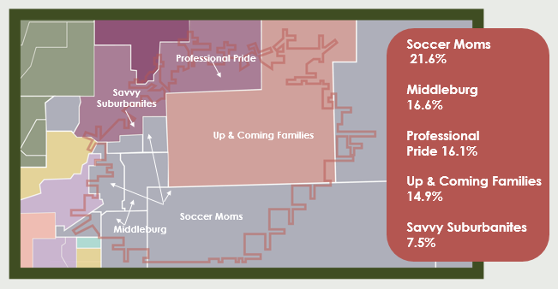
Detailed Market Segmentation for the Primary Market
13
McCordsville | Market Analysis | January 2019
Notes:
The Primary Market is fairly homogenous: the top 5 segments represent 76% of the area.
These segments represent younger, family-oriented units that prefer to live in more rural and suburban areas, but close to an urban core. They generally have higher than average median income and are financially aware.
Soccer Moms: Fairly affluent, family-oriented market that prefers to live away from urban centers, but close enough to commute to professional job centers. These two-working-parents households favor time-saving devices and services and prefer family-oriented purchases and activities.
Middleburg: Young, conservative, family-oriented communities that live in semi-rural subdivisions. Traditional values- faith, county, and family. These households are thrifty and prefer to buy American and travel in the US. Entertainment is family-oriented and spending priorities focus on children and home DIY projects
Professional Pride: Affluent, well-educated career professionals. These households include goal-oriented couples with young children who work and commute long hours to maintain their upscale suburban lifestyles. They are financially savvy, with a median net worth over 5 times greater than the US. These families spend time and money upgrading their homes, traveling, and on self-care.
Up and Coming Families: These families are ambitious, willing to work hard to get ahead, and optimistic about their financial future. As young families establishing their homes and style, they are careful shoppers and are willing to shop around. They enjoy family activities and often rely on the internet for entertainment and shopping. This is one of the fastest growing markets in the country.
Savvy Suburbanites: Relatively affluent, well-educated, married couples with no children or older children. Their suburban lifestyles allow them to pursue home remodeling and gardening while still enjoying the city’s cultural amenities. These households are informed shoppers who do research and focus on quality, and they prefer natural or organic products.

Slide 14
RETAIL ANALYSIS
McCordsville | Market Analysis | January 2019

Slide 15
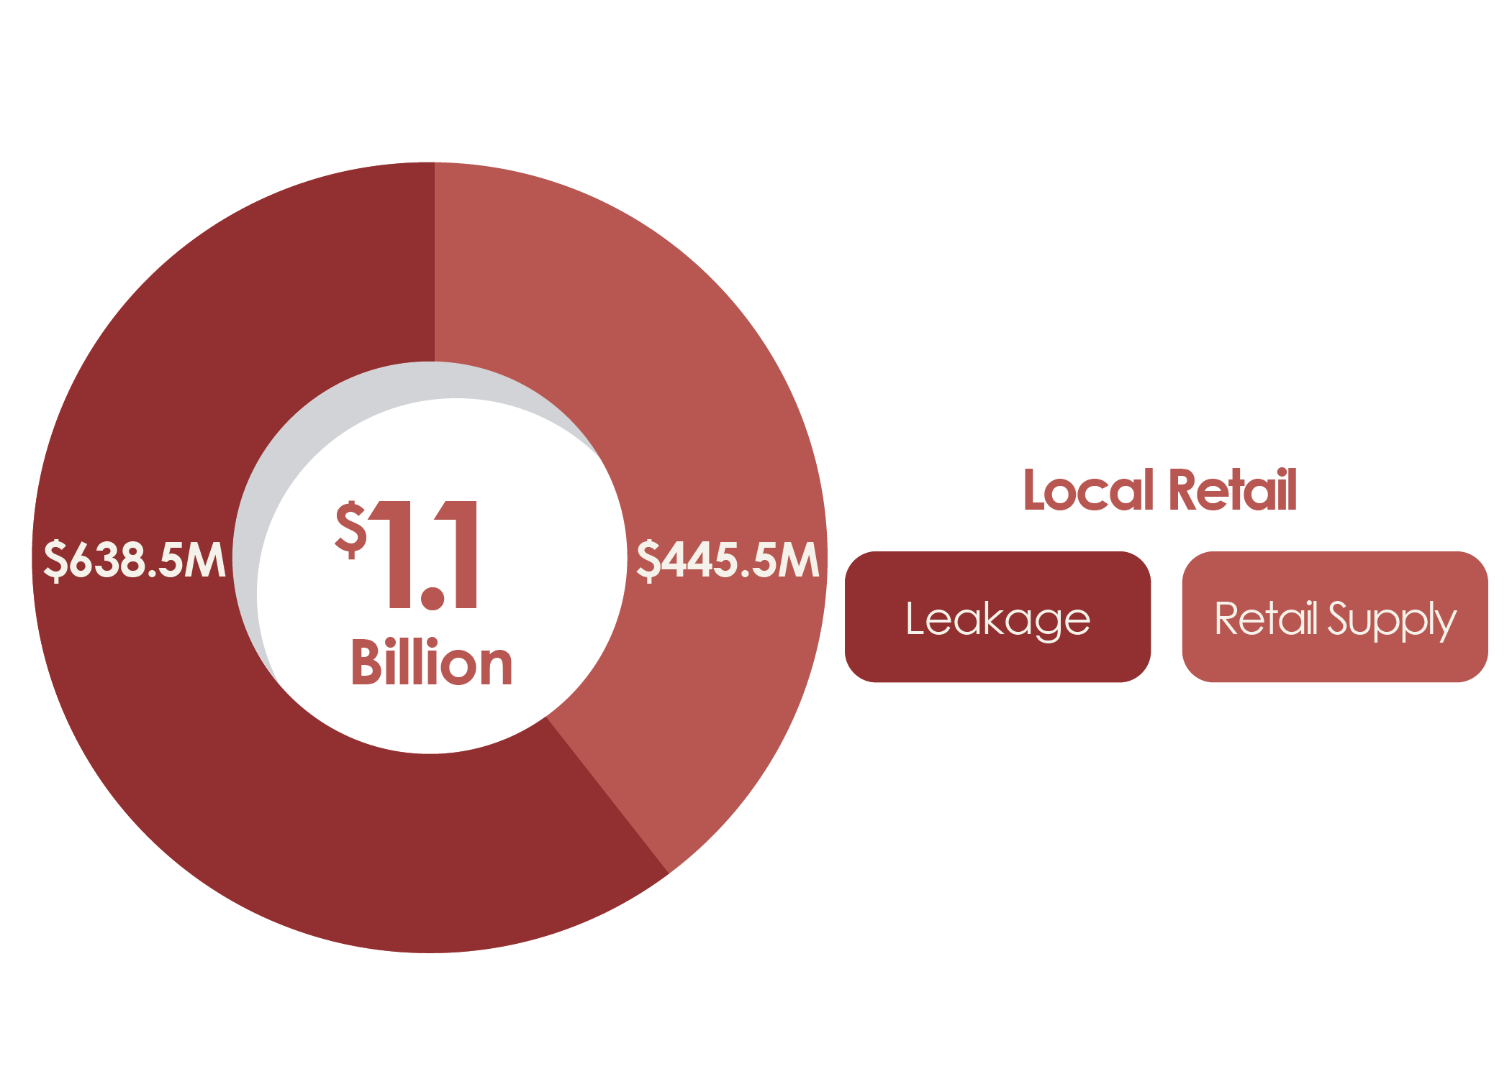
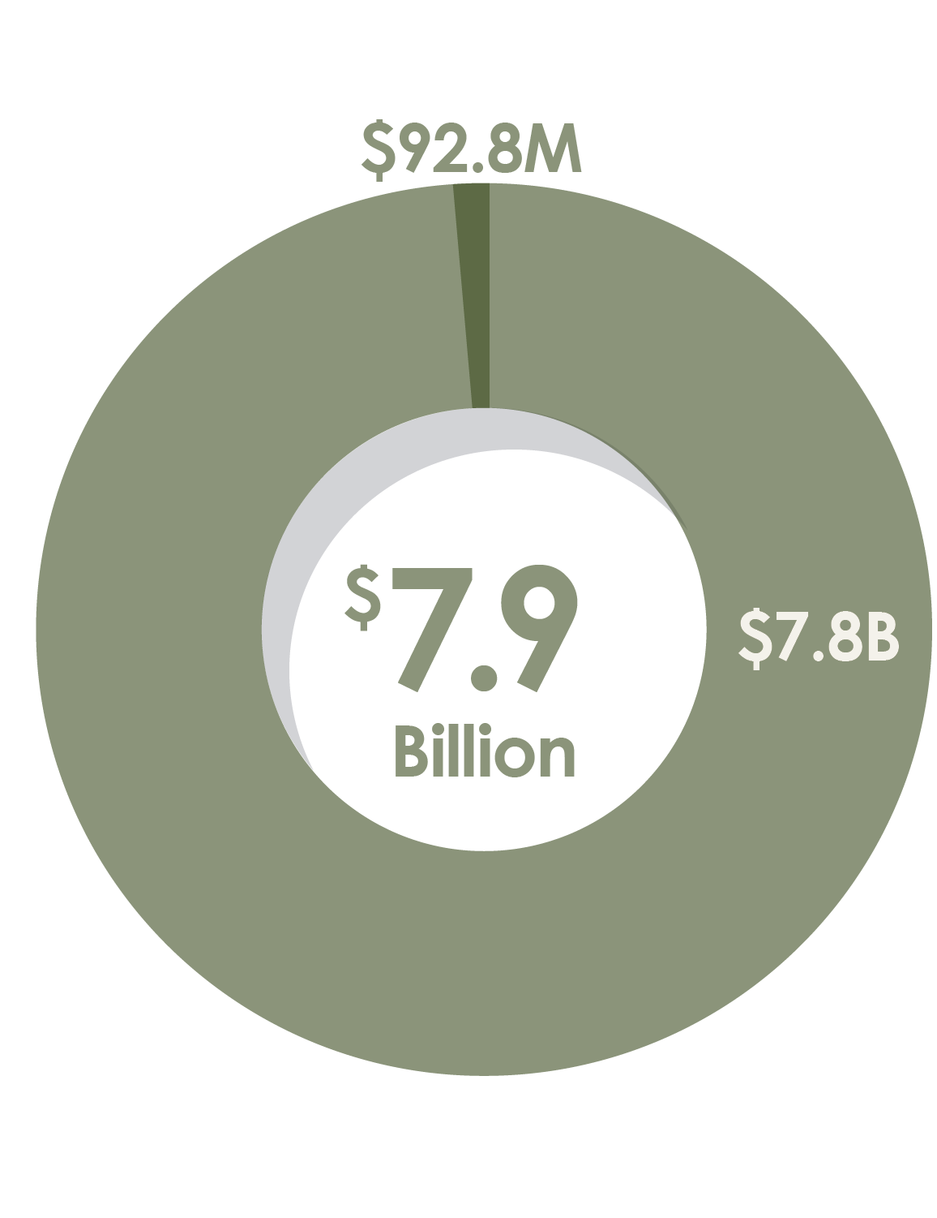
Retail Gaps
Retail Market:
The Primary Market is a net importer of retail goods.
Local Supply
Imports (“Leakage”)
Retail Market:
The Secondary Market is a net exporter of retail goods.
Local Demand
Exports (“Surplus”)
15
McCordsville | Market Analysis | January 2019
Notes:
Only 41.1% of local retail demand is being met within the Primary Market.
Businesses in the area supply $445.5 million in retail goods; however, local residents have a retail demand of $1.1 billion. This means $638.5 million in residents’ retail demand is being met outside of the area. This is known as “leakage.”
No single retail industry within the area is able to meet consumer demand.
Local retail demand accounts for 98.8% of the retail supply produced within the Secondary Market.
Area businesses supply $7.9 billion in retail goods; however, local residents’ retail demand is only $7.8 billion. This means $92.8 million in retail goods are sold to residents from outside the area. This is known as “surplus.”
More than half of the retail industries within the area produce a surplus.

Slide 16
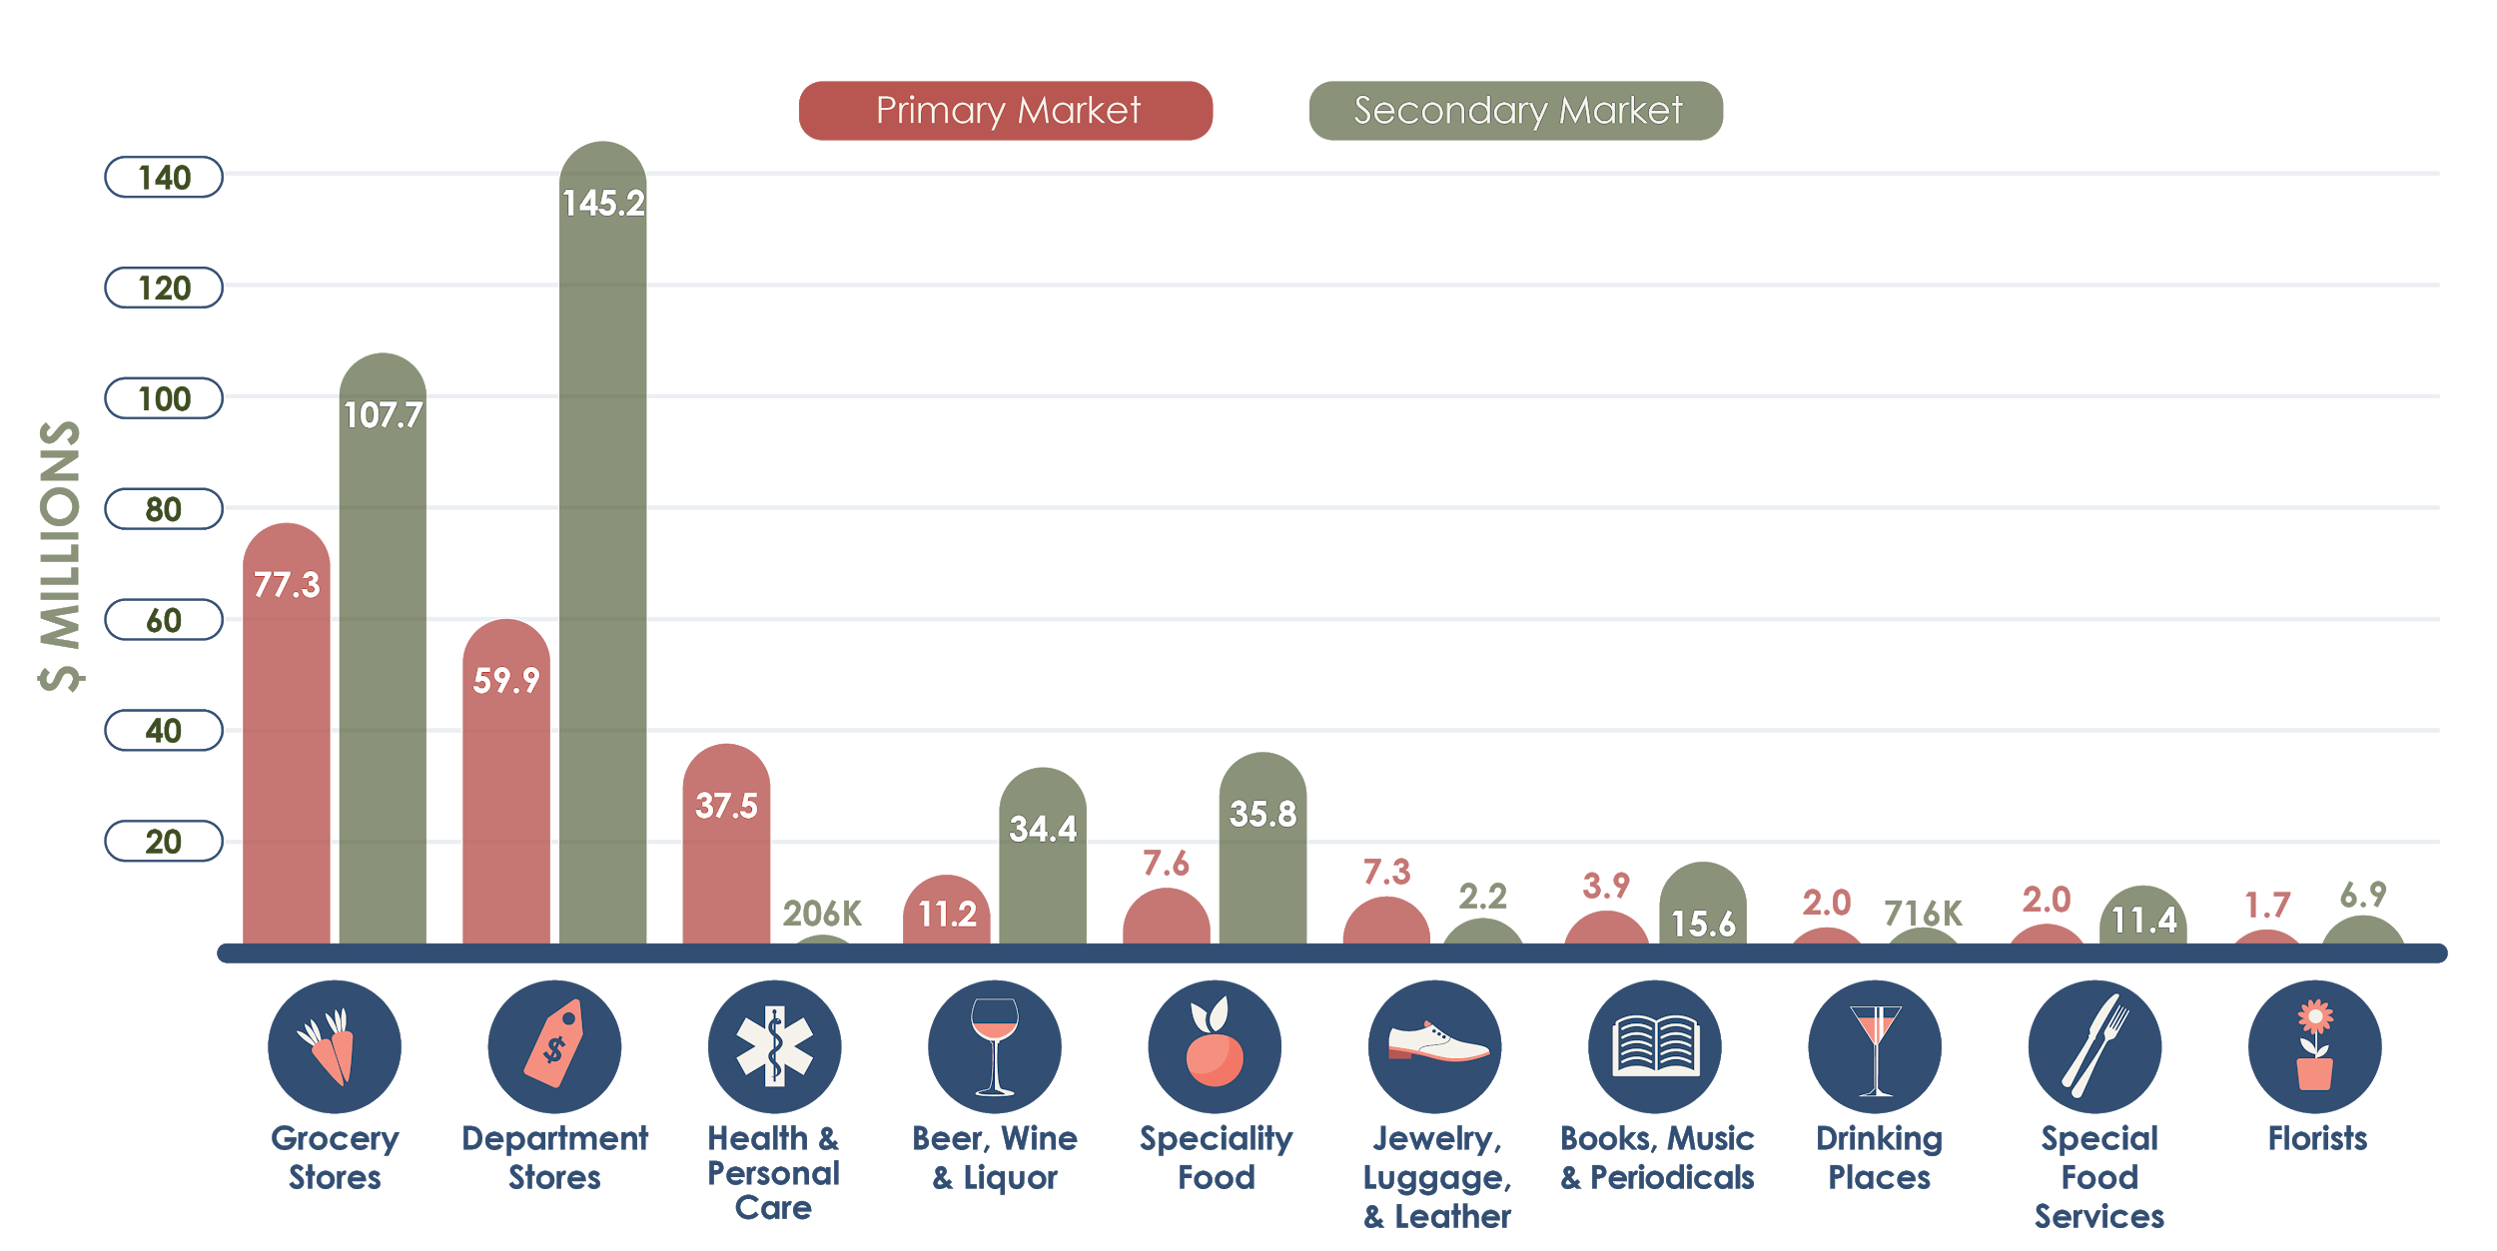
Leakage in the Primary and Secondary Markets
16
McCordsville | Market Analysis | January 2019

Slide 17
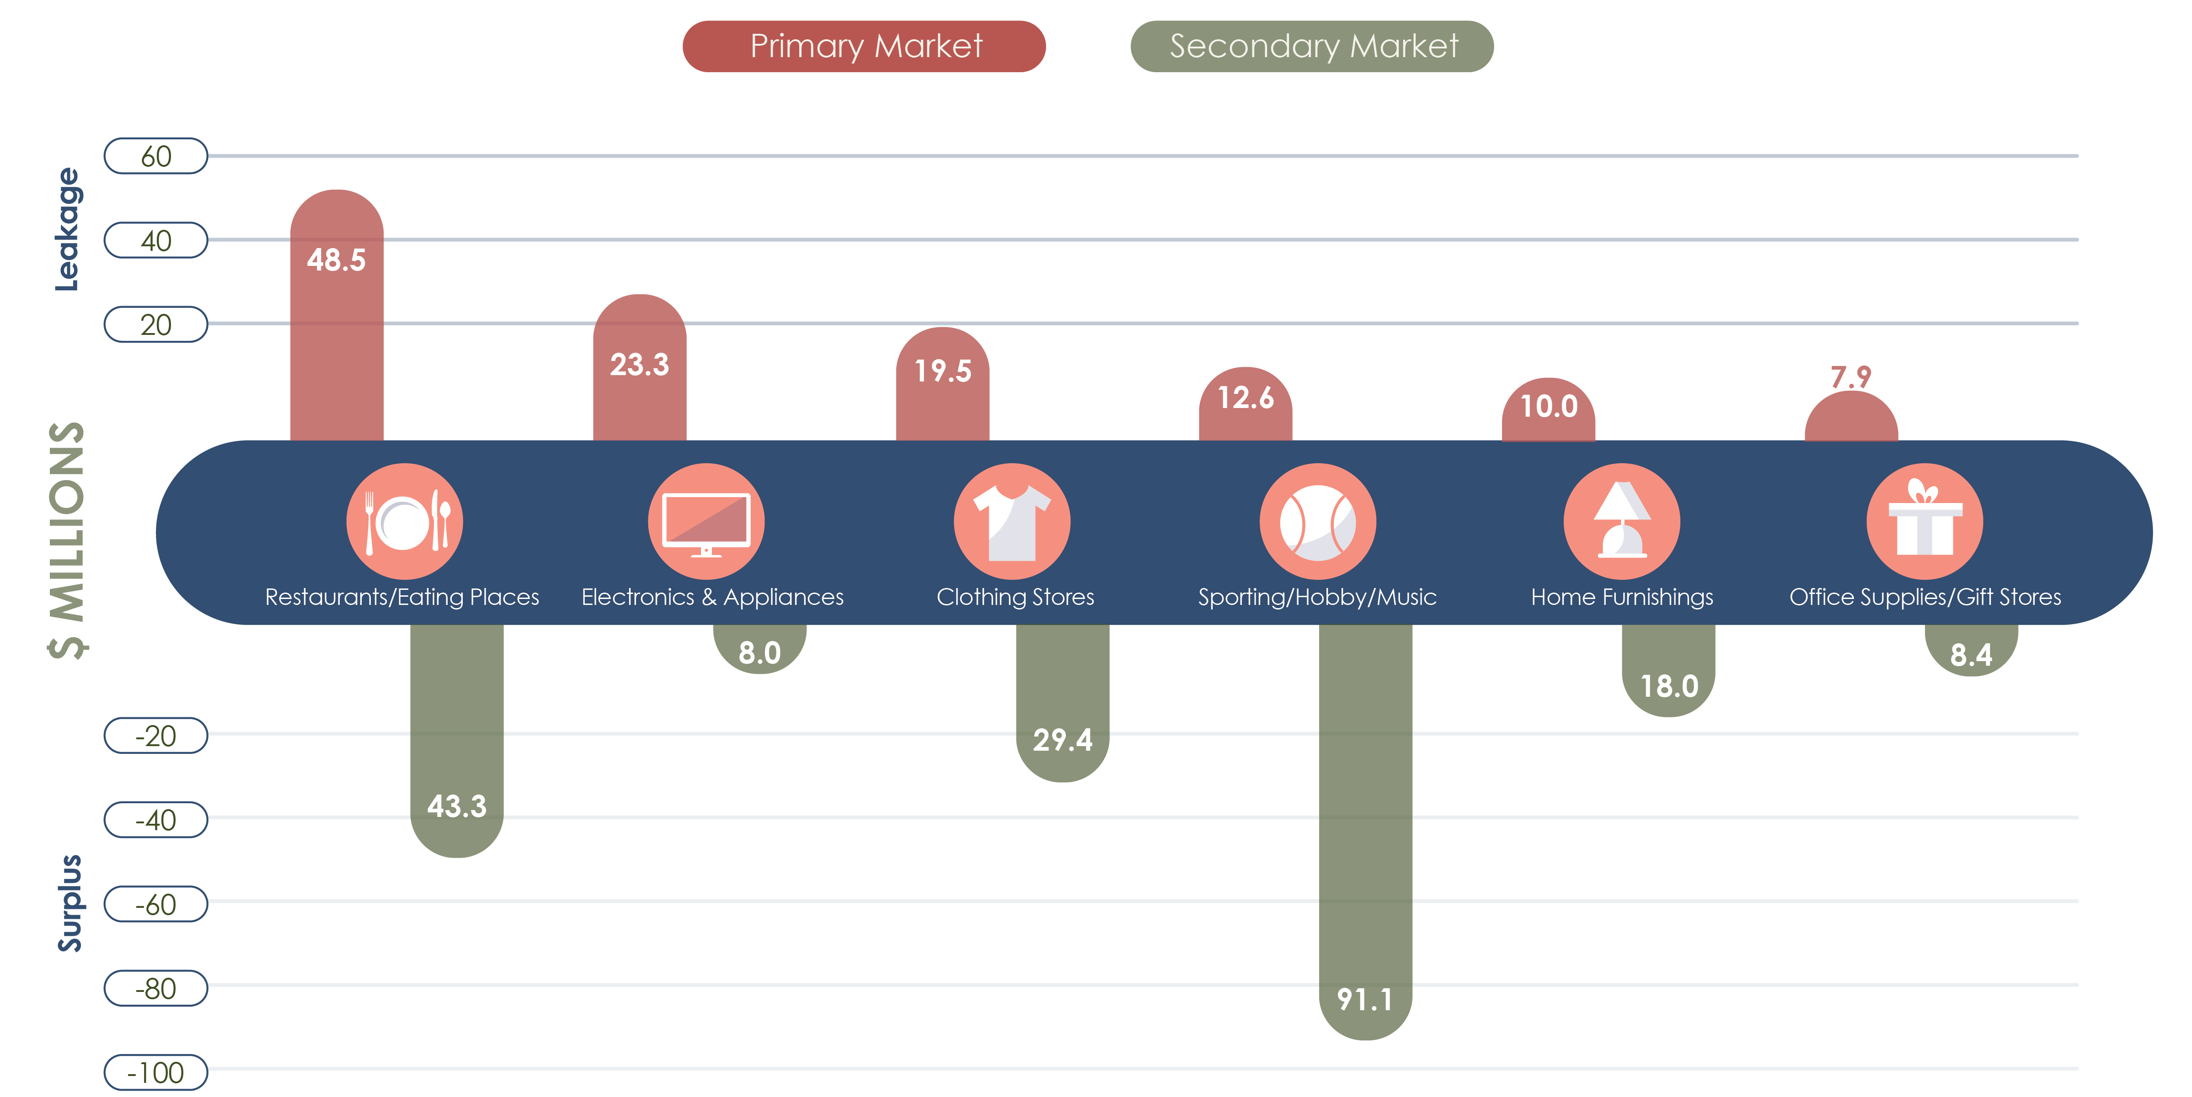
Leakage in the Primary, Surplus in the Secondary
17
McCordsville | Market Analysis | January 2019
Notes:
With the exception of Restaurants and Electronics & Appliance Stores, Primary Market demand could feasibly be met within the Secondary Market. These industries must cater to Primary Market preferences and/or specializations, as the Secondary Market likely has a variety of alternatives

Slide 18
ONLINE SURVEY
McCordsville | Market Analysis | January 2019
Notes:
An online survey titled “McCordsville Market Analysis Survey” was distributed by the Town of McCordsville and affiliated partners from September 28 - October 19, 2018. More than 873 responses were recorded by the survey instrument, Survey Monkey. Participants self-reported their age group and other demographic information, along with preferences for the types of business most desired for a new Town Center.

Slide 19
Survey Respondent Demographics
On the whole, survey respondent demographics validate the findings from the market area characteristics
Where Respondents Live: 82% live in McCordsville
Household size: 32% have 4 people
Age: 60% are between 25-44
Annual Household Income: 38% earn between $100,000-$149,000
Average One-Way Commute Time: 67% drive less than 30 minutes
19
McCordsville | Market Analysis | January 2019
Notes:
Where Respondents Live: Most respondents live in McCordsville (82%), with others from elsewhere in Hancock County (10%).
Size of Households: While the majority of respondents (32%) have a total of four people in their household, the next largest group of respondents have only two (27%), indicating a mix of families, professionals, and empty-nesters.
Age of Respondents: The majority of respondents are 25-44 years old (60%), followed by 45-64 year olds (31%).
Annual Household Income: Most respondents make more than $50,000 (96%), with the largest portion making $100,000-$149,000 (38%).
Average One-Way Commute Time: The majority of respondents have a commute time of fewer than 30 minutes (67%); however, a large portion of respondents have a commute between 30-45 minutes (26%).

Slide 20
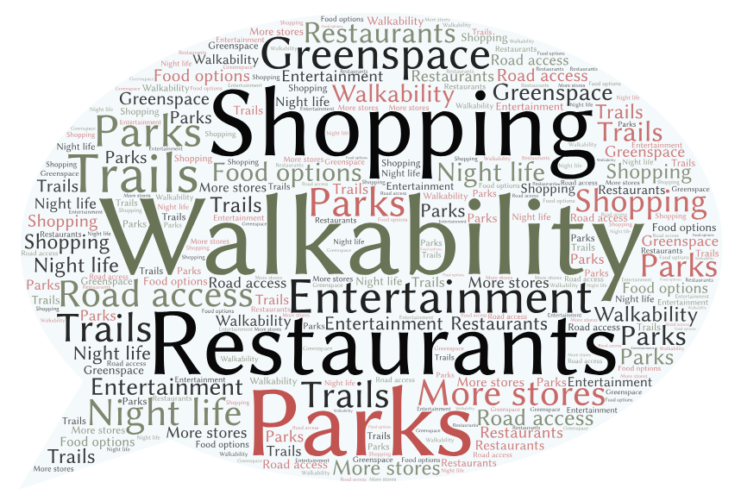
Consumer Preferences
What types of amenities would increase your desire to visit, stay or relocate to McCordsville?
20
McCordsville | Market Analysis | January 2019

Slide 21
Consumer Preferences
As a consumer, would you potentially visit either of the following in downtown McCordsville?
21
McCordsville | Market Analysis | January 2019

Slide 22
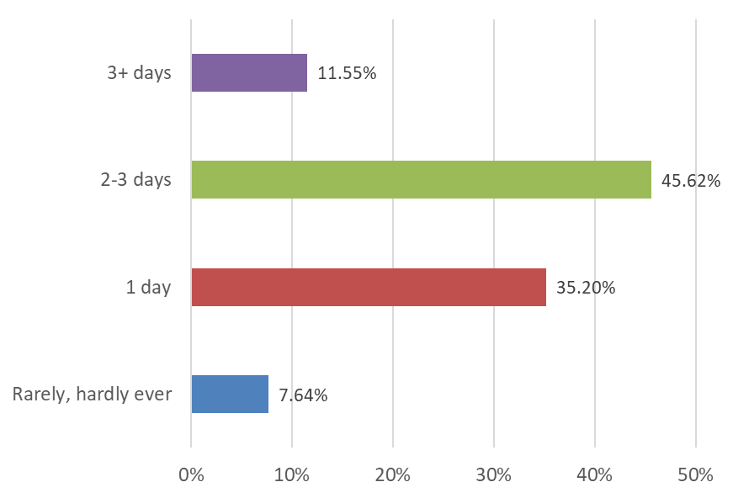
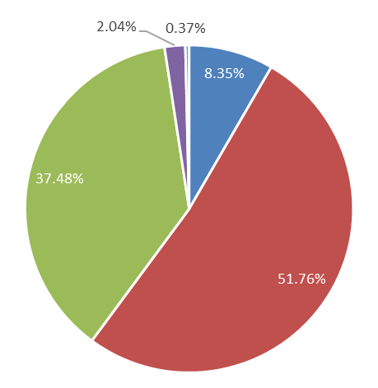
Consumer Preferences: Restaurants
How many days a week do you get take-out (excluding fast food)?
How much do you typically spend when you go out to eat or to get take-out (excluding fast food)?
22
McCordsville | Market Analysis | January 2019

Slide 23
Consumer Preferences: Restaurants
Where do you go to dine at a good restaurant?
How long are you willing to travel to dine at a good restaurant?
23
McCordsville | Market Analysis | January 2019

Slide 24
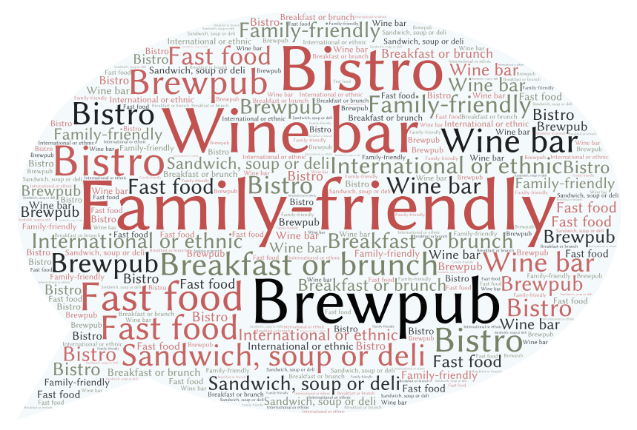
Consumer Preferences: Restaurants
When you eat out or get take-out, what types of restaurants do you typically frequent? Select all that apply.
24
McCordsville | Market Analysis | January 2019

Slide 25
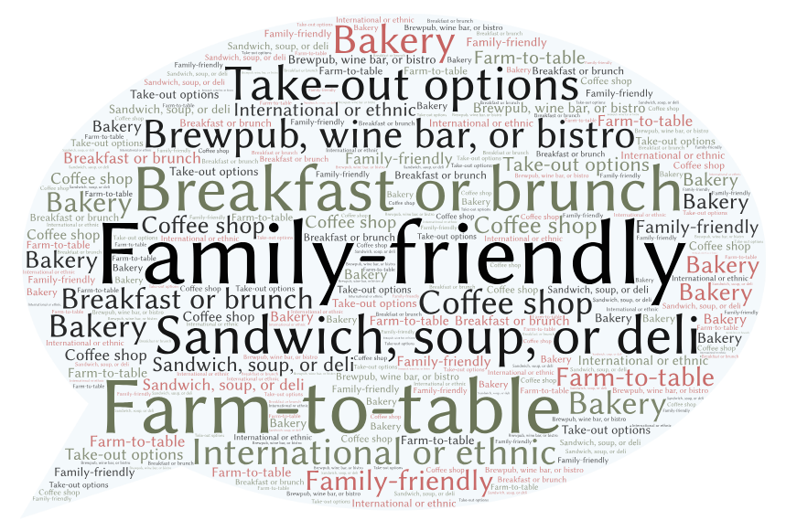
Consumer Preferences: Restaurants
What type of locally-owned/operated restaurants would you visit in downtown McCordsville? Select all that apply.
25
McCordsville | Market Analysis | January 2019

Slide 26
Consumer Preferences: Shopping
As a consumer, would you potentially visit a clothing store (i.e. women’s, men’s, children’s) in downtown McCordsville?
Yes – 90%
No – 10%
What type of clothing store
would you visit in downtown
McCordsville?
26
McCordsville | Market Analysis | January 2019

Slide 27
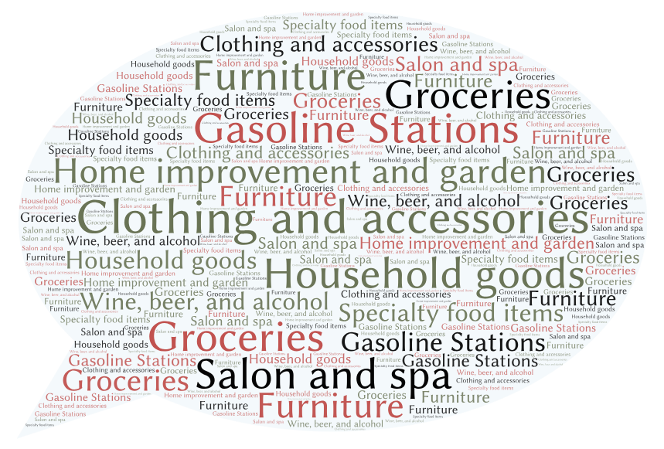
Consumer Preferences: Shopping
In the last 6 months, which services and products have you shopped for OUTSIDE of McCordsville (include online purchases)?
27
McCordsville | Market Analysis | January 2019

Slide 28
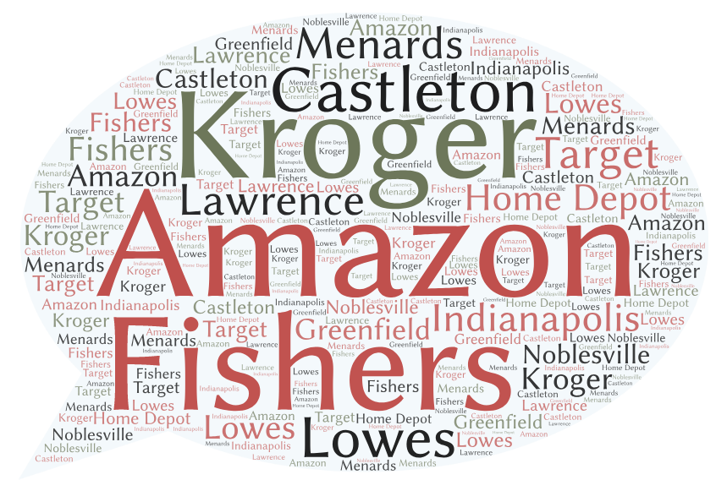
Consumer Preferences: Shopping
Names and locations of three stores OUTSIDE of McCordsville that you shop at most often.
28
McCordsville | Market Analysis | January 2019

Slide 29
FOCUS GROUPS
McCordsville | Market Analysis | January 2019
Notes:
During the September 25, 2018 on-site visit, Veridus conducted two focus groups, targeting a broad range of individuals and organizations involved in business, real estate, governance, economic development, transportation, and civic initiatives. The purpose of these focus groups was to identify local strengths and challenges, as well as opportunities for the Town of McCordsville to target and issues that would impact development of the future Town Center. Primary focused on the need for a defined identity, marketing, and increased communication. Respondents overwhelmingly love the schools, quality of life, and friendliness of the community. They would also like to see more variety of shops and restaurants, with more things for all generations to do.

Slide 30
Strengths
Gigabit fiber
Financially stable economy, core group of leaders
Desirable location
Blank slate for development
School system is fantastic!
Sense of community via initiatives
Friday Blast is a great communication tool
30
McCordsville | Market Analysis | January 2019

Slide 31
Vision
In need of a strong, unique identity
Plan for future retail
In need of a social side to maintain sense of community
Likes the feel of Nickel Plate District
Design Town Center as a place to bring people together
Target a balanced demographic
Designated economic developer
31
McCordsville | Market Analysis | January 2019

Slide 32
Other Key Themes
Traffic flow is critical
County line and road names are a psychological barrier
More frequent and transparent communication desired
More staff needed to support small businesses and development efforts
Stronger collaboration and alignment of policies/ordinances with neighboring communities desired
Must pick a vision for growth and act on it
32
McCordsville | Market Analysis | January 2019

Slide 33
317.598.6647
www.theveridusgroup.com

