Slide 1
BOT Statute
IC 5-23
January 12, 2021
McCordsville Town Council Meeting

Slide 2
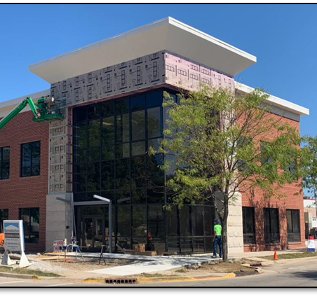
The Agenda
BOT Overview
Project Delivery Methods
Simple BOT Explanation
The BOT Process
Pros / Cons of the BOT
Examples
Yorktown Town Hall - BOT

Slide 3
Build – Operate – Transfer (BOT))
Utilizes Indiana Statute 5-23
Owner contracts with a “developer” to build, operate, and transfer the project
Can be delivered by a lump sum payment or long-term financing
BOT allows for design, construction, operation, management, maintenance, and securing financing of the cost of a public facility to be partially or entirely the responsibility of the operator
City or Town
Developer
(Finance, Design, Construct)
Design Team
Construction Manager
Architect
Structural Eng.
Civil Eng.
Landscape Arch.
Planner
Etc.
General Contractor
Primes
Subs
Etc.

Slide 4
Available Public Delivery Methods
Design – Bid – Build (DBB)
Construction Manager Agency (CMa)
Design – Build (DB)
Construction Manager as Constructor (CMc)
Build – Operate – Transfer (BOT)
Guaranteed Energy Savings Contract
Integrated Project Delivery (IPD)

Slide 5
Project Delivery Method
A project delivery method is a system used by an agency or owner for organizing and financing design, construction, operations, and maintenance services for a structure or facility by entering into legal agreements with one or more entities or parties.

Slide 6
PDM Considerations
Cost
Schedule
Financing
Risk Allocation
Control

Slide 7
Evolution of BOT and IC 5-23
Originally enacted decades ago for larger projects
Now used as project delivery for local projects
Various changes in use over the years
May or may not include long-term financing mechanism
May or may not include operation of asset

Slide 8
Design – Bid – Build
Design-Bid-Build (DBB)
Government Unit
Most common delivery system for units of government
Separated into three distinct phases - Design, Procurement, and Construction (each contracted directly with the owner)
Fixed-price through a sealed bid
Could have a “Multiple Prime” arrangement
Owner’s Risk = High
Design Team
Architect
Structural Eng.
Civil Eng.
Landscape Arch.
Planner
Etc.
Construction Team
General Contractor
Const. Mgr.
Primes
Subs
Etc.

Slide 9
Simple BOT Explanation
BOT Delivery
Government Unit
Gaining popularity
Three phases (design, bid, build) all incorporated into a single agreement under control of the developer.
Shifts significant risk to the developer
Owner’s Risk = Low
Developer
(Finance, Design, Construct)
Design Team
Construction Manager
Architect
Structural Eng.
Civil Eng.
Landscape Arch.
Planner
Etc.
General Contractor
Primes
Subs
Etc.

Slide 10
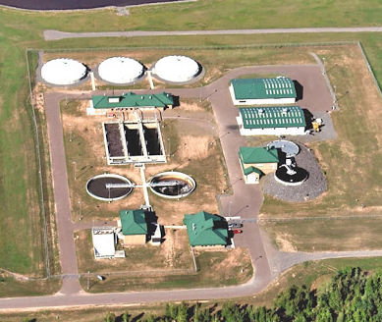
Build-Operate-Transfer Process
BOT Process
The unit of government (UG) releases a request for proposals/qualifications for the financing, design, and construction of the project.
The most qualified team is selected.
The selected respondent enters into a scoping period whereby they must deliver a schematic design, guaranteed financing terms, and a budget.
Representative Wastewater Treatment Plant Project

Slide 11
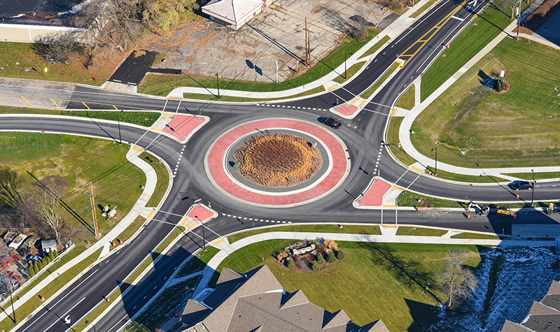
Build-Operate-Transfer Process
BOT Process
The UG votes to move forward with the project only upon receiving satisfactory design, financing terms, and budget.
If deliverables are not satisfactory, then the RFPQ process can be cancelled.
If deliverables are satisfactory, then financing is closed and construction begins.
Representative Round-a-bout Project

Slide 12
Build – Operate – Transfer (BOT)
Advantages
Flexibility – Indiana statute is very broad
Project is privately developed, so construction risk shifts to BOT developer
Efficient execution
Direct negotiations with the developer
Reduced costs (money goes further)
Reduced timeline

Slide 13
Build – Operate – Transfer (BOT)
Disadvantages
Limited bidder pool – but growing
Historical rationale tied to politics (no longer true)
Not well understood by the legal and financial community
Lack of integration with “Bond Portfolio”
Rogue Developers

Slide 14
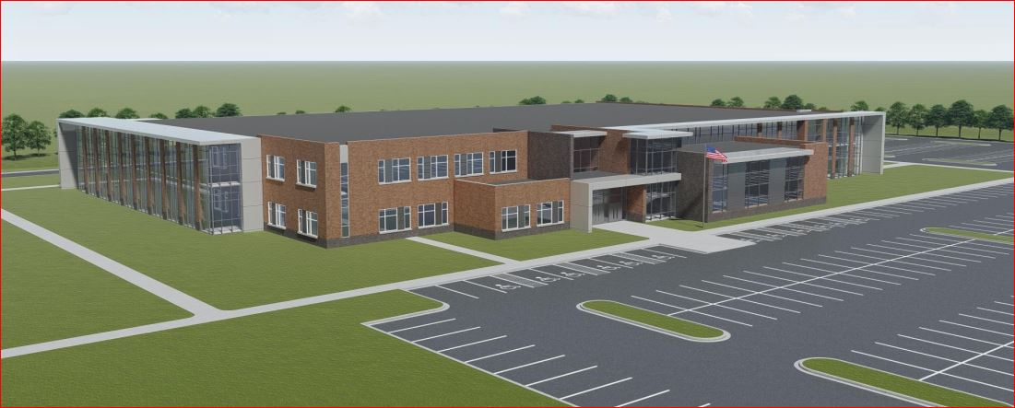
Examples and Anecdotes
$35MM
100k+ SF
Town of Plainfield
Ivy Tech/Vincennes
Plainfield Schools
MADE@Plainfield Higher Education Building - BOT

Slide 15
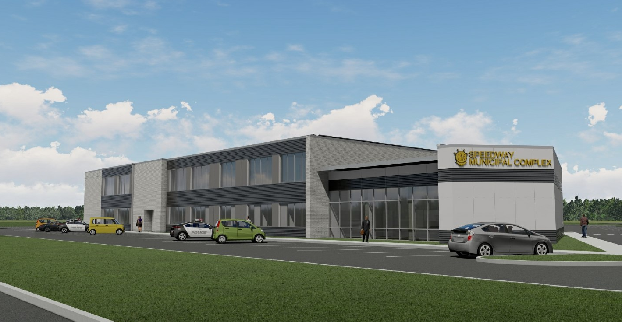
Examples and Anecdotes
$7MM
35k+ SF
Town of Speedway
Town/Police/Schools
Speedway Town Hall and Police Headquarters - BOT

Slide 16
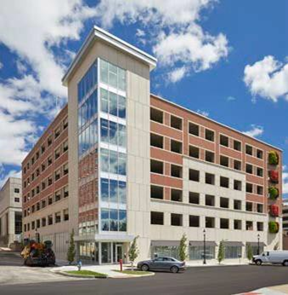
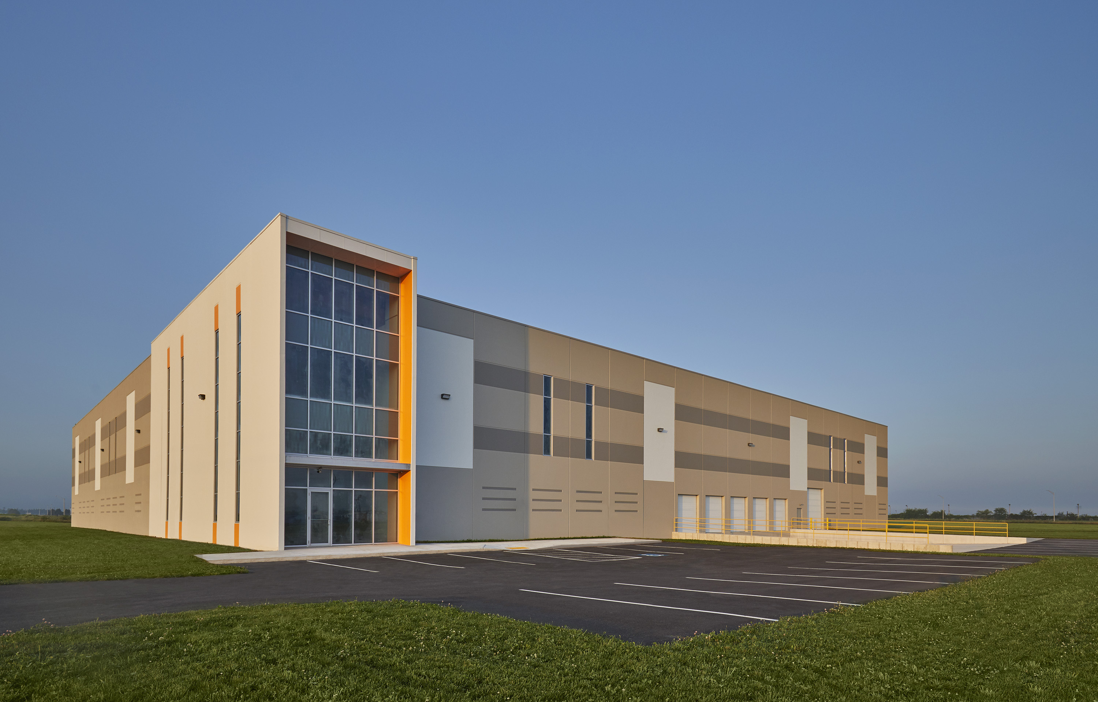
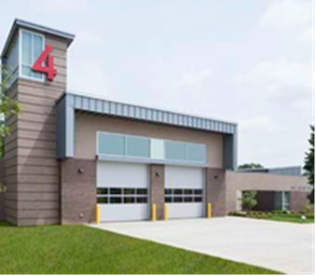
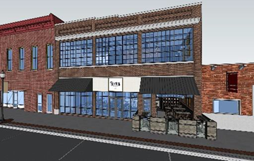
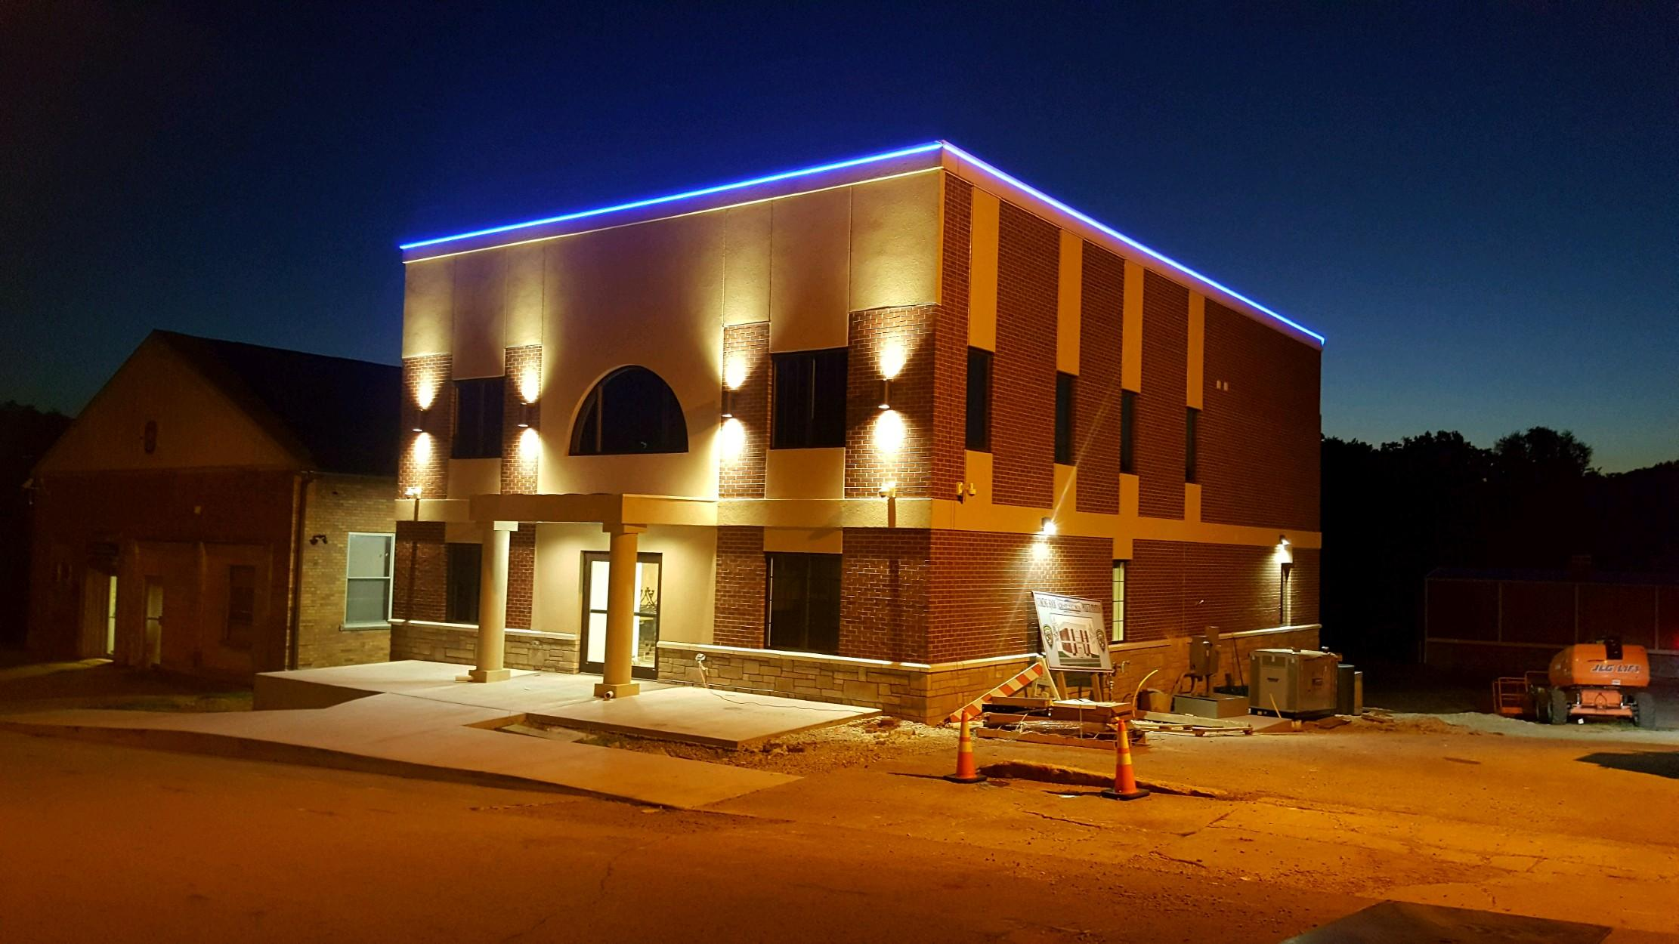
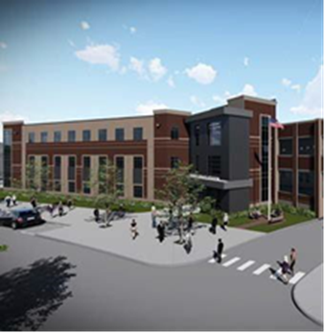
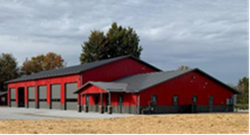
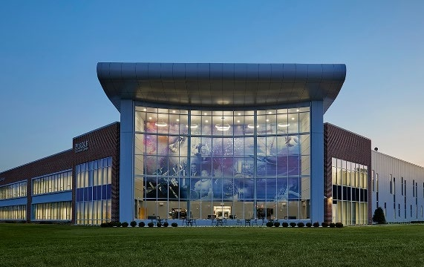
Examples and Anecdotes

