Slide 1
Pole Selection Worksheet
Customer
Town of McCordsville
Contact
XXXXXXXX
TRAINFO Customer Support Engineer:
Moazzam Faisal
Phone
431-668-9238
Email
Moazzam.Faisal@trainfo.ca
Date
2024-11-10
Location | Train Sensor | Bluetooth Sensor | Sign | Signal Kit | Worksheet No.
E 750 St | ✓ |  |  |  | 1
N 600 W | ✓ |  |  |  | 2
N 500 W | ✓ |  |  |  | 3

Slide 2
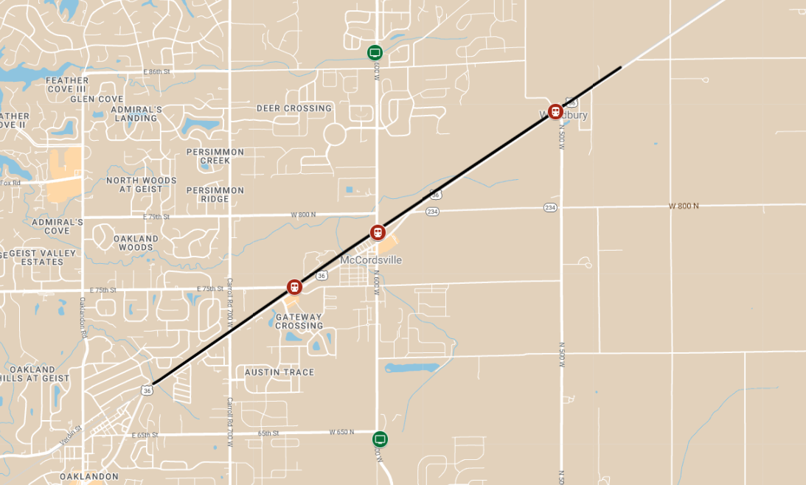
CR 146
LEGEND
Hardware Deployment Map
Train sensor
DMS Board
McCordsville
Bluetooth sensor
Traffic signal integration

Slide 3
CITY | ROADWAY | NEAR (ROADWAY) | LATITUDE | LONGITUDE | CROSSING ID
Instructions
Please use this worksheet to select the preferred pole for installing train detection sensors.
The grey call-out boxes below provide instructions.
Once completed, return the worksheet to your TRAINFO Rep via email.
If you have any questions, please contact your TRAINFO Rep.
Poles should be positioned within 30 meter of the railway crossing bells and located on the same side of the track as the bell
Candidate poles are labelled (A, B, C, etc.); choose the best one and place letter in this field. If there is none, indicate “N/A” and leave the rest of the fields blank.
Indicate whether a joint-use permit is required to install sensors on the pole
Indicate whether solar power is required or preferred
Check the box representing who owns the pole
Indicate whether power can be drawn from the pole
Indicate if the City will install the sensor
POLE | POLE OWNER |  |  | JOINT-USE PERMIT REQ’D? |  | DIRECT POWER AVAIL.? |  | SOLAR POWER REQ’D? |  | CITY INSTALLER? |  | Quiet Order
 | City | Utility | Other | Yes | No | Yes | No | Yes | No | Yes | No | Yes | No
A | x |  |  |  | x | x |  |  | x | x |  |  | x
PREFERRED POLE | POLE OWNER |  |  | JOINT-USE PERMIT REQ’D? |  | DIRECT POWER AVAIL.? |  | SOLAR POWER REQ’D? |  | CITY INSTALLER?
 | City | Utility | Other | Yes | No | Yes | No | Yes | No | Yes | No
B | ✓ |  |  |  | ✓ | ✓ |  |  | ✓ | ✓

Slide 4
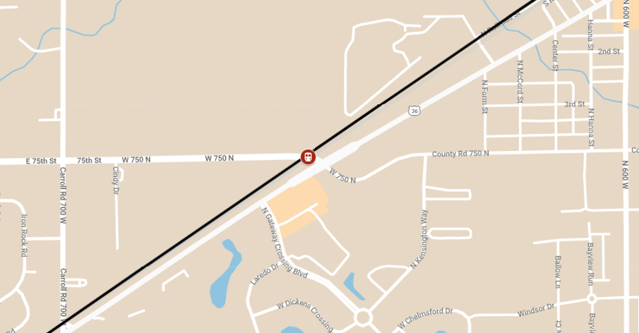
WORKSHEET
- 01 -
WORKSHEET 05
120th Ave @ CanAm Hwy
WORKSHEET 01
120th Ave @ Havana St

Slide 5
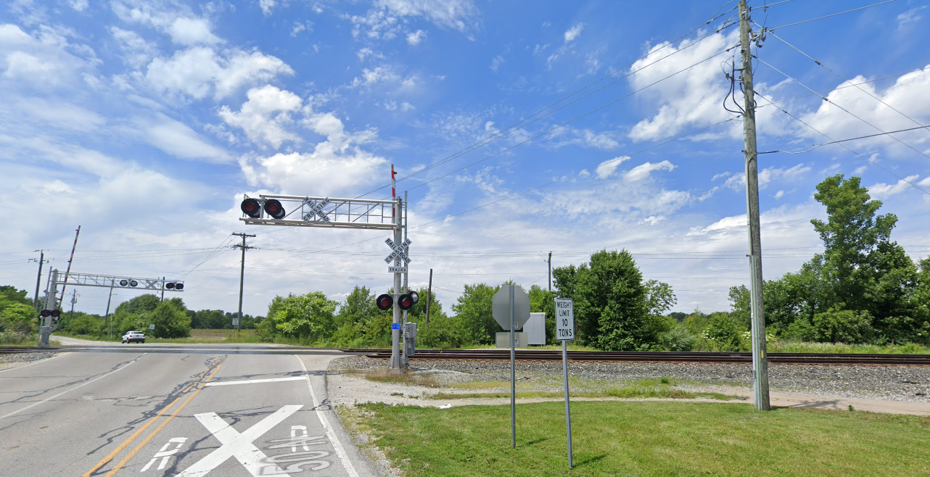
CITY | ROADWAY | NEAR (ROADWAY) | LATITUDE | LONGITUDE | CROSSING ID
McCordsville, IN | W 750 N | W Broadway
A
B
Bell
Bell
POLE | POLE OWNER |  |  | JOINT-USE PERMIT REQ’D? |  | DIRECT POWER AVAIL.? |  | SOLAR POWER REQ’D? |  | CITY INSTALLER? |  | Quiet Order
 | City | Utility | Other | Yes | No | Yes | No | Yes | No | Yes | No | Yes | No
A |  | X - AES |  |  |  |  | x | x

Slide 6
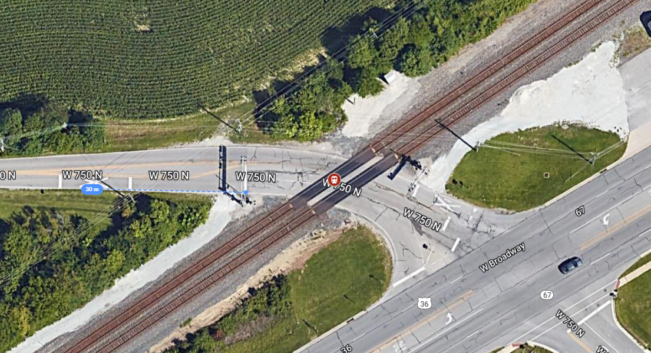
CITY | ROADWAY | NEAR (ROADWAY) | LATITUDE | LONGITUDE | CROSSING ID
Crawfordsville, IN | W Market St | N Washington St
CITY | ROADWAY | NEAR (ROADWAY) | LATITUDE | LONGITUDE | CROSSING ID
McCordsville, IN | W 750 N | W Broadway
Sensor to be installed in the white shaded area
POLE | POLE OWNER |  |  | JOINT-USE PERMIT REQ’D? |  | DIRECT POWER AVAIL.? |  | SOLAR POWER REQ’D? |  | CITY INSTALLER? |  | Quiet Order
 | City | Utility | Other | Yes | No | Yes | No | Yes | No | Yes | No | Yes | No

Slide 7
WORKSHEET
- 02 -
WORKSHEET 05
120th Ave @ CanAm Hwy
WORKSHEET 01
120th Ave @ Havana St

Slide 8
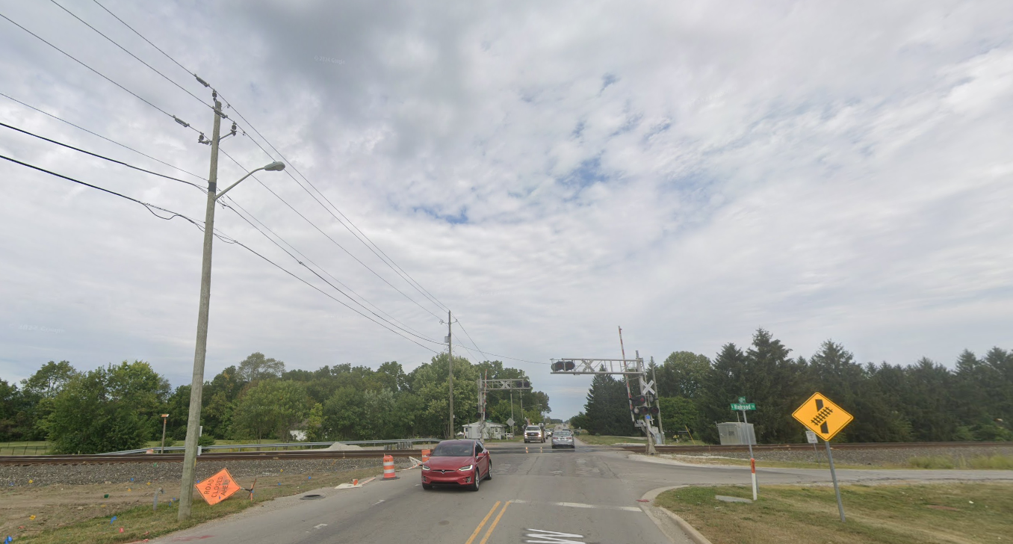
CITY | ROADWAY | NEAR (ROADWAY) | LATITUDE | LONGITUDE | CROSSING ID
McCordsville, IN | N 600 W | W Broadway
A
B
Bell
Bell
POLE | POLE OWNER |  |  | JOINT-USE PERMIT REQ’D? |  | DIRECT POWER AVAIL.? |  | SOLAR POWER REQ’D? |  | CITY INSTALLER? |  | Quiet Order
 | City | Utility | Other | Yes | No | Yes | No | Yes | No | Yes | No | Yes | No
A |  | X-AES |  |  |  |  | x | x

Slide 9
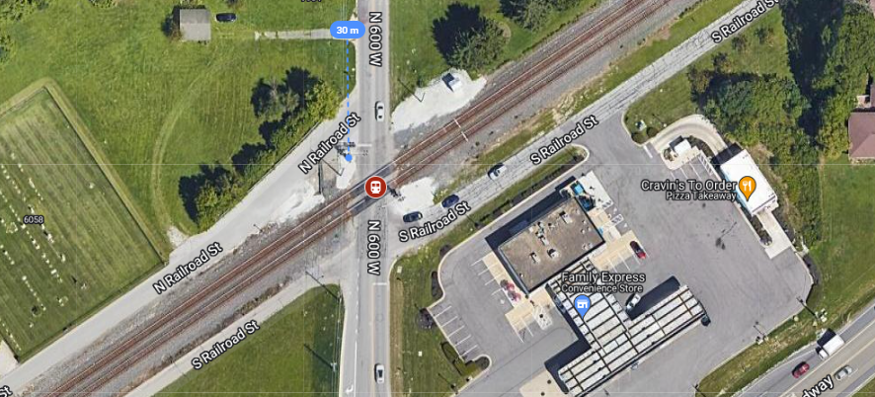
CITY | ROADWAY | NEAR (ROADWAY) | LATITUDE | LONGITUDE | CROSSING ID
McCordsville, IN | N 600 W | W Broadway
CITY | ROADWAY | NEAR (ROADWAY) | LATITUDE | LONGITUDE | CROSSING ID
Crawfordsville, IN | W Market St | N Washington St
CITY | ROADWAY | NEAR (ROADWAY) | LATITUDE | LONGITUDE | CROSSING ID
McCordsville, IN | W 750 N | W Broadway
Sensor to be installed in the white shaded area
POLE | POLE OWNER |  |  | JOINT-USE PERMIT REQ’D? |  | DIRECT POWER AVAIL.? |  | SOLAR POWER REQ’D? |  | CITY INSTALLER? |  | Quiet Order
 | City | Utility | Other | Yes | No | Yes | No | Yes | No | Yes | No | Yes | No

Slide 10
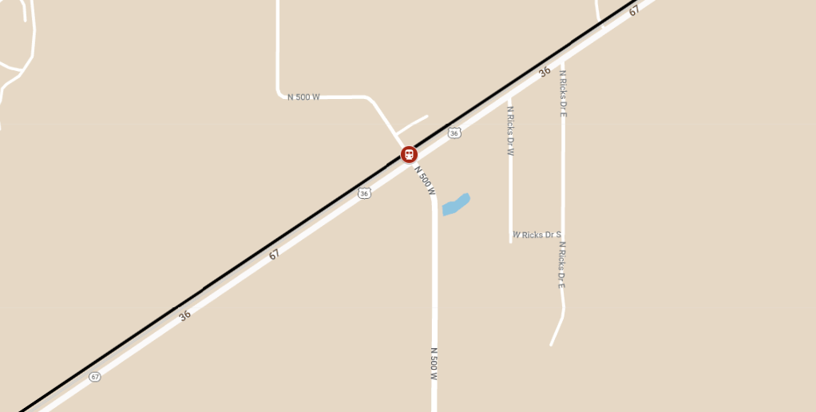
WORKSHEET
- 03 -
WORKSHEET 05
120th Ave @ CanAm Hwy
WORKSHEET 01
120th Ave @ Havana St

Slide 11
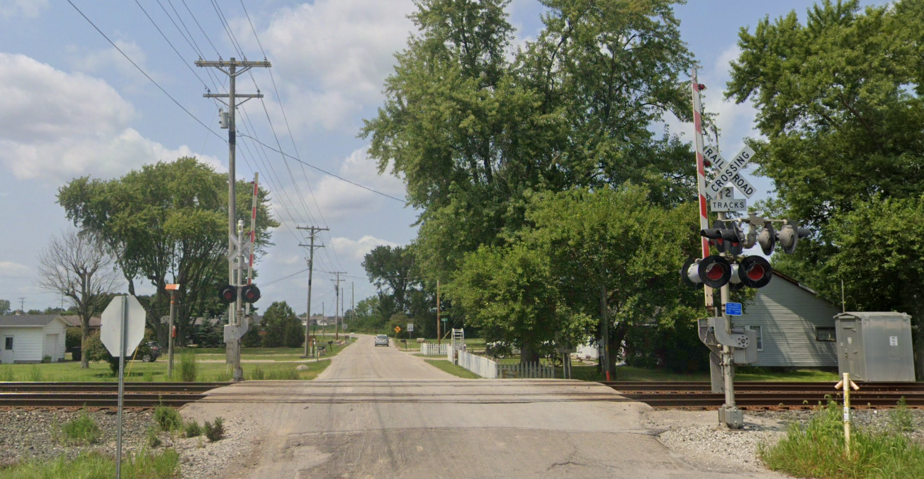
CITY | ROADWAY | NEAR (ROADWAY) | LATITUDE | LONGITUDE | CROSSING ID
McCordsville, IN | N 500 W | W Broadway
A
Bell
POLE | POLE OWNER |  |  | JOINT-USE PERMIT REQ’D? |  | DIRECT POWER AVAIL.? |  | SOLAR POWER REQ’D? |  | CITY INSTALLER? |  | Quiet Order
 | City | Utility | Other | Yes | No | Yes | No | Yes | No | Yes | No | Yes | No
A |  | X -ninestar |  |  |  |  | x | x

Slide 12
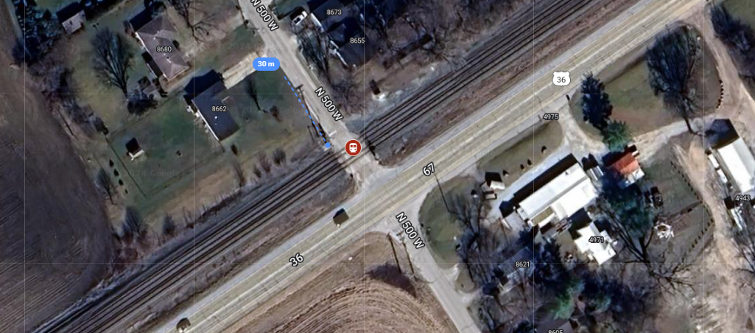
CITY | ROADWAY | NEAR (ROADWAY) | LATITUDE | LONGITUDE | CROSSING ID
Crawfordsville, IN | W Market St | N Washington St
CITY | ROADWAY | NEAR (ROADWAY) | LATITUDE | LONGITUDE | CROSSING ID
McCordsville, IN | N 500 W | W Broadway
Sensor to be installed in the white shaded area
POLE | POLE OWNER |  |  | JOINT-USE PERMIT REQ’D? |  | DIRECT POWER AVAIL.? |  | SOLAR POWER REQ’D? |  | CITY INSTALLER? |  | Quiet Order
 | City | Utility | Other | Yes | No | Yes | No | Yes | No | Yes | No | Yes | No

