Slide 1
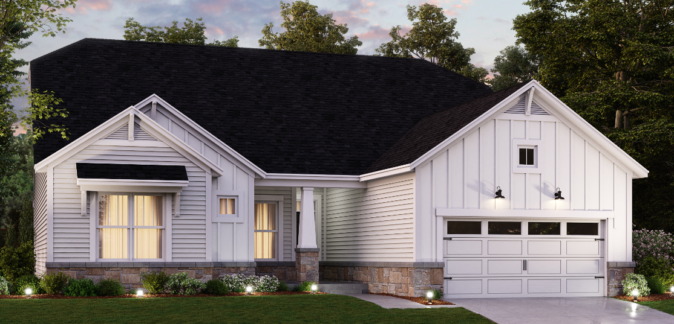
Prestige Plans for
Rockport

Slide 2
Prestige Product Line Up
Kentmore III | 1 story | 2100-2800 SF
Cheswicke II | 1 story | 2188 -2800 SF
Drake | 2 story | 2884 SF
Glendale | 2 story | 3100 SF
Ainsley II | 2 story | 3156 SF
Glendale | 2 story | 3160 Sf
Berkley | 2 story | 3273 Sf
Kensington | 2 story | 3400 SF

Slide 3
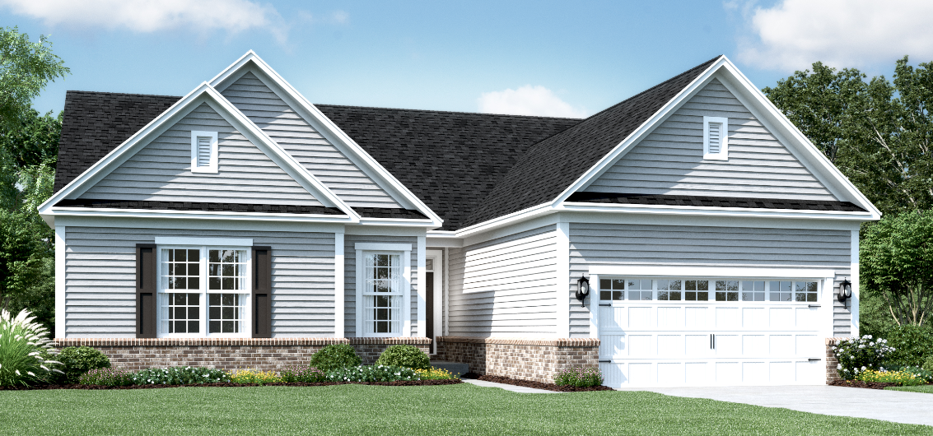
Kentmore III A

Slide 4
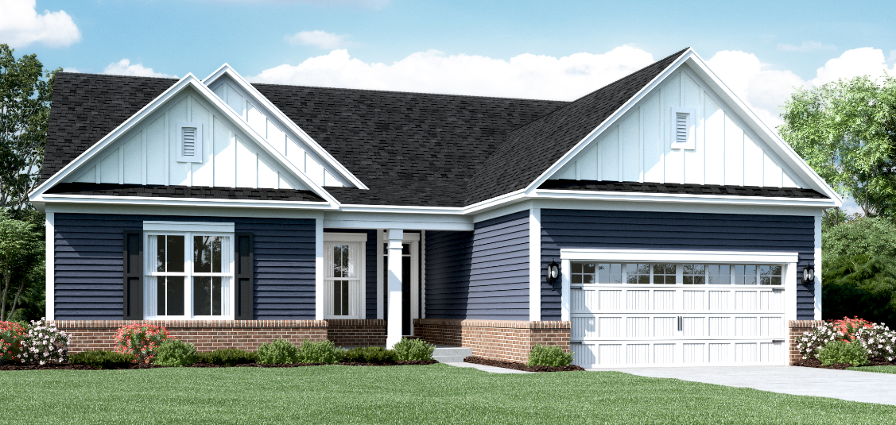
Kentmore III B

Slide 5
Kentmore III C

Slide 6
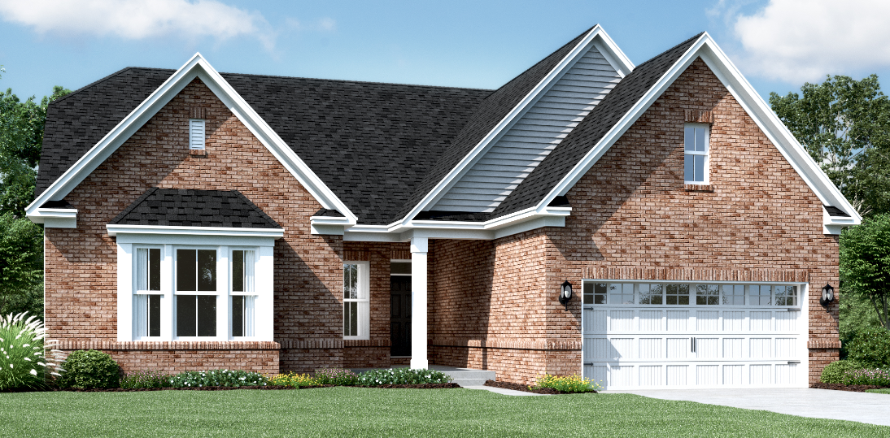
Kentmore III D

Slide 7
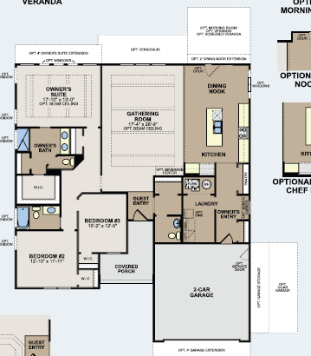
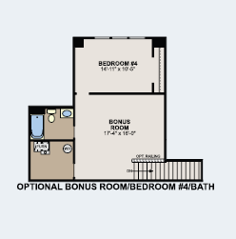
Kentmore Floorplan

Slide 8
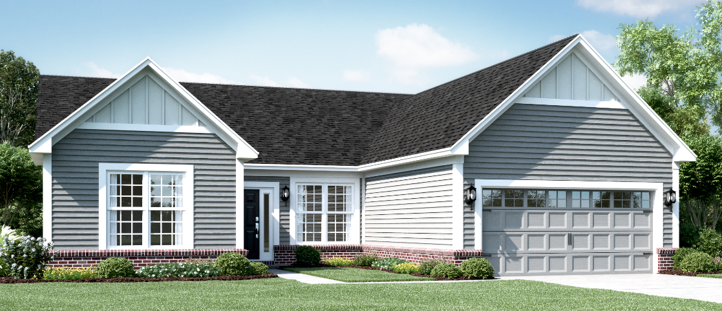
Cheswicke A

Slide 9
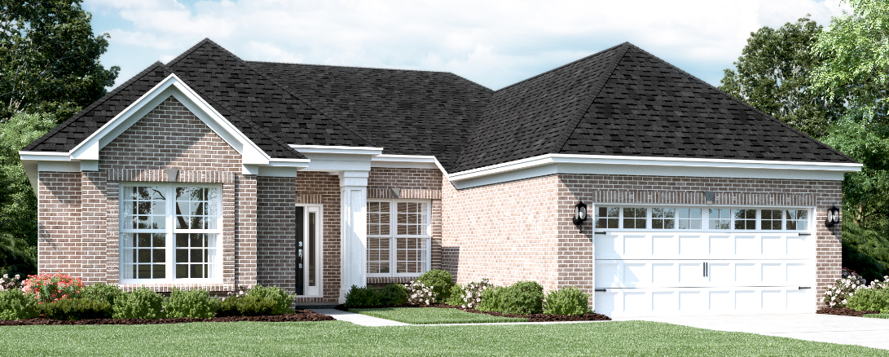
Cheswicke B

Slide 10
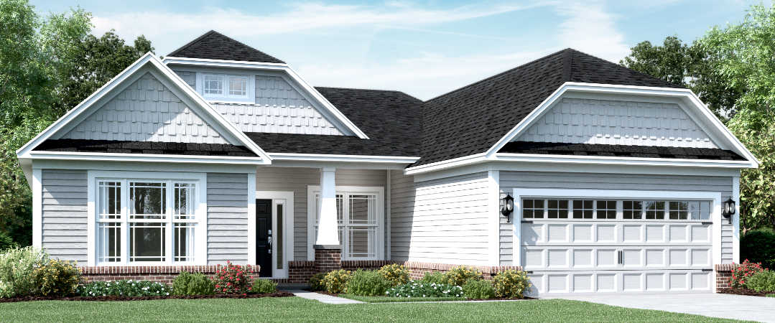
Cheswicke C

Slide 11
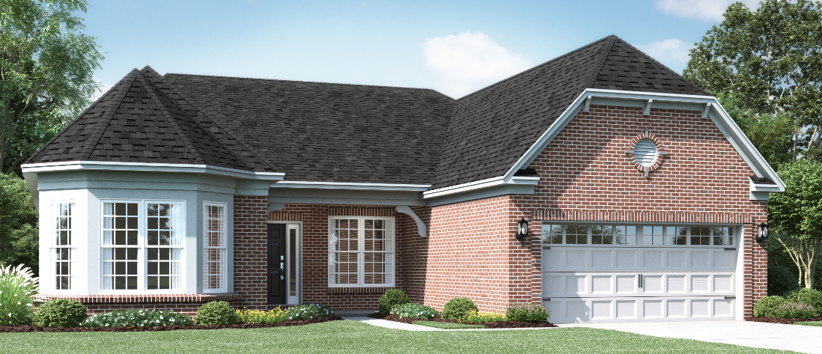
Cheswicke D

Slide 12
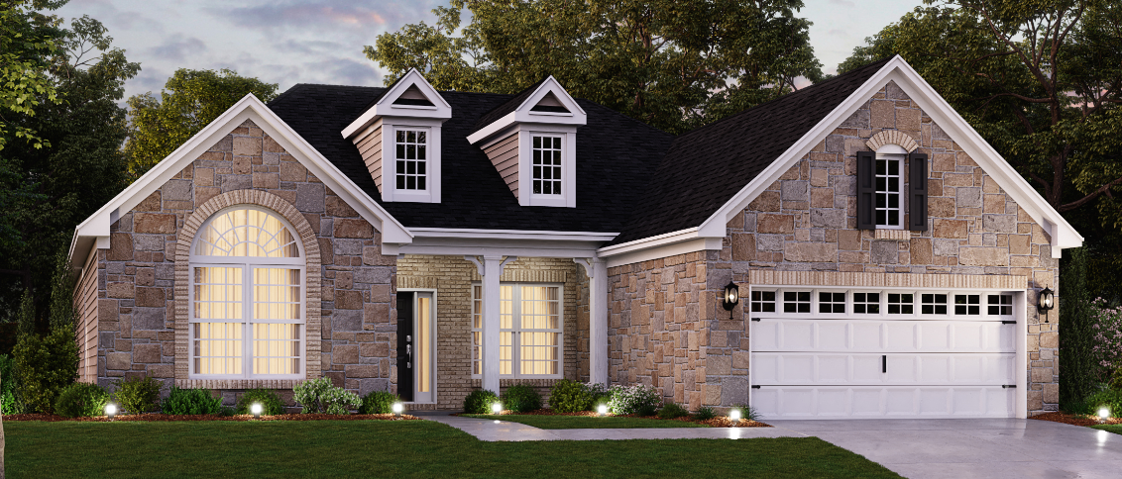
Cheswicke E

Slide 13
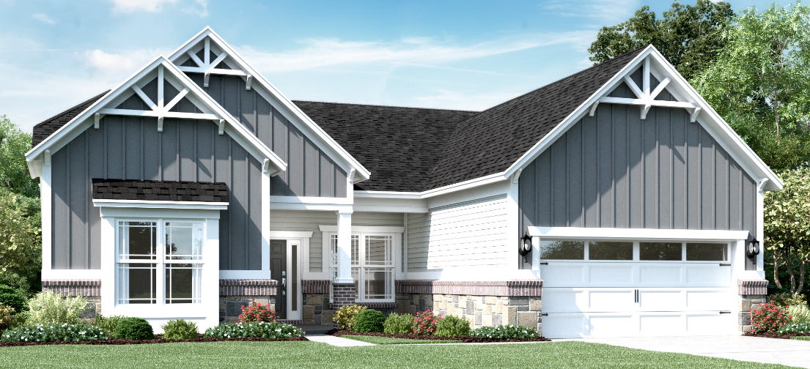
Cheswicke G

Slide 14
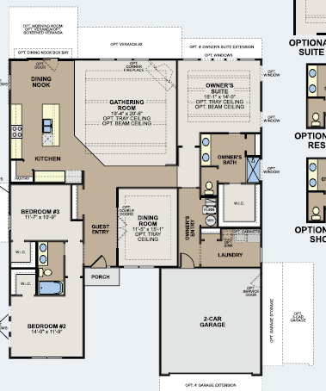
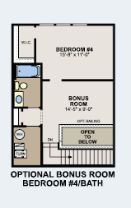
Cheswicke Floorplan

Slide 15
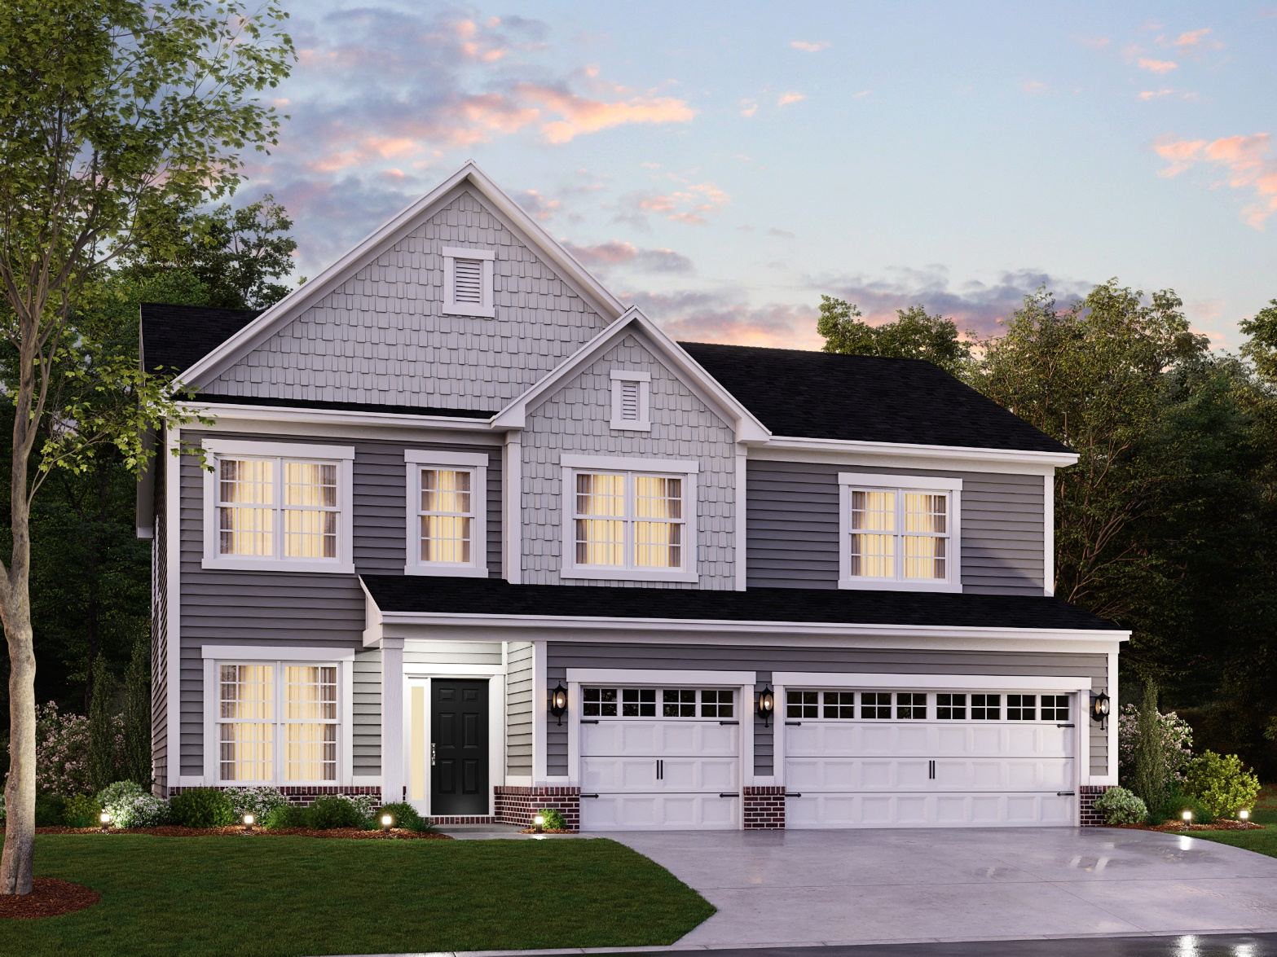
Drake A

Slide 16
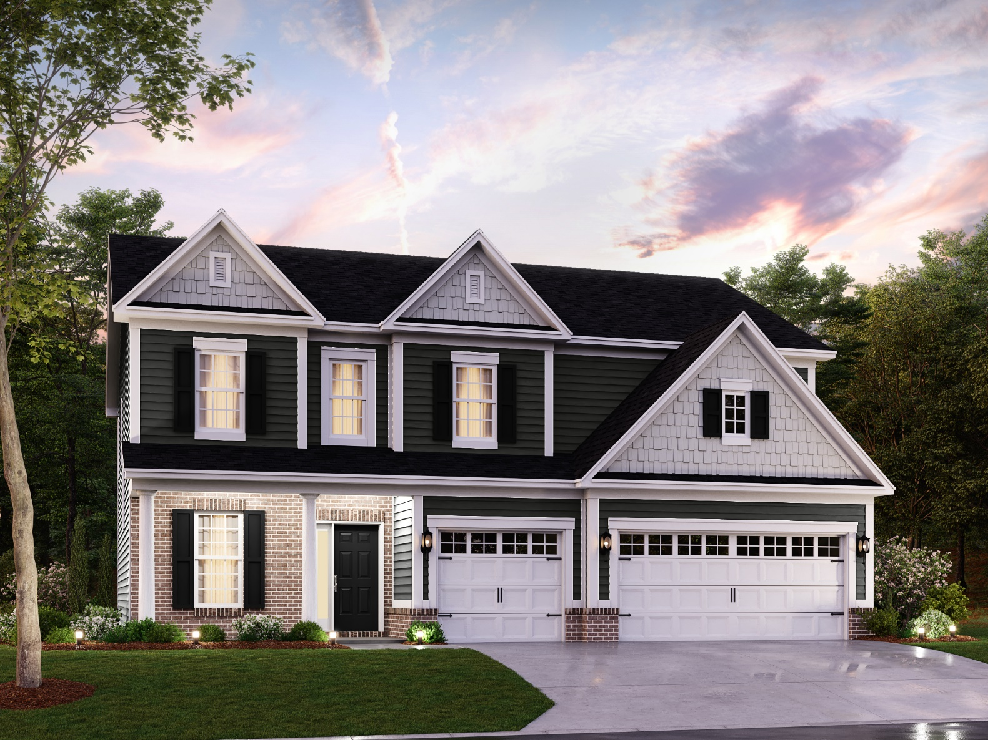
Drake B

Slide 17
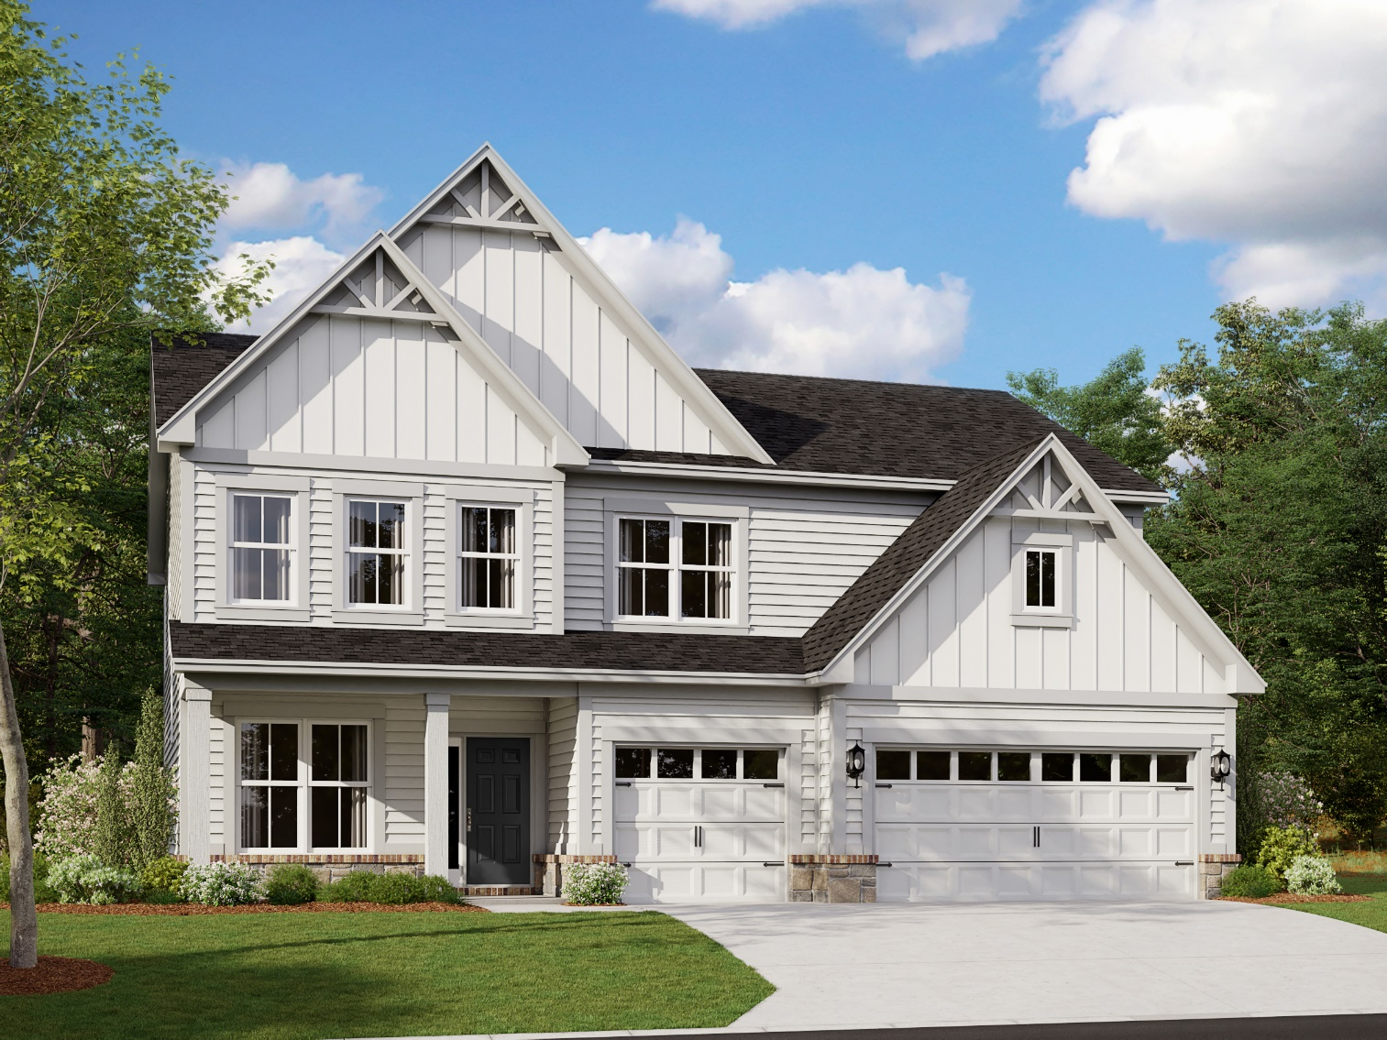
Drake C

Slide 18
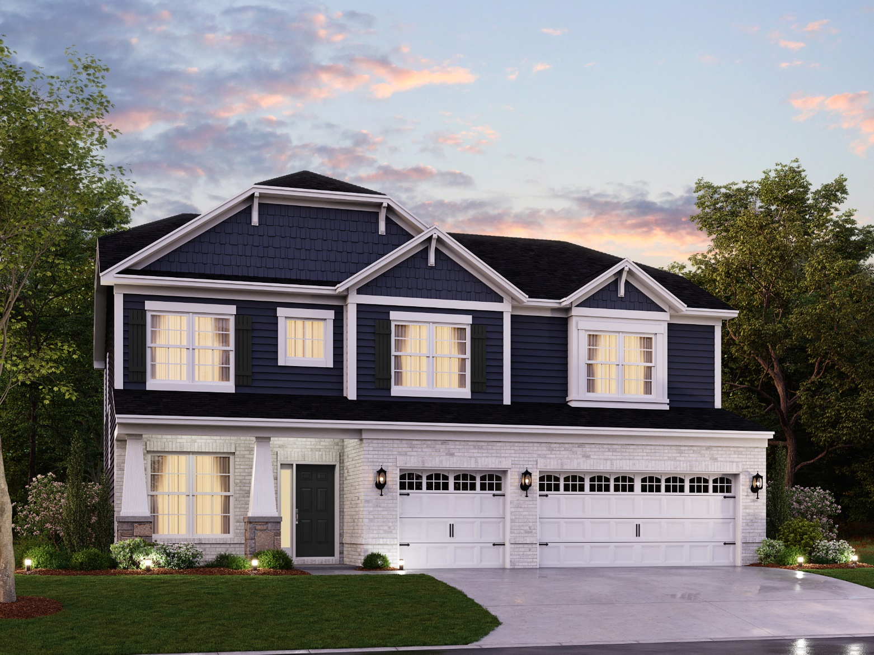
Drake D

Slide 19
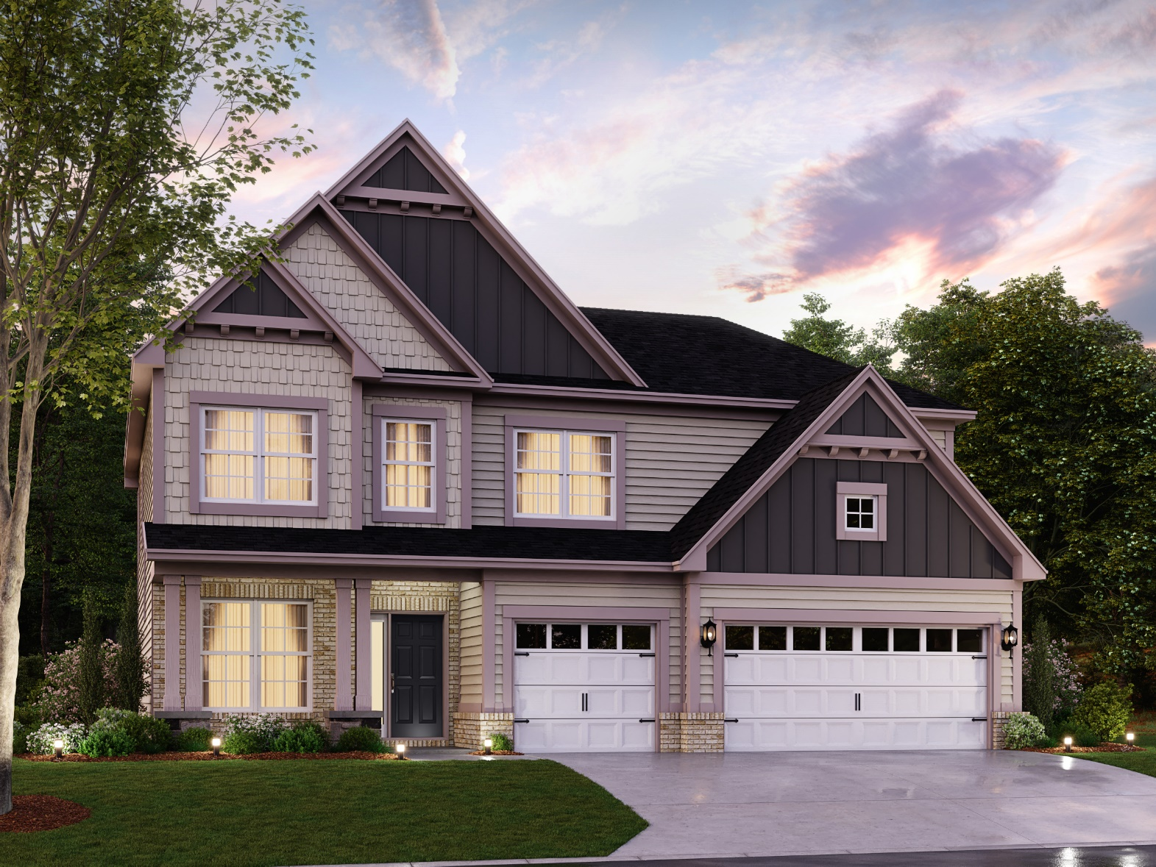
Drake E

Slide 20
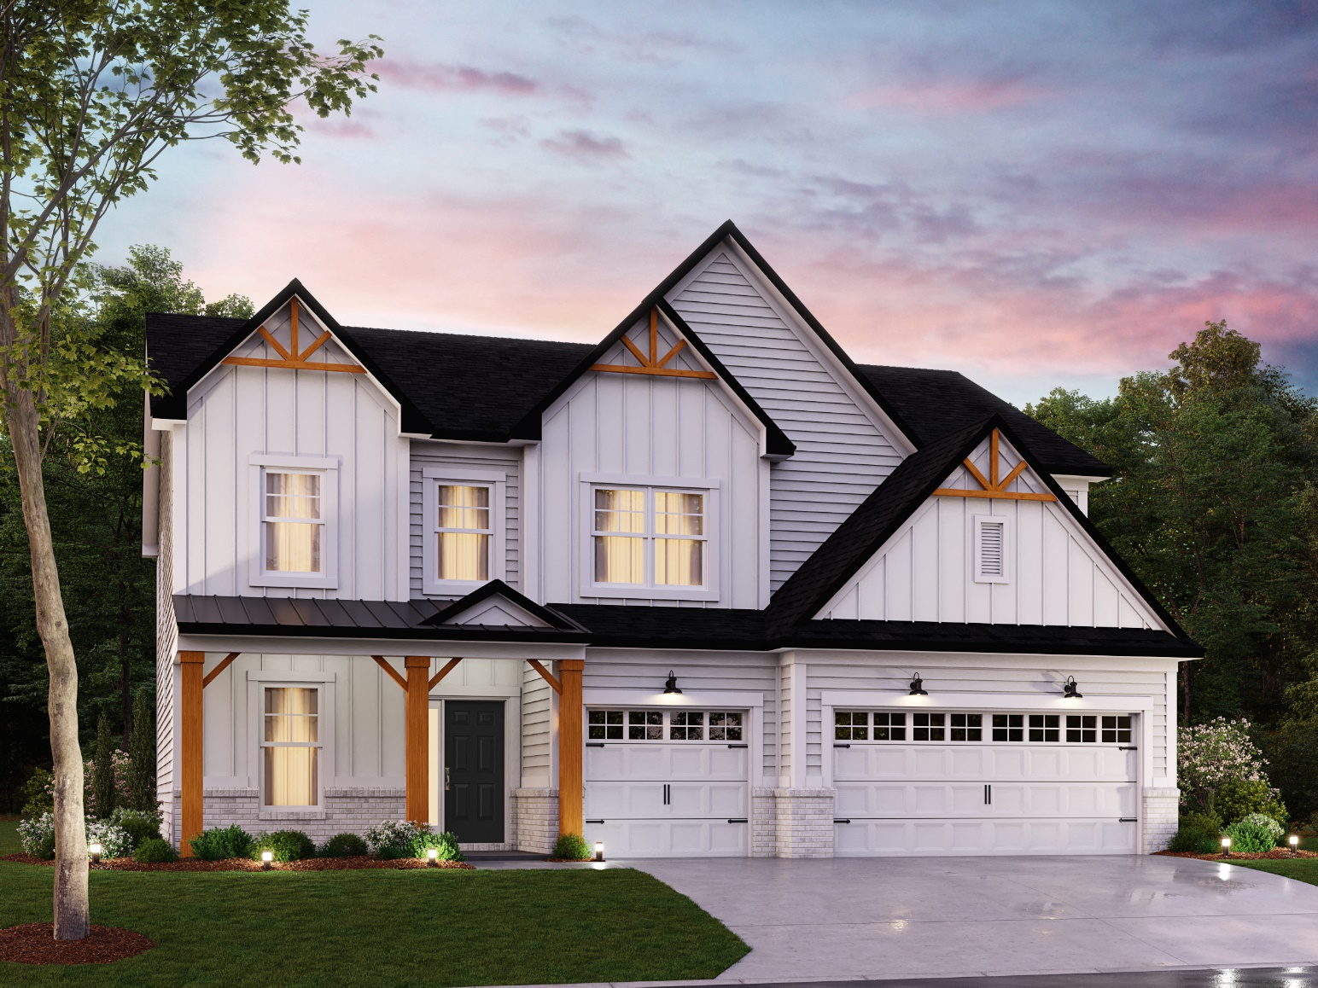
Drake F

Slide 21
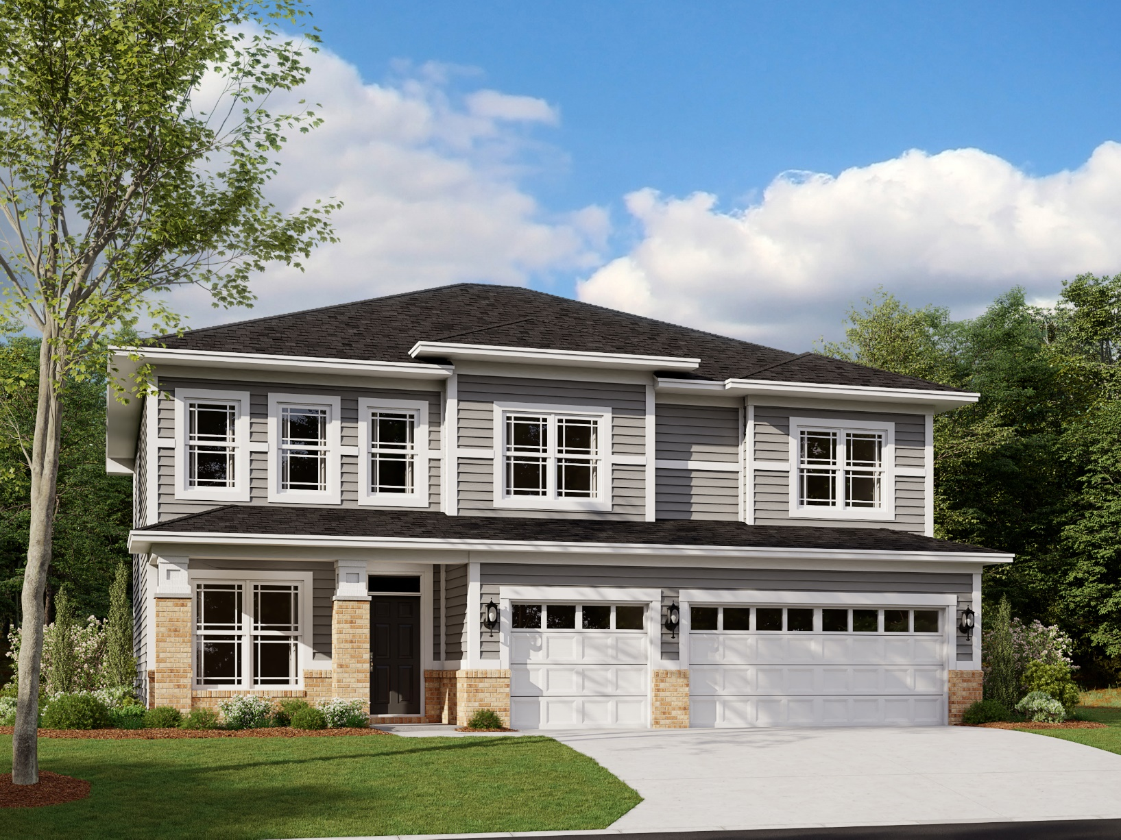
Drake G

Slide 22
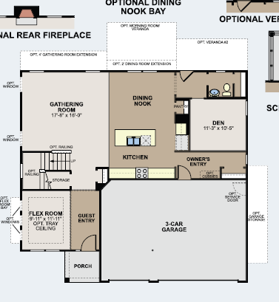
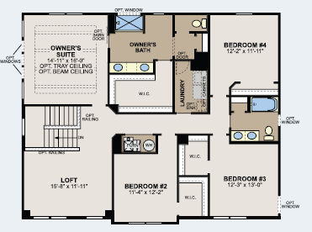
Drake Floorplan

