Slide 1
Pine Vail Estates
McCordsville
Informal Introduction
1/14/2020

Slide 2
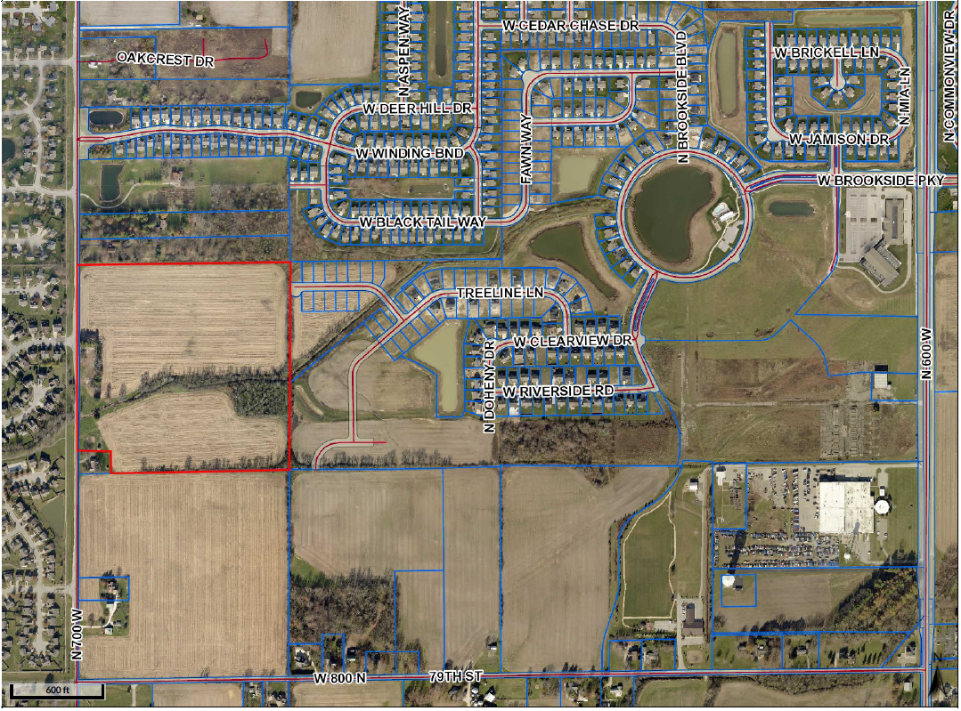
Pine Vail Estates Location Map

Slide 3
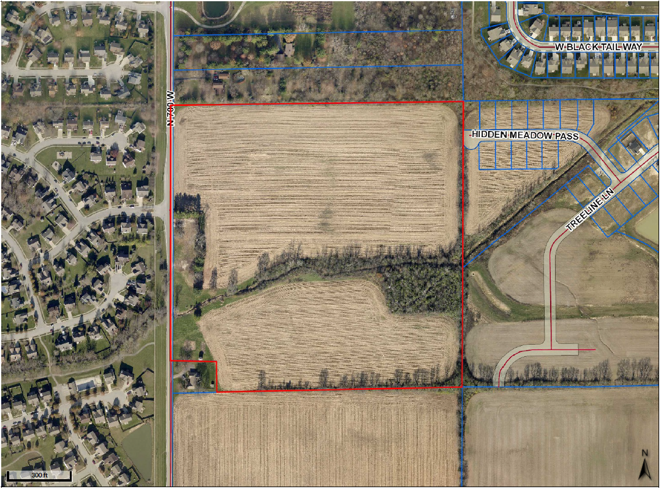
Pine Vail Estates Site Map

Slide 5
Pine Vail Estates Entrance

Slide 6
 | Pine Vail Estates Standards
Maximum Number of Lots | 78
Minimum Lot Area | 10,400 Sq. Ft.
Minimum Lot Width at Building Line | 75 Ft.
Minimum Front Yard Setback | 25 Ft.
Minimum Side Yard Setback | 6 Ft.
Minimum Rear Yard Setback | 25 Ft.
Minimum Livable Floor Area | (Single Story) 1,800 Sq. Ft.
Minimum Livable Floor Area | (Two Story) 2,000 Sq. Ft.
Maximum Lot Coverage | 45 Ft.
Maximum Height Principal | 35 Ft.

Slide 7
M/I Homes

Slide 8
M/I Homes

Slide 9
M/I Homes

Slide 10
M/I Homes

Slide 11
M/I Homes

Slide 12
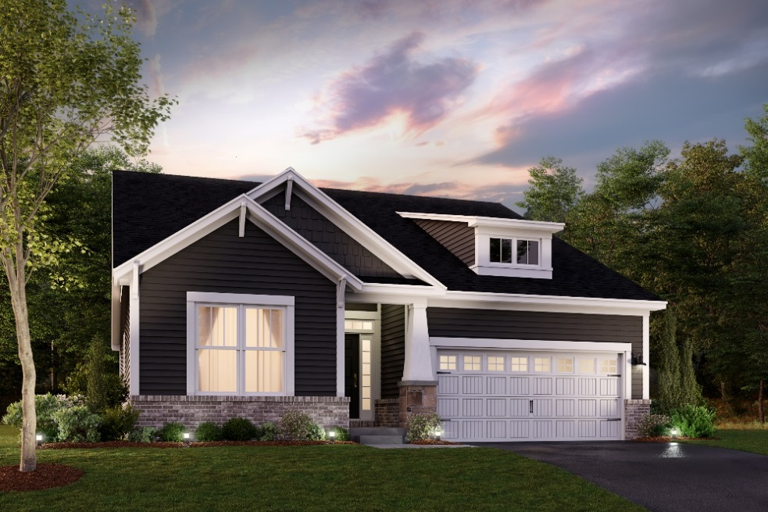
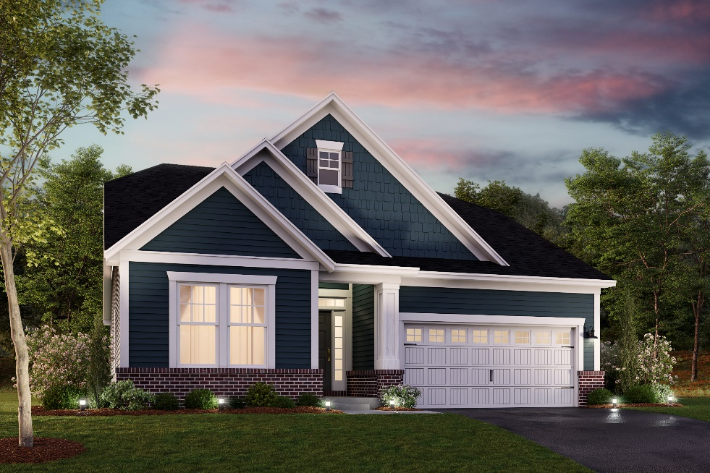
M/I Homes

Slide 13
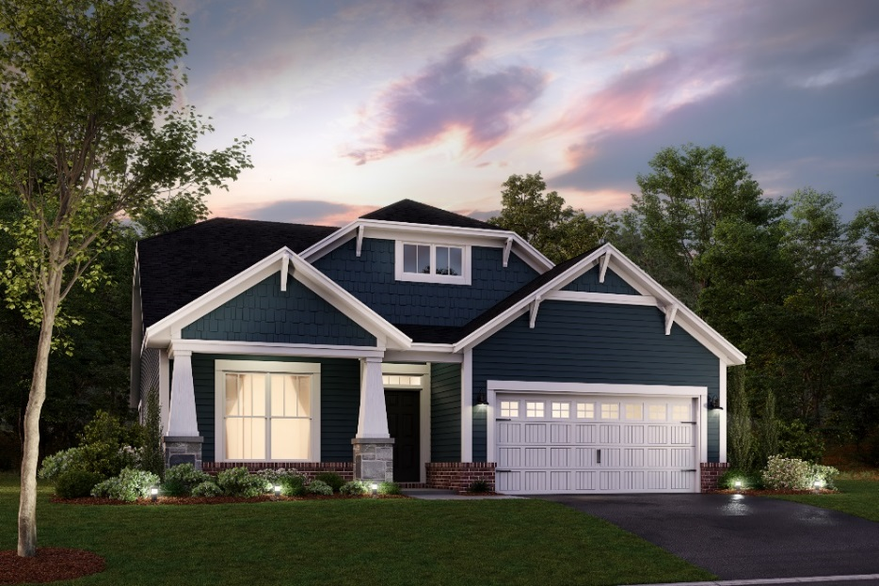
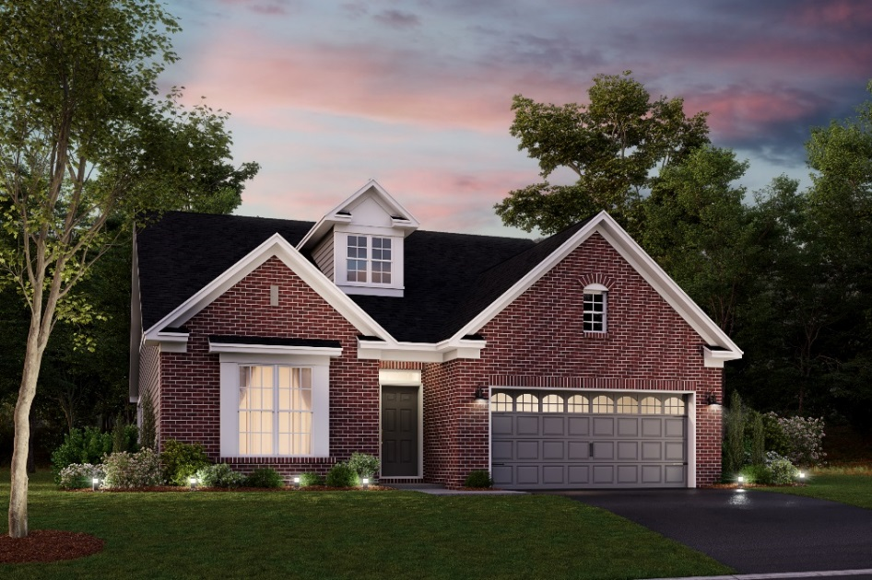
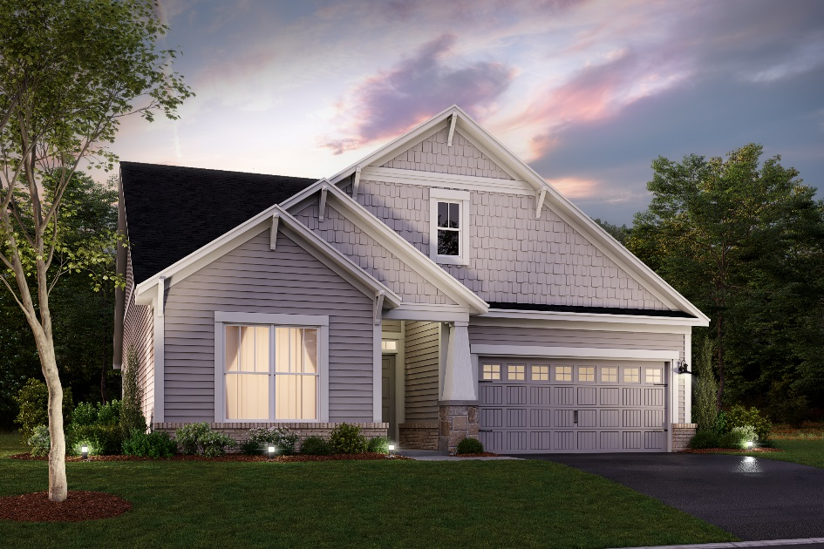
M/I Homes

