Slide 1
SMART Series Plans for Helms Mill
Mackey II | Ranch | 1603 -1950 SF
Ashton | Ranch | 1842 – 2300 Sf
Irvington | 2 Story | 2002 SF
Findlay | 2 Story | 2315 SF
Akerman | 2 Story | 2444 SF
Foster | 2 Story | 2714 SF
Fairbanks | 2 story | 2957 Sf

Slide 2
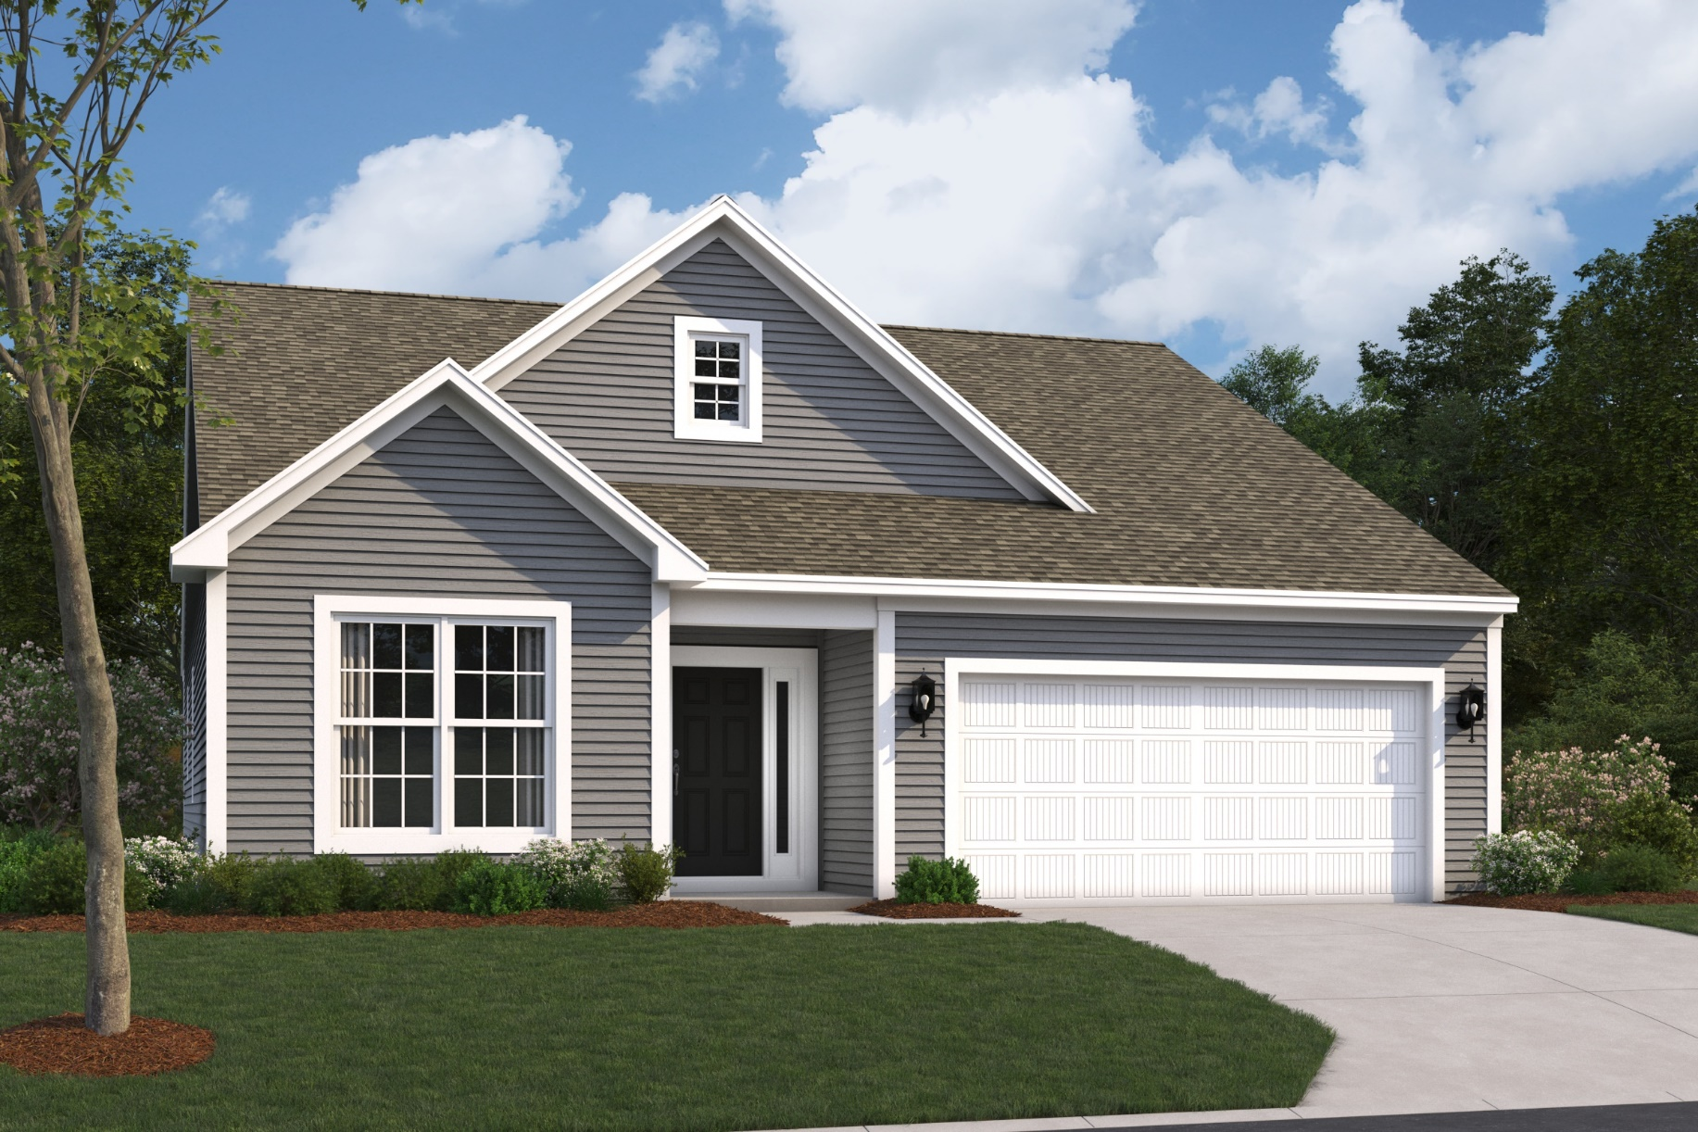
Mackey II A

Slide 3
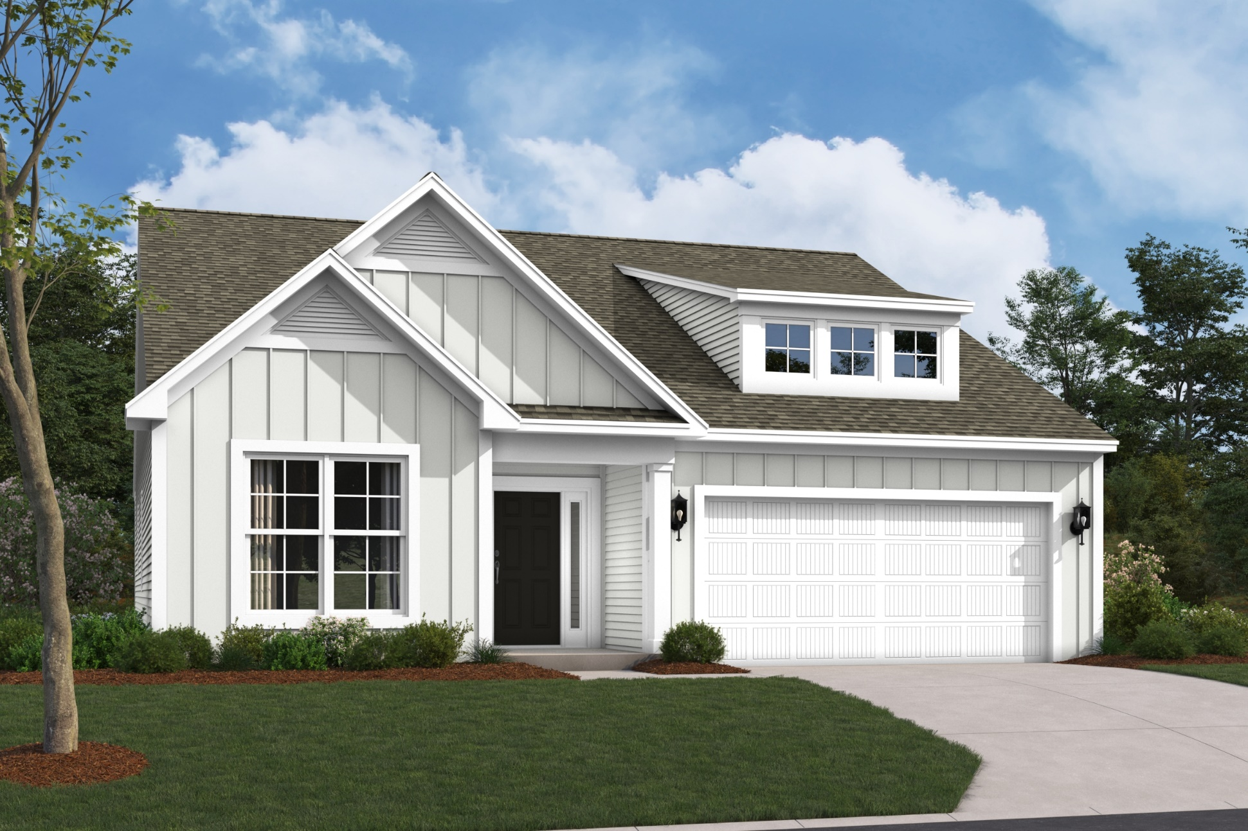
Mackey II B

Slide 4
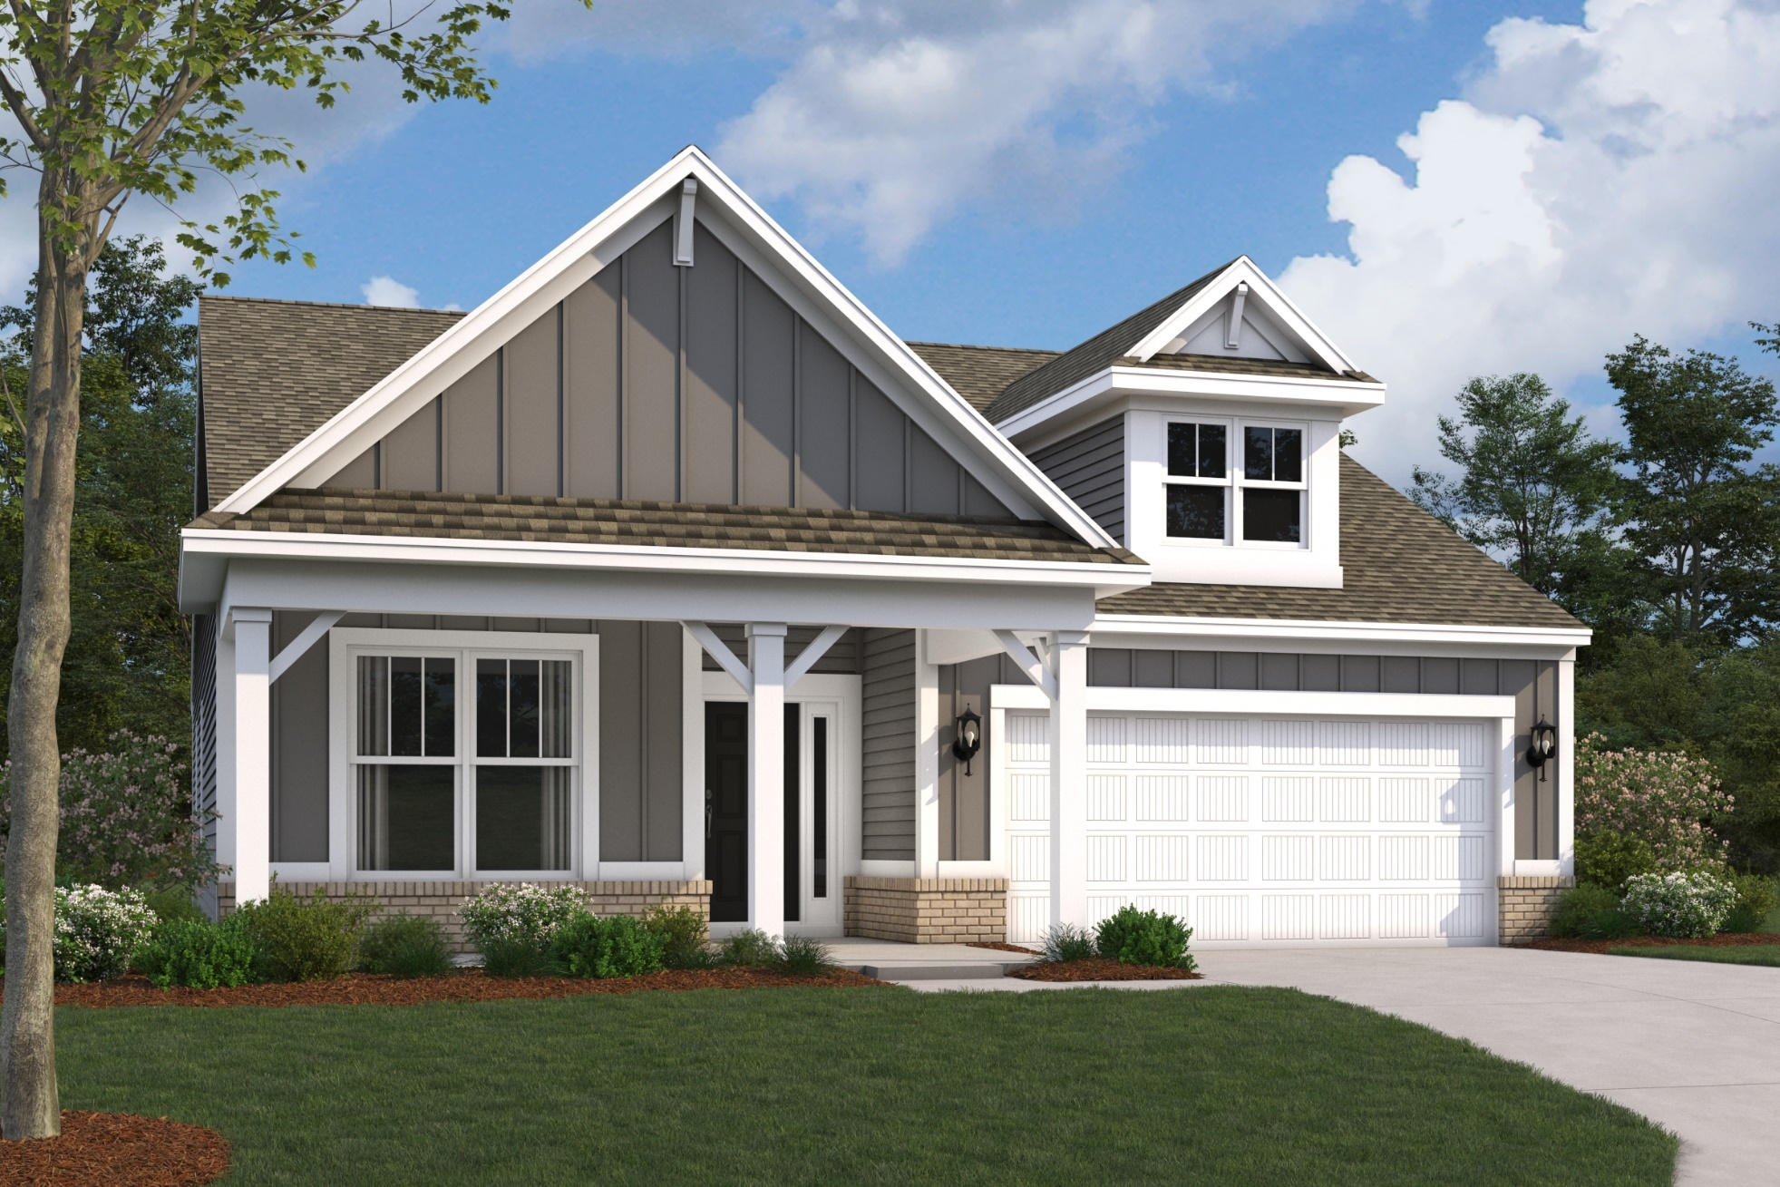
Mackey II D

Slide 5
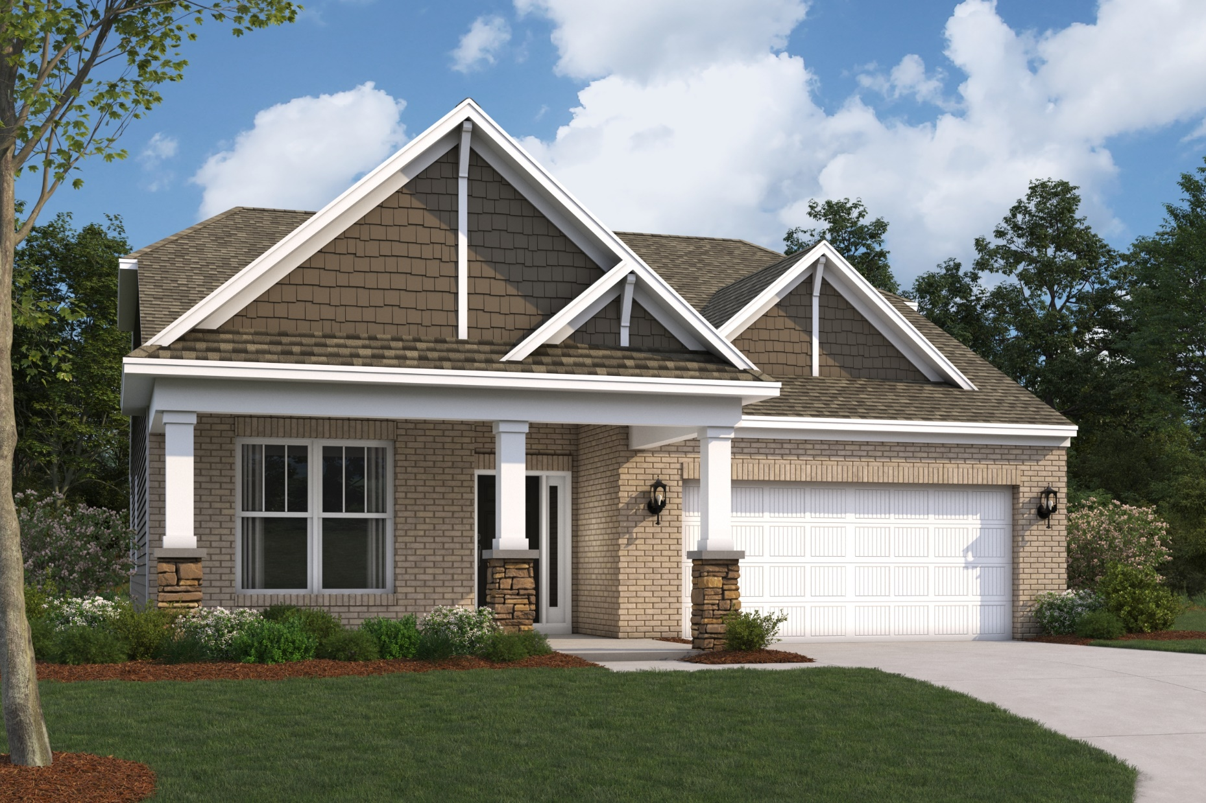
Mackey II E

Slide 6
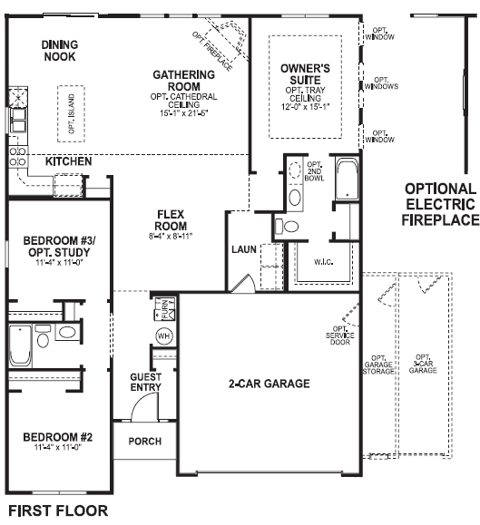
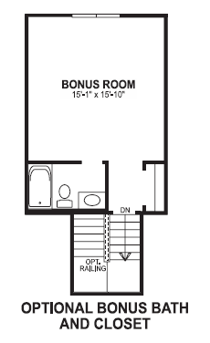
Mackey Floorplans

Slide 7
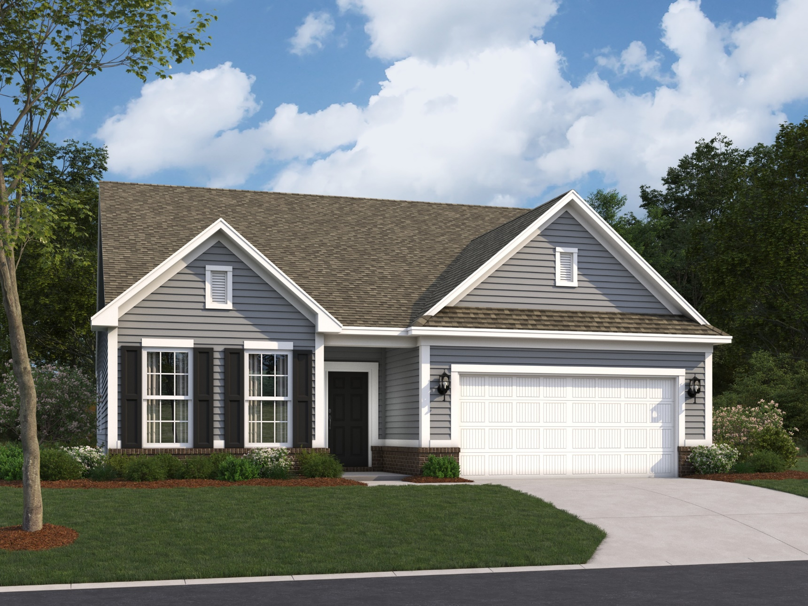
Ashton A

Slide 8
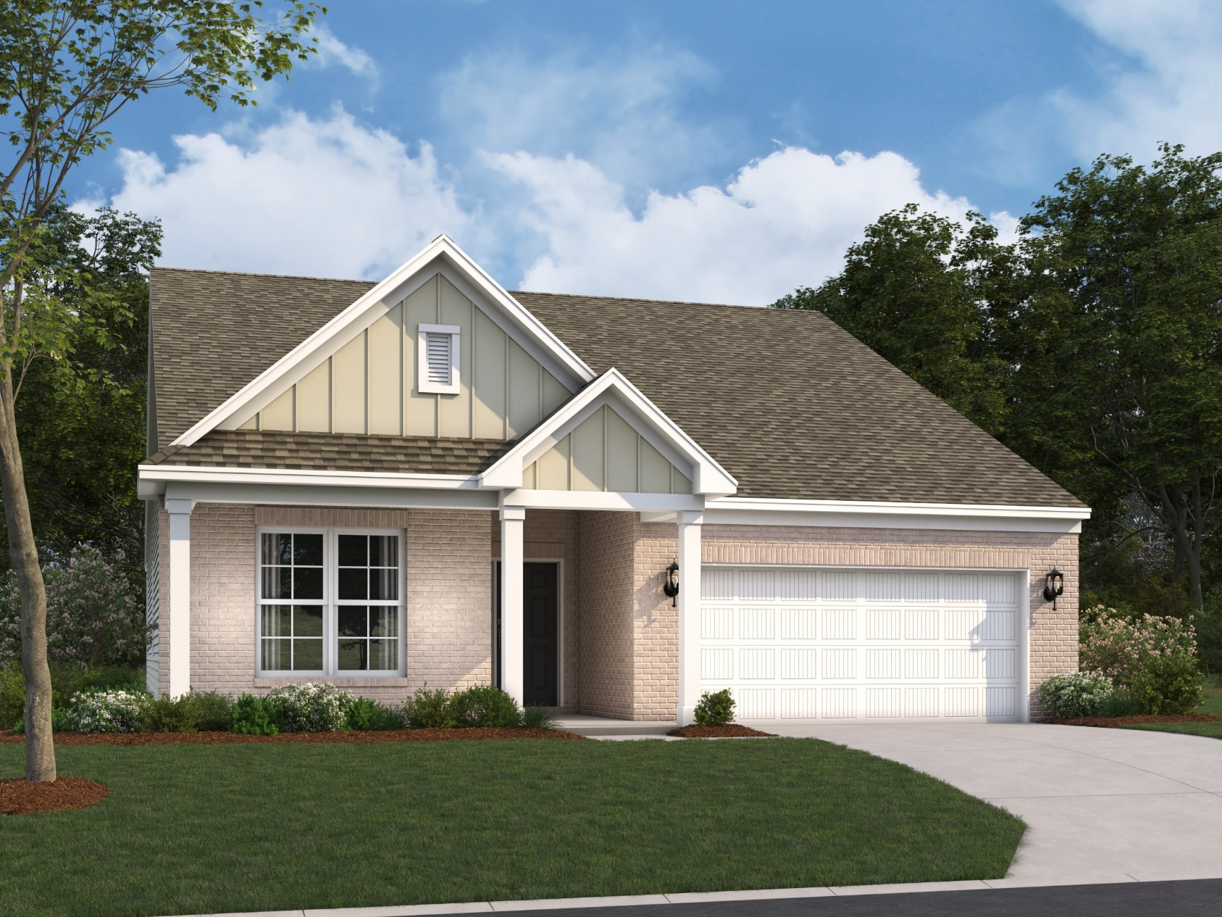
Ashton B

Slide 9
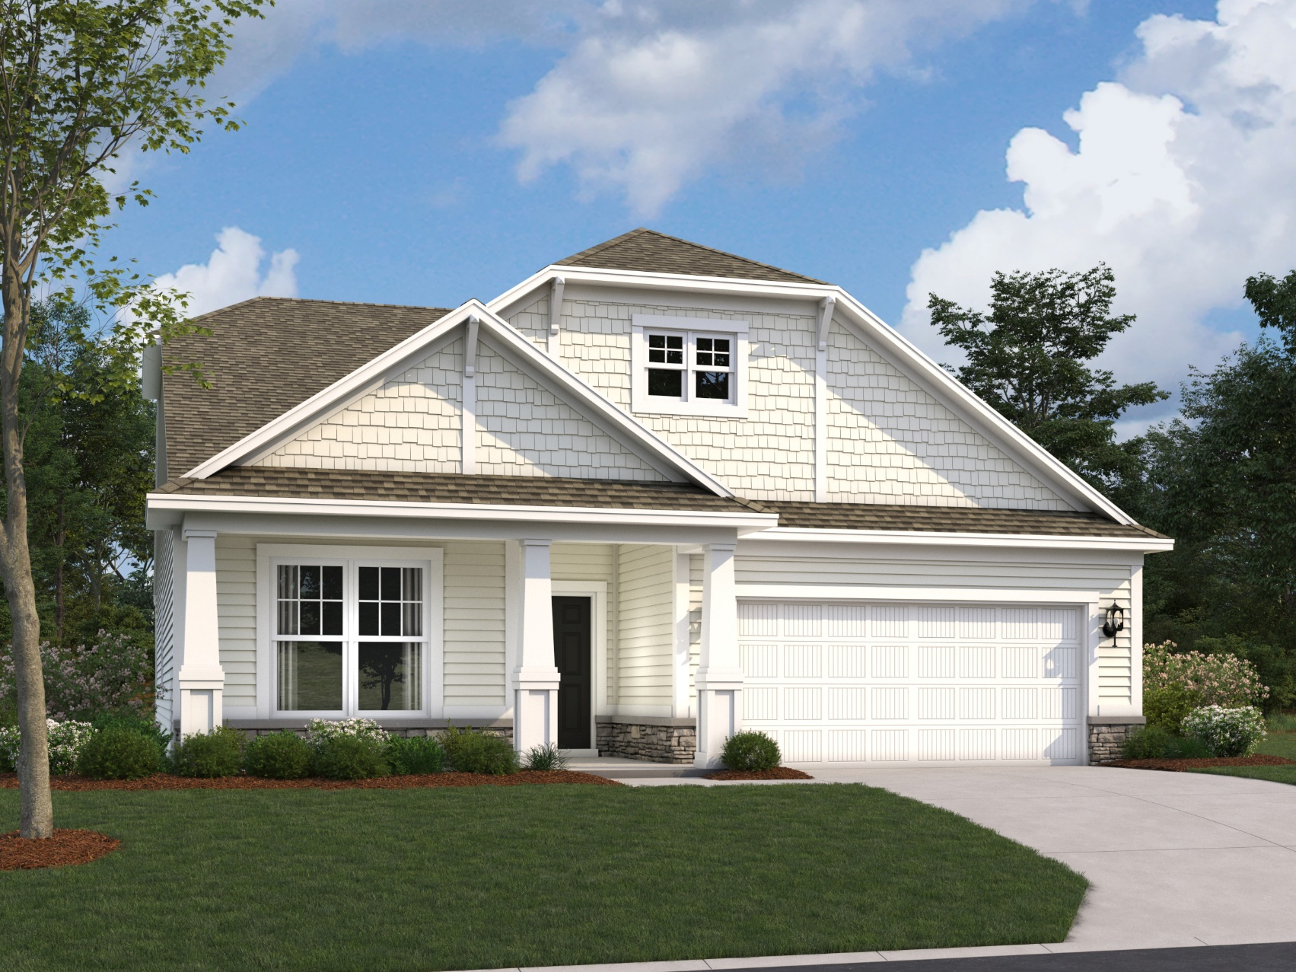
Ashton C

Slide 10
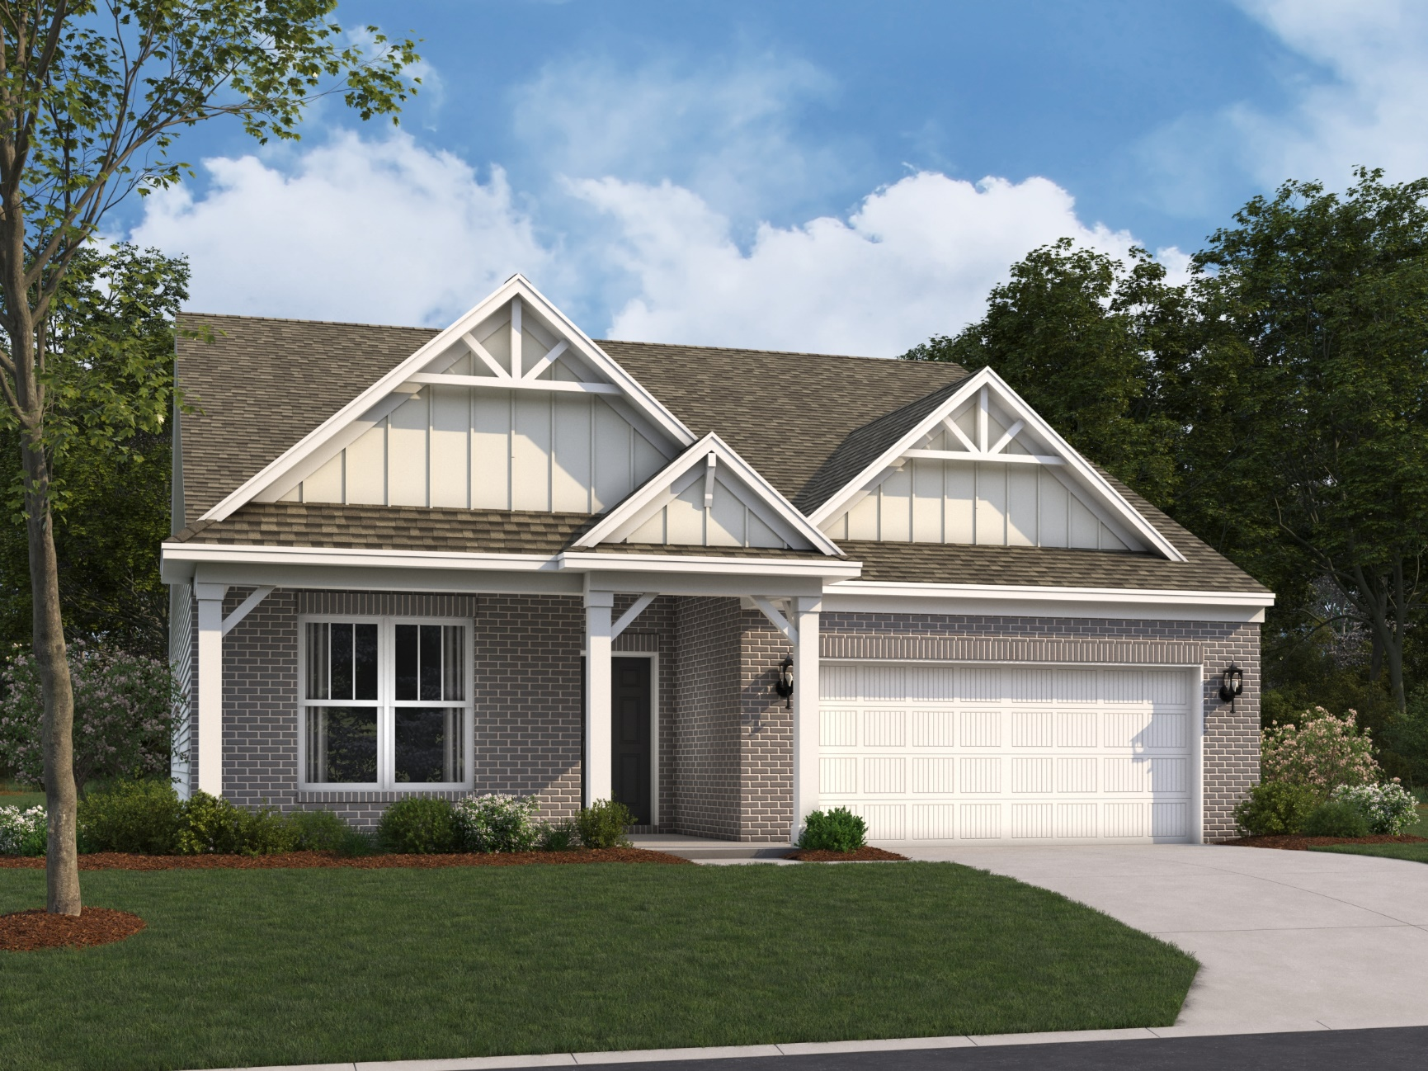
Ashton D

Slide 11
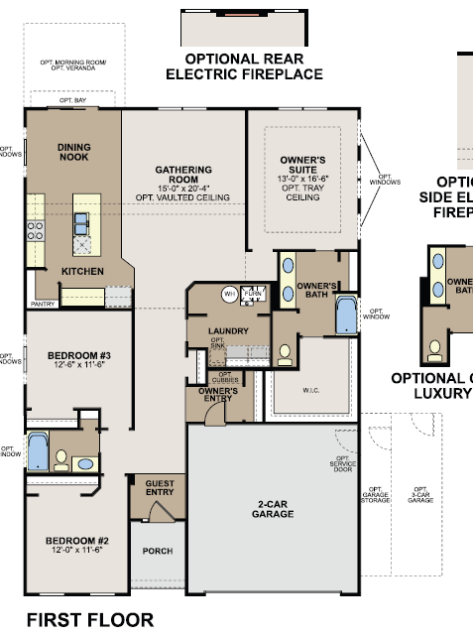
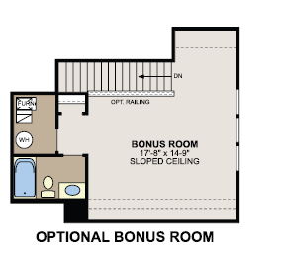
Ashton Floorplan

Slide 12
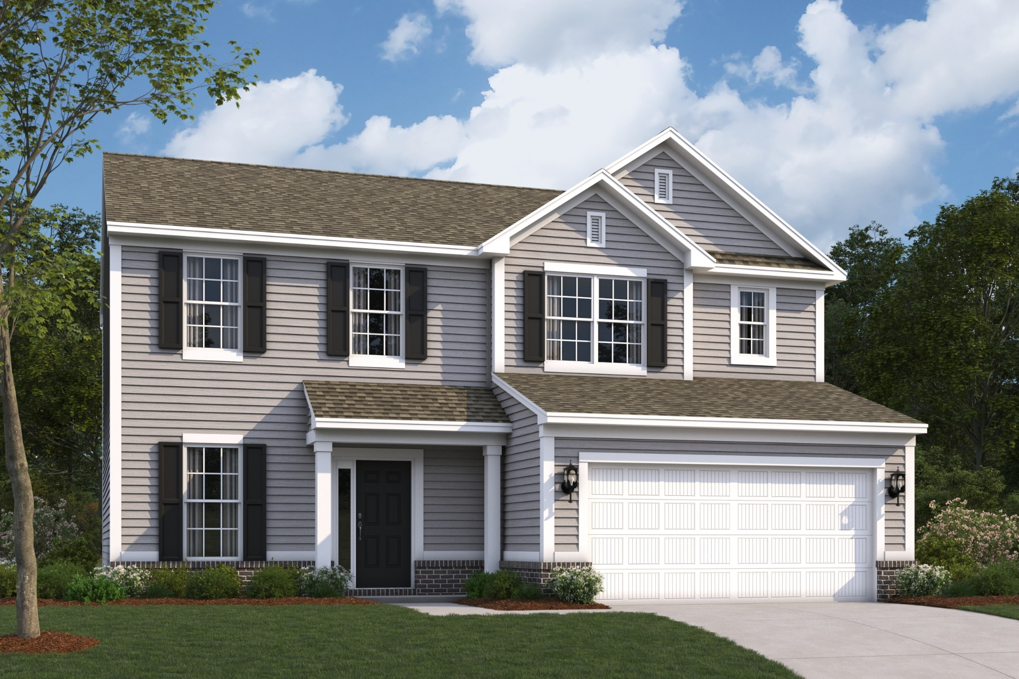
Irvington A

Slide 13
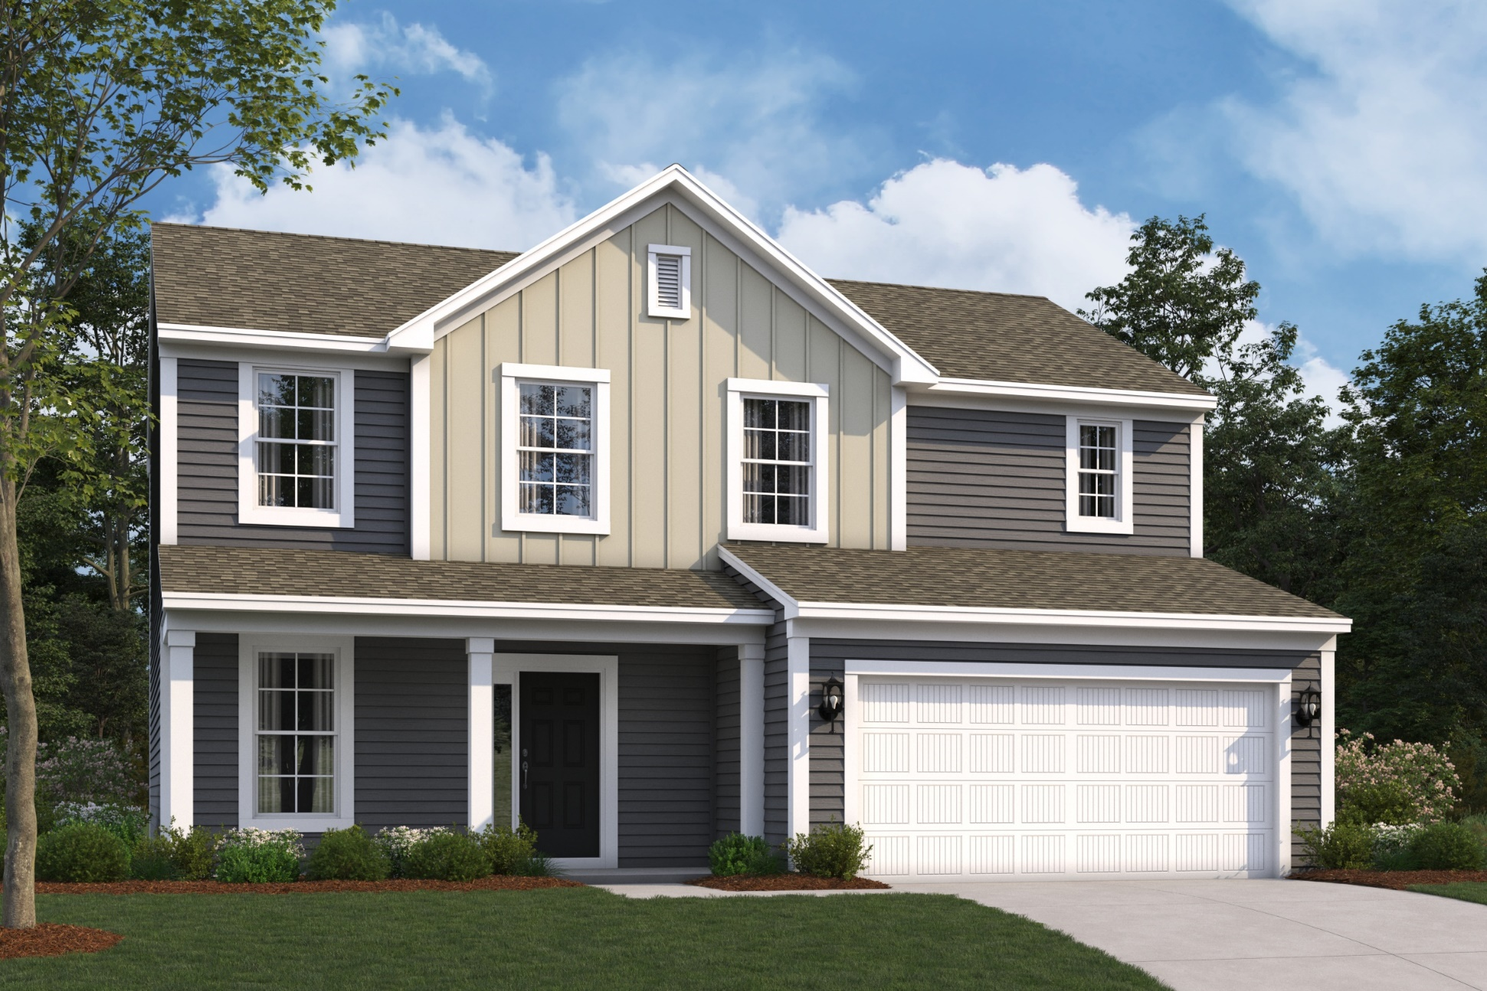
Irvington B

Slide 14
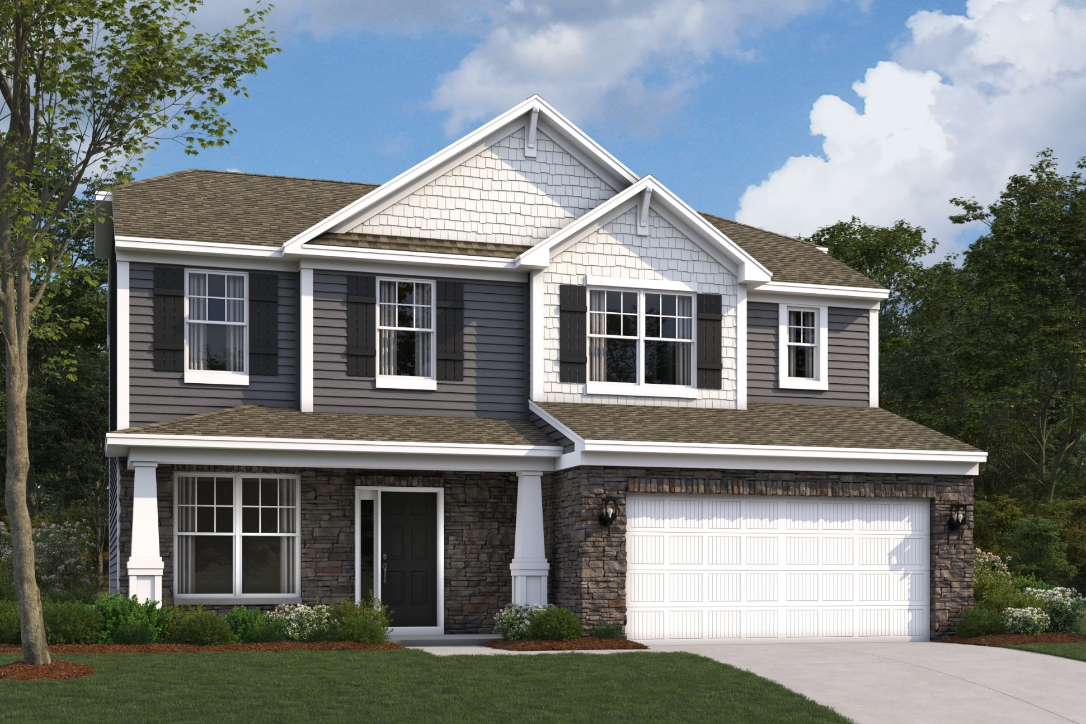
Irvington C

Slide 15
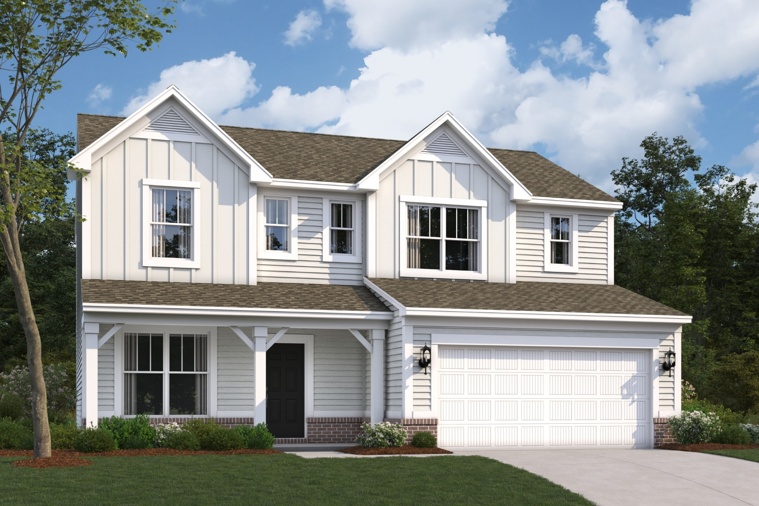
Irvington D

Slide 16
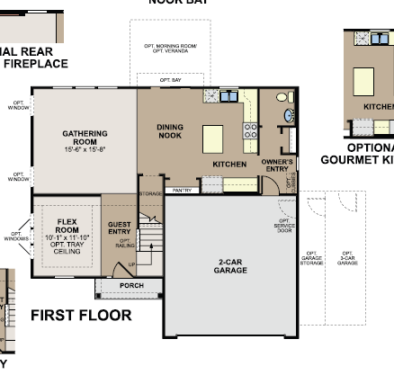
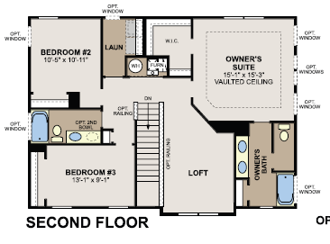
Irvington Floorplan

Slide 17
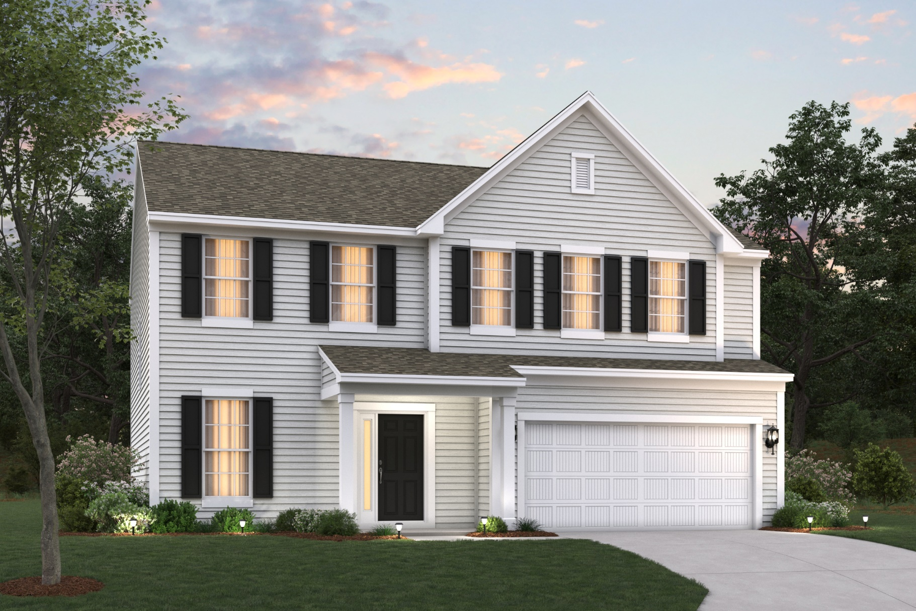
Findlay A

Slide 18
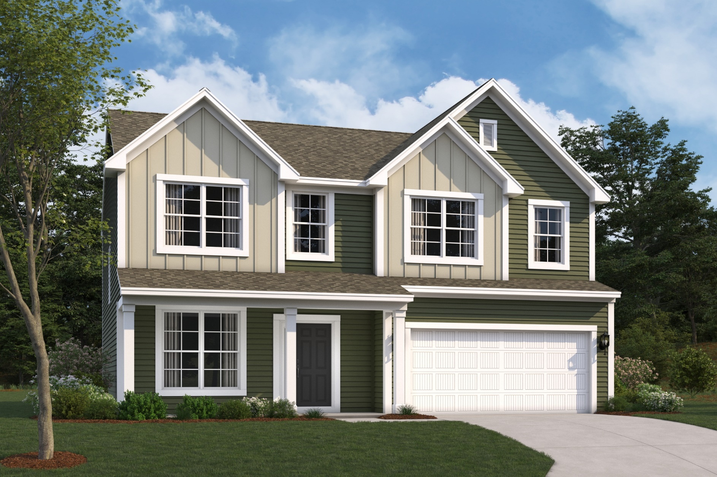
Findlay B

Slide 19
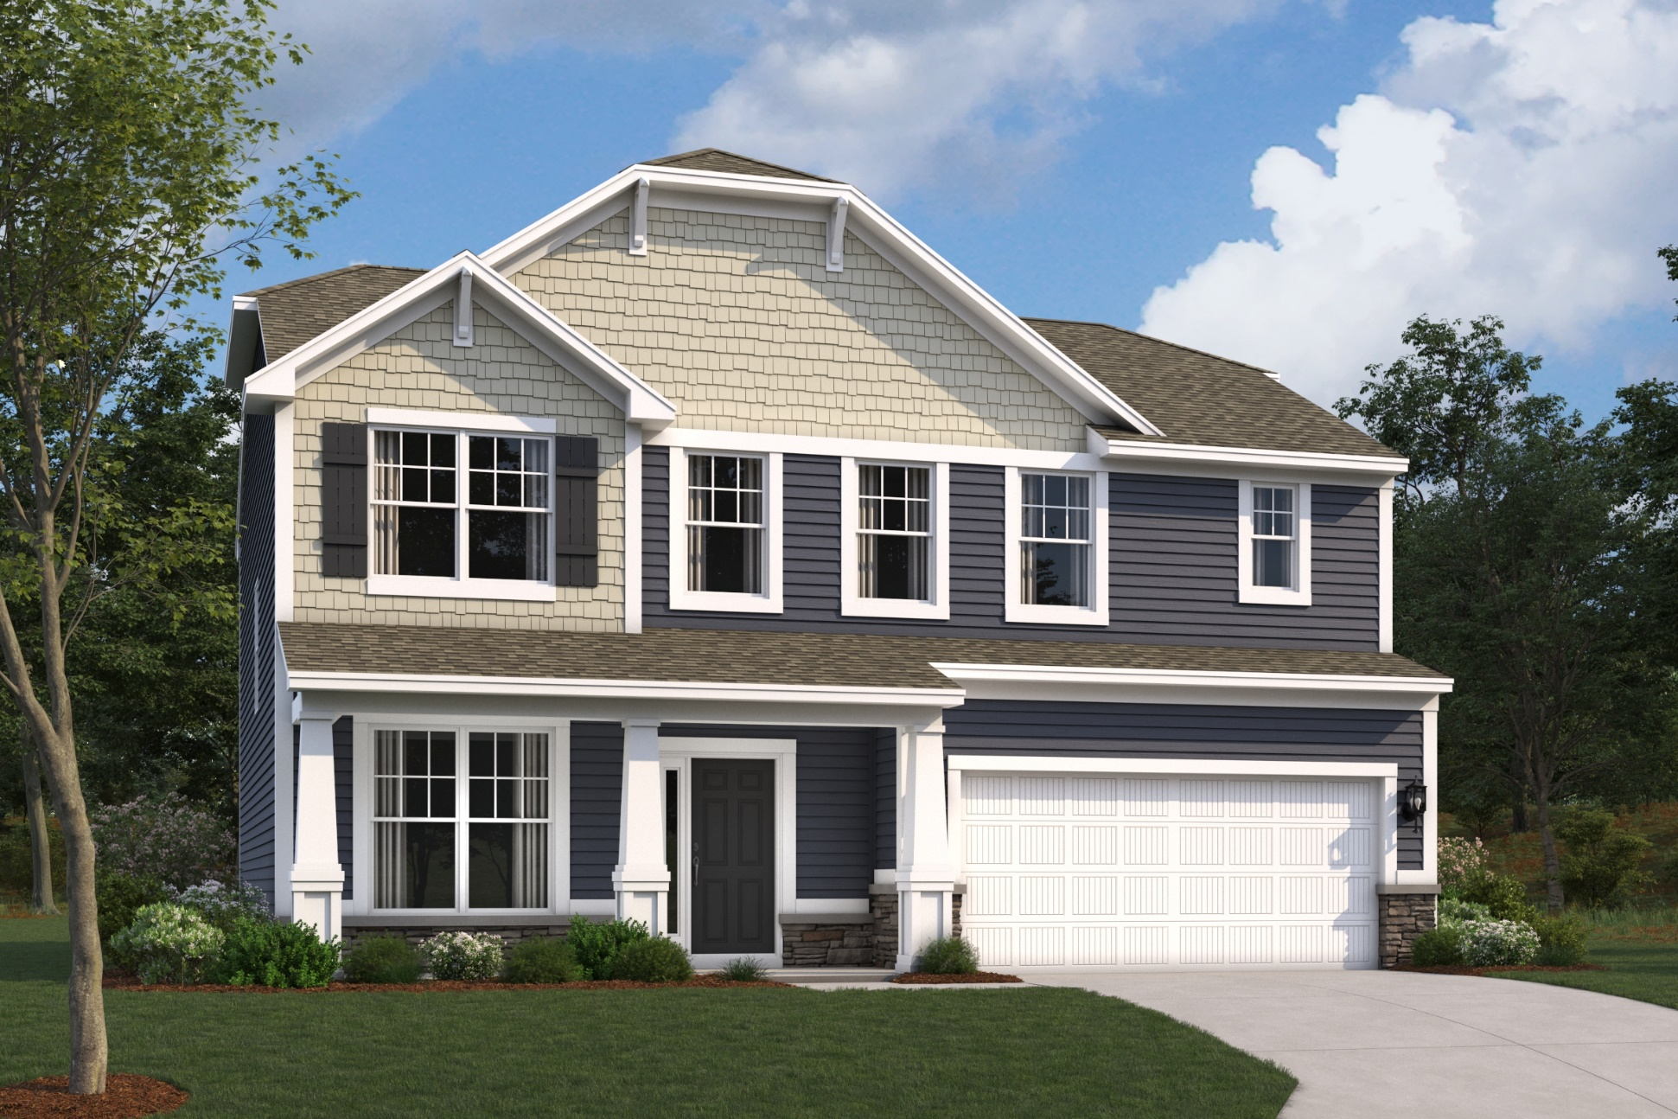
Findlay C

Slide 20
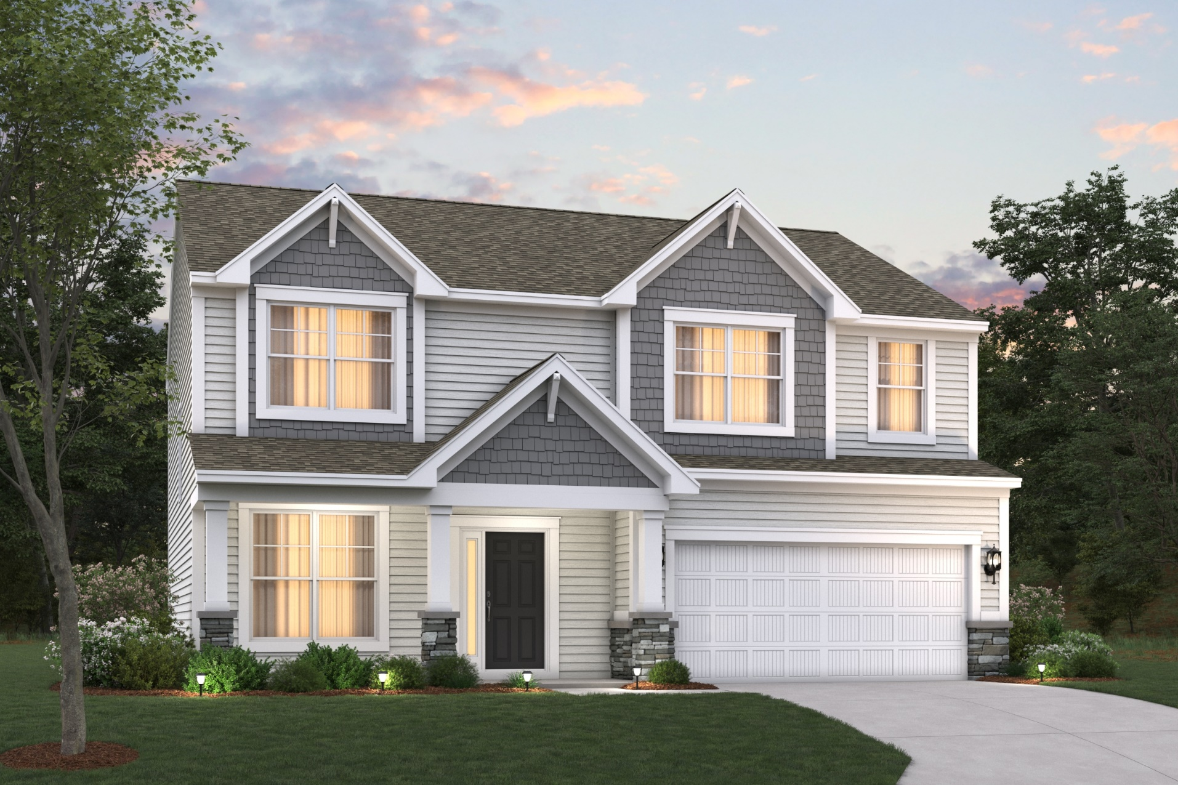
Findlay D

Slide 21
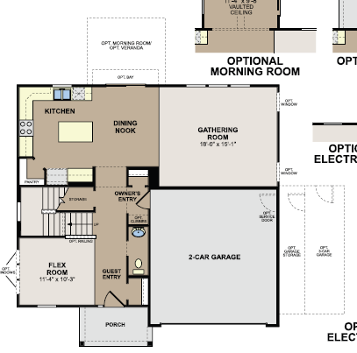
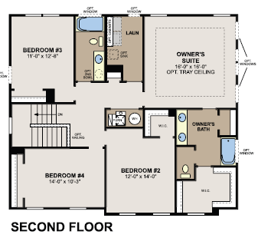
Findlay Floorplan

Slide 22
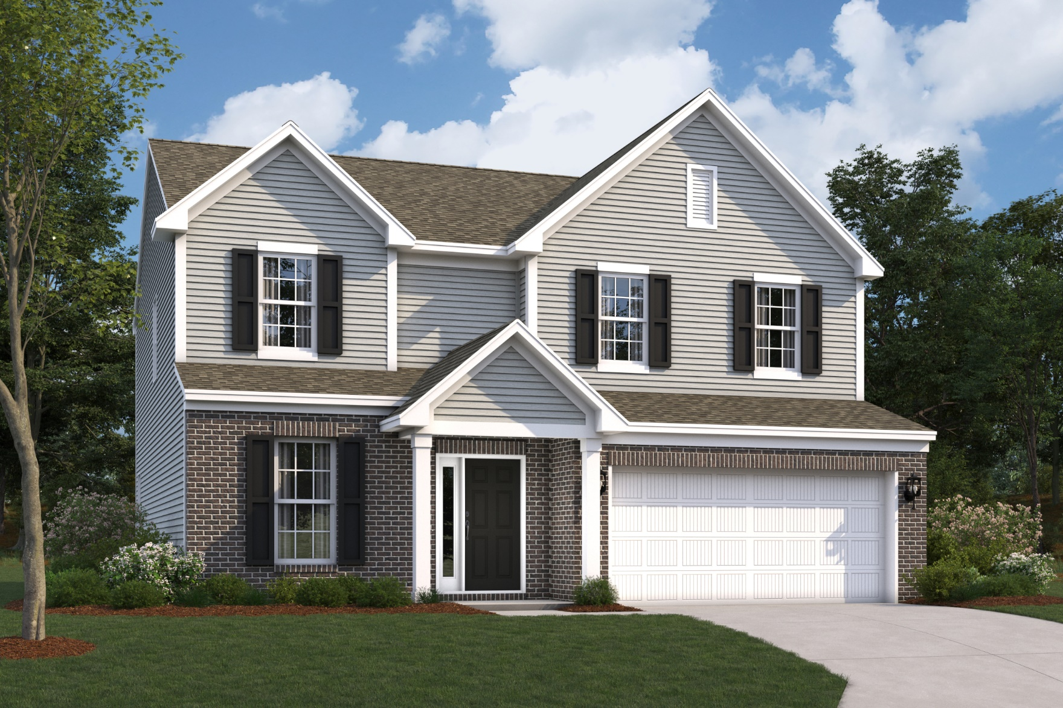
Akerman (McKinley) A

Slide 23
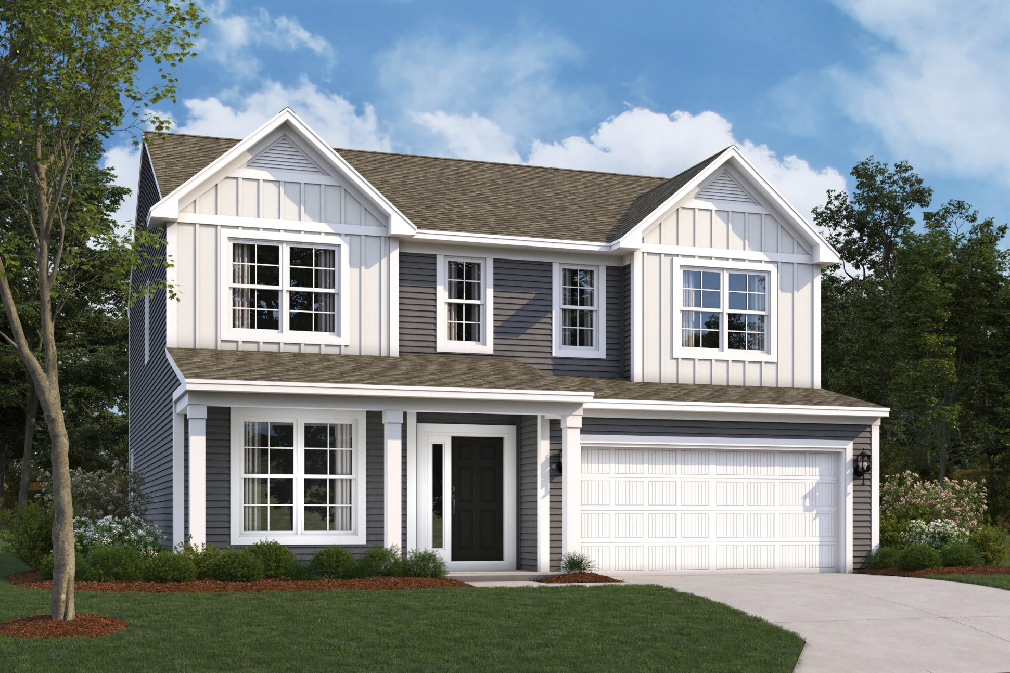
Akerman (McKinley) B

Slide 24
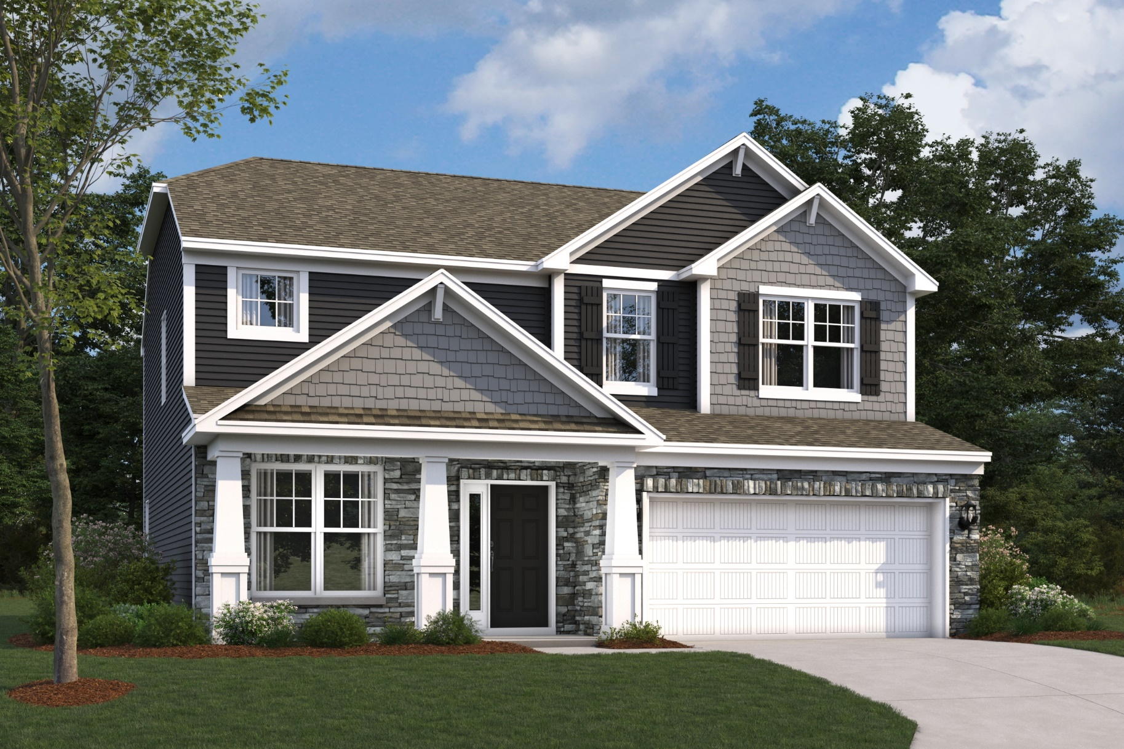
Akerman (McKinley) C

Slide 25
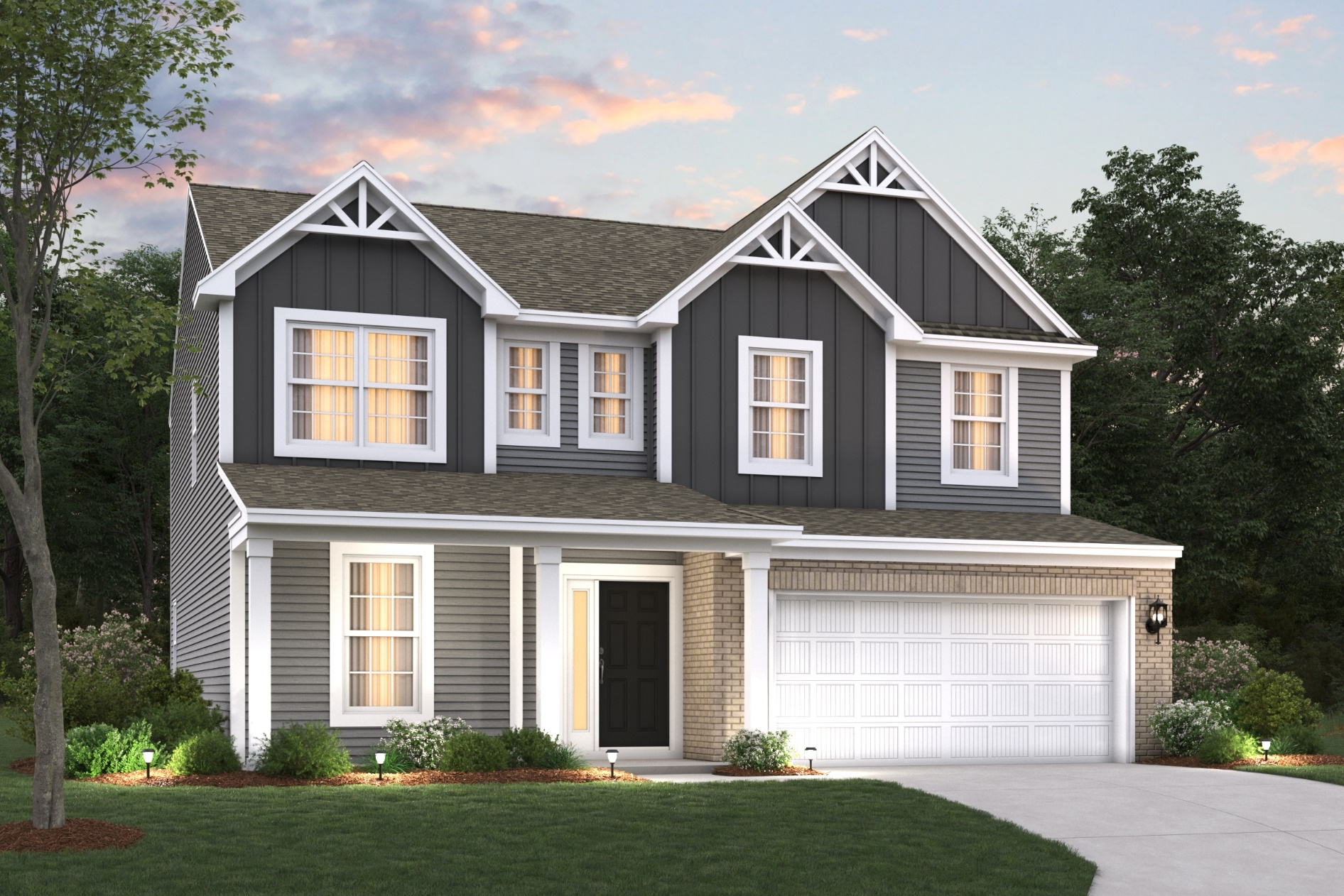
Akerman (McKinley) D

Slide 26
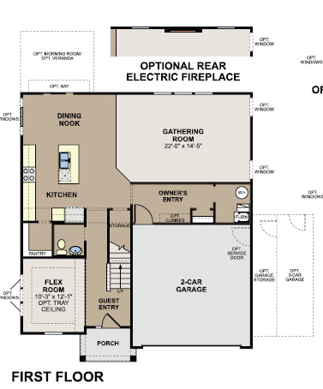
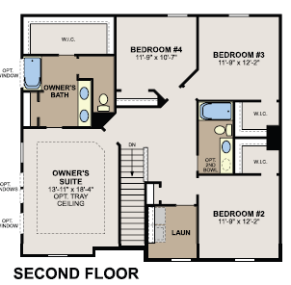
Akerman Floorplan

Slide 27
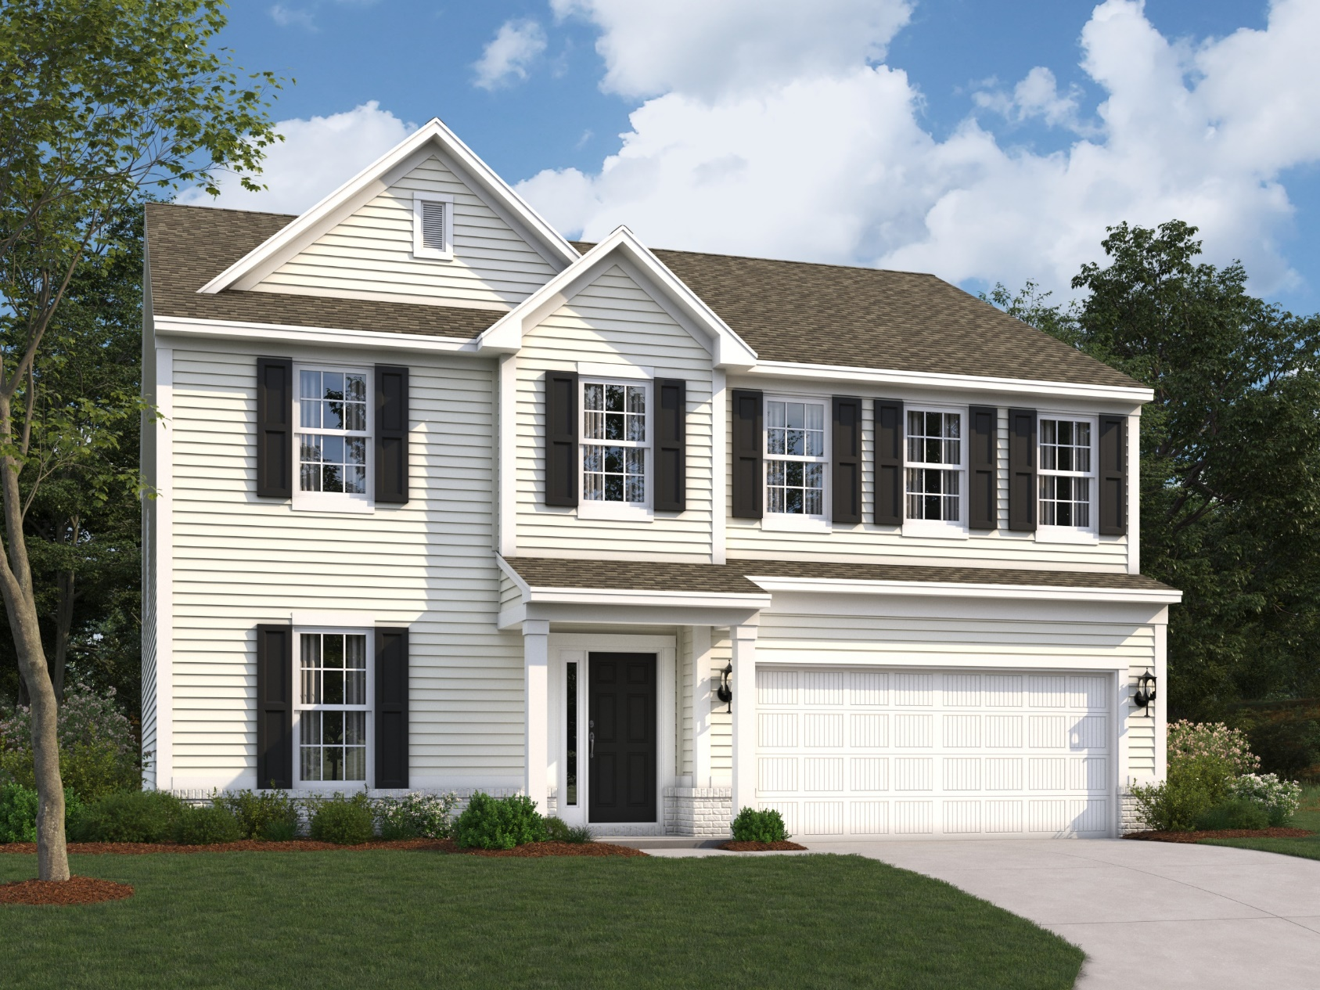
Foster A

Slide 28
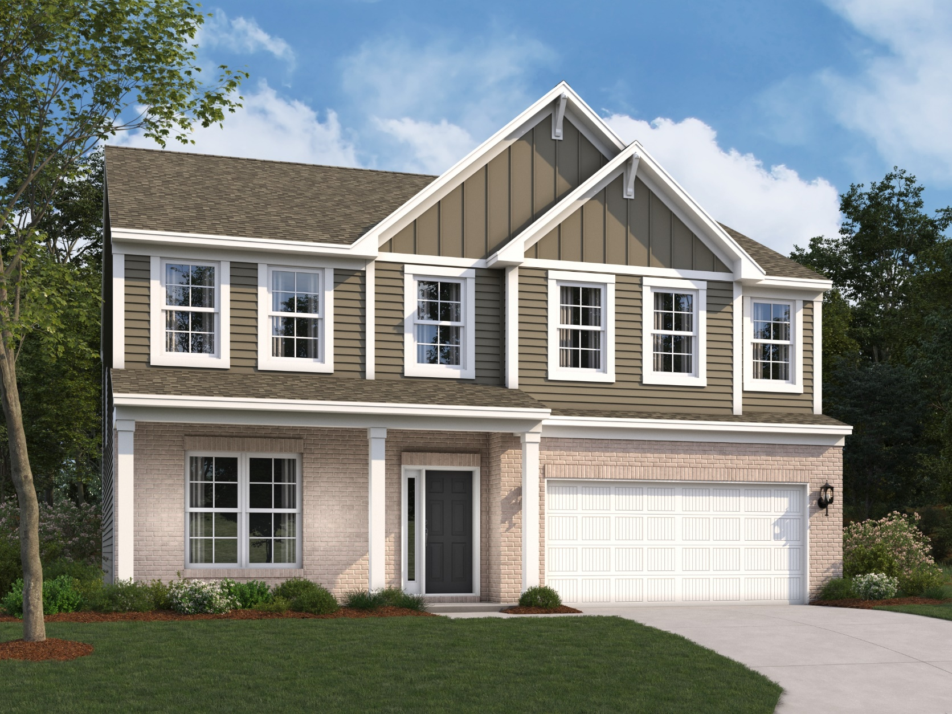
Foster B

Slide 29
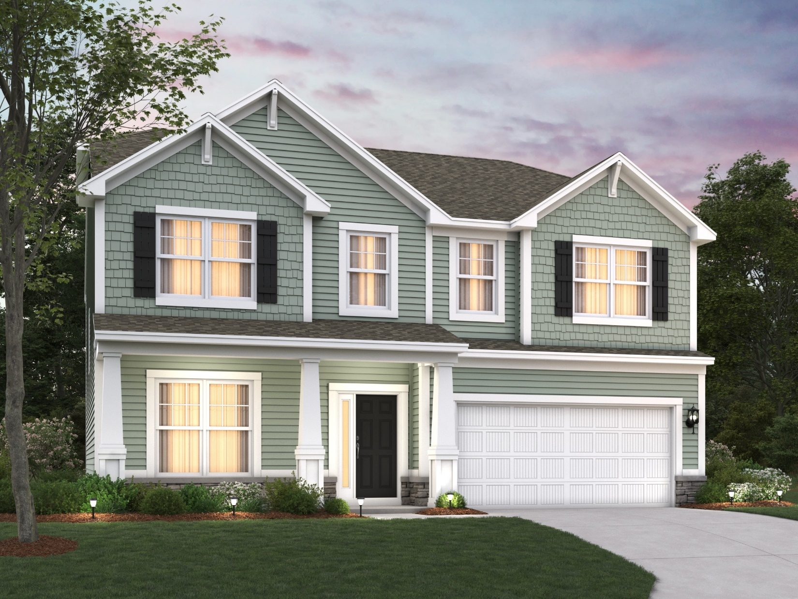
Foster C

Slide 30
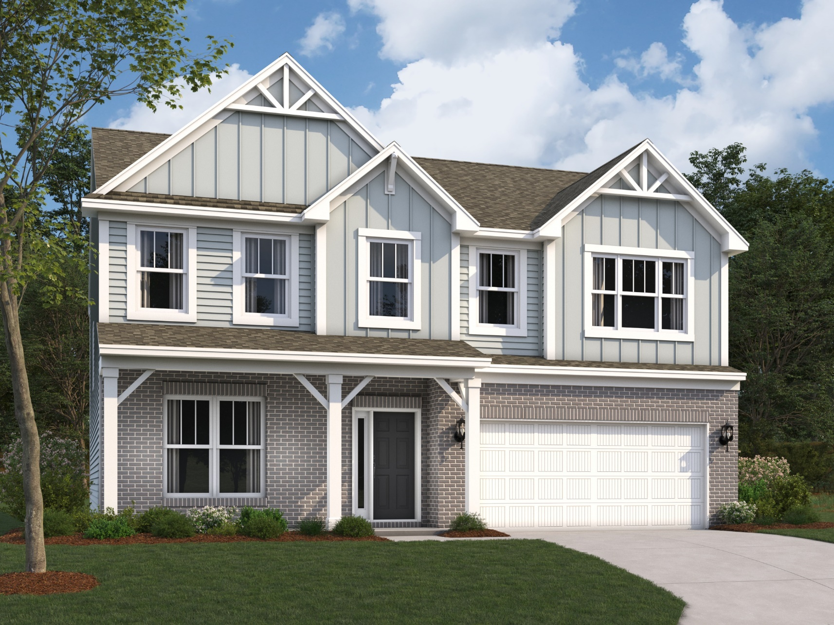
Foster D

Slide 31
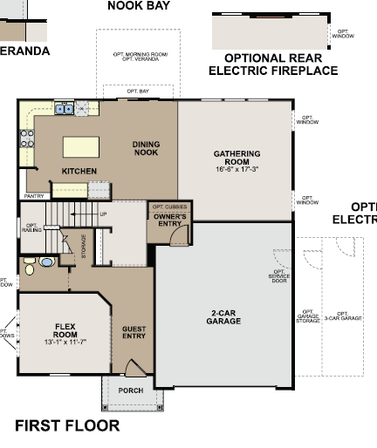
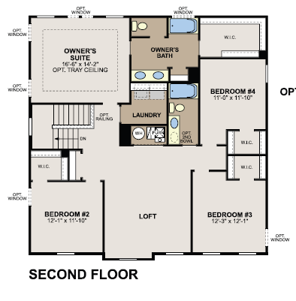
Foster Floorplan

Slide 32
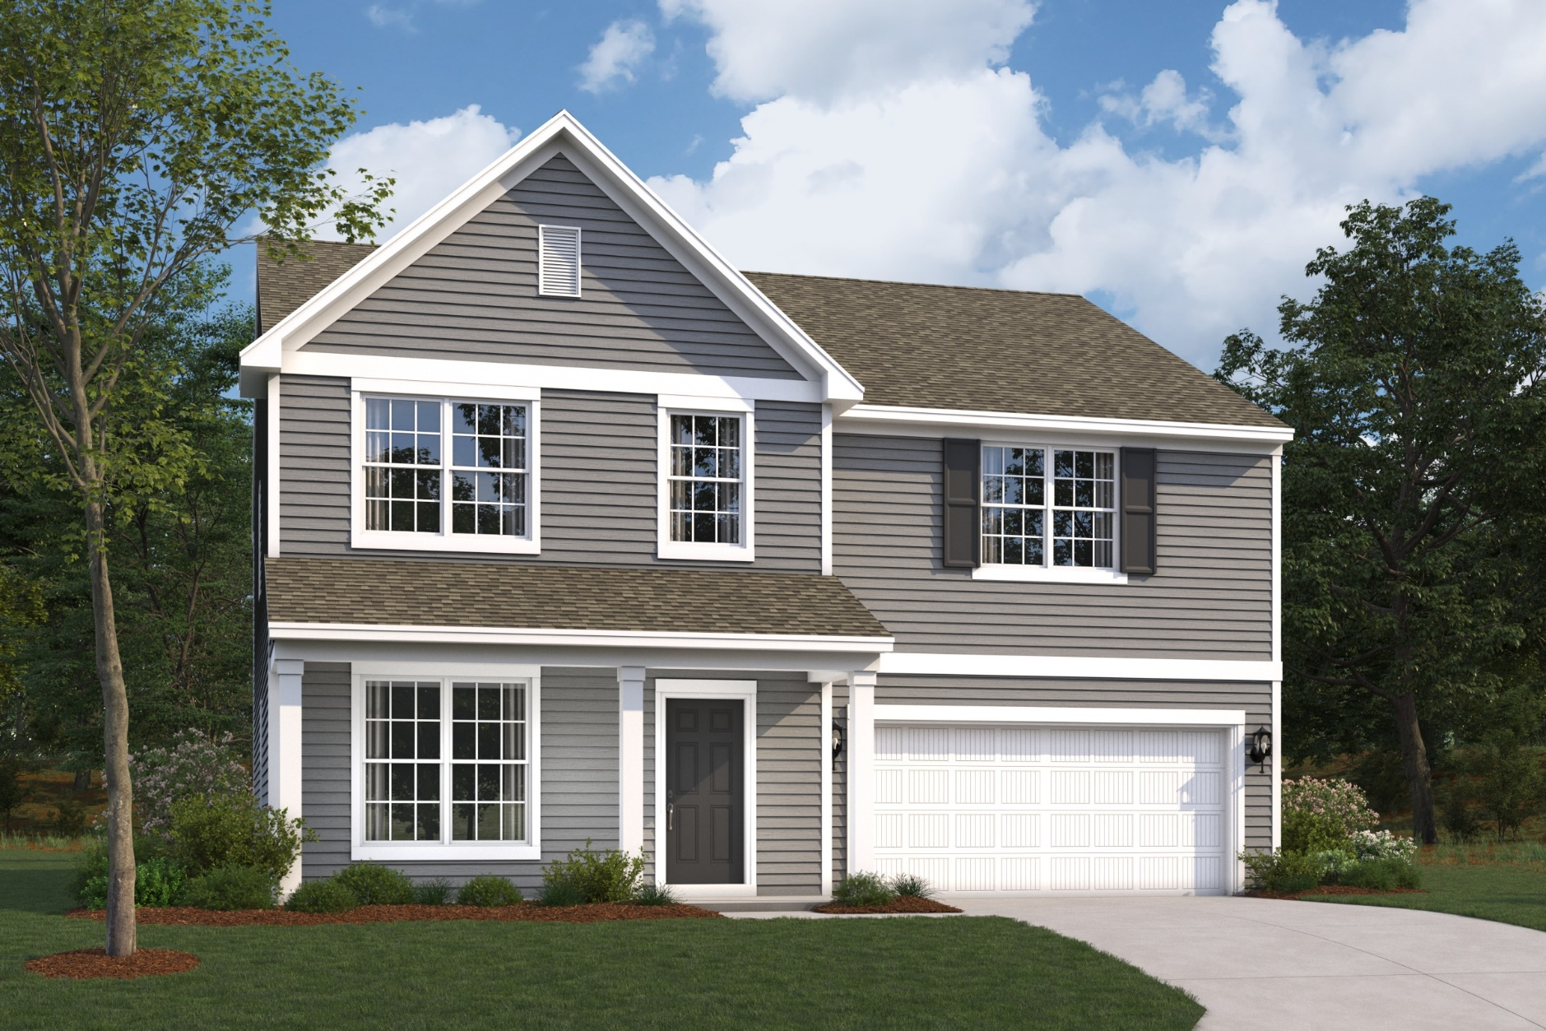
Fairbanks A

Slide 33
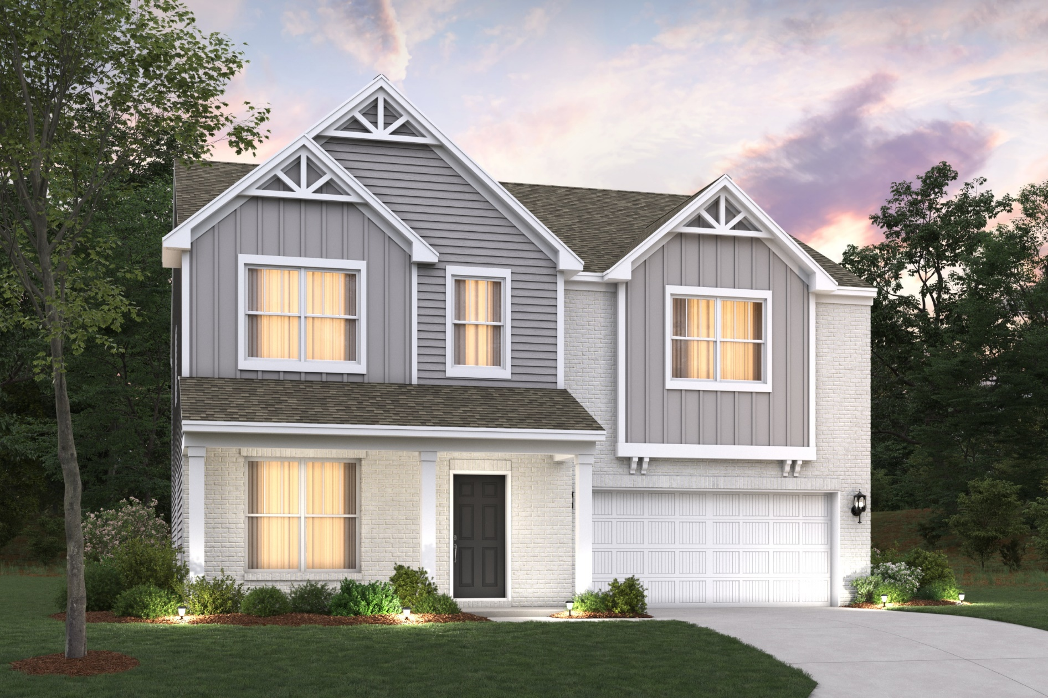
Fairbanks C

Slide 34
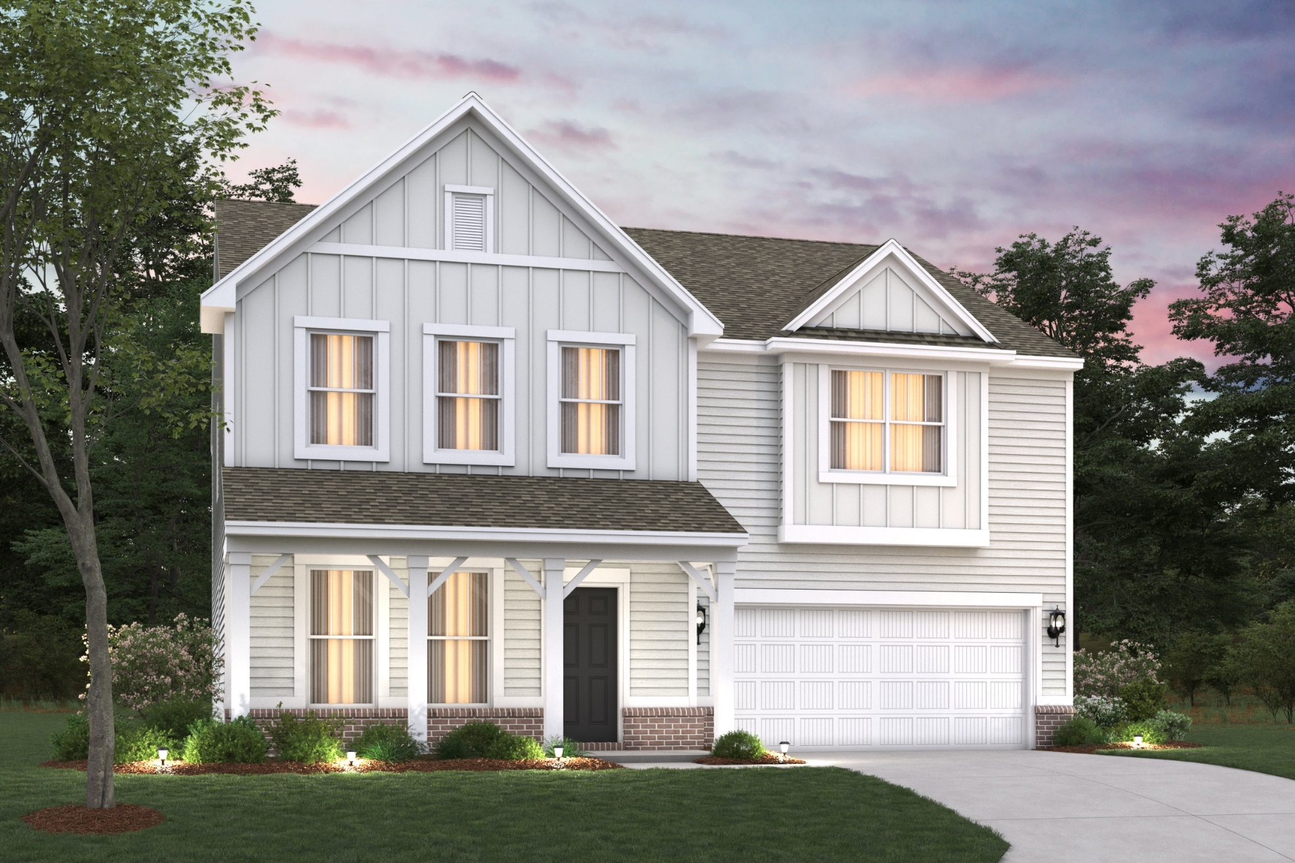
Fairbanks D

Slide 35
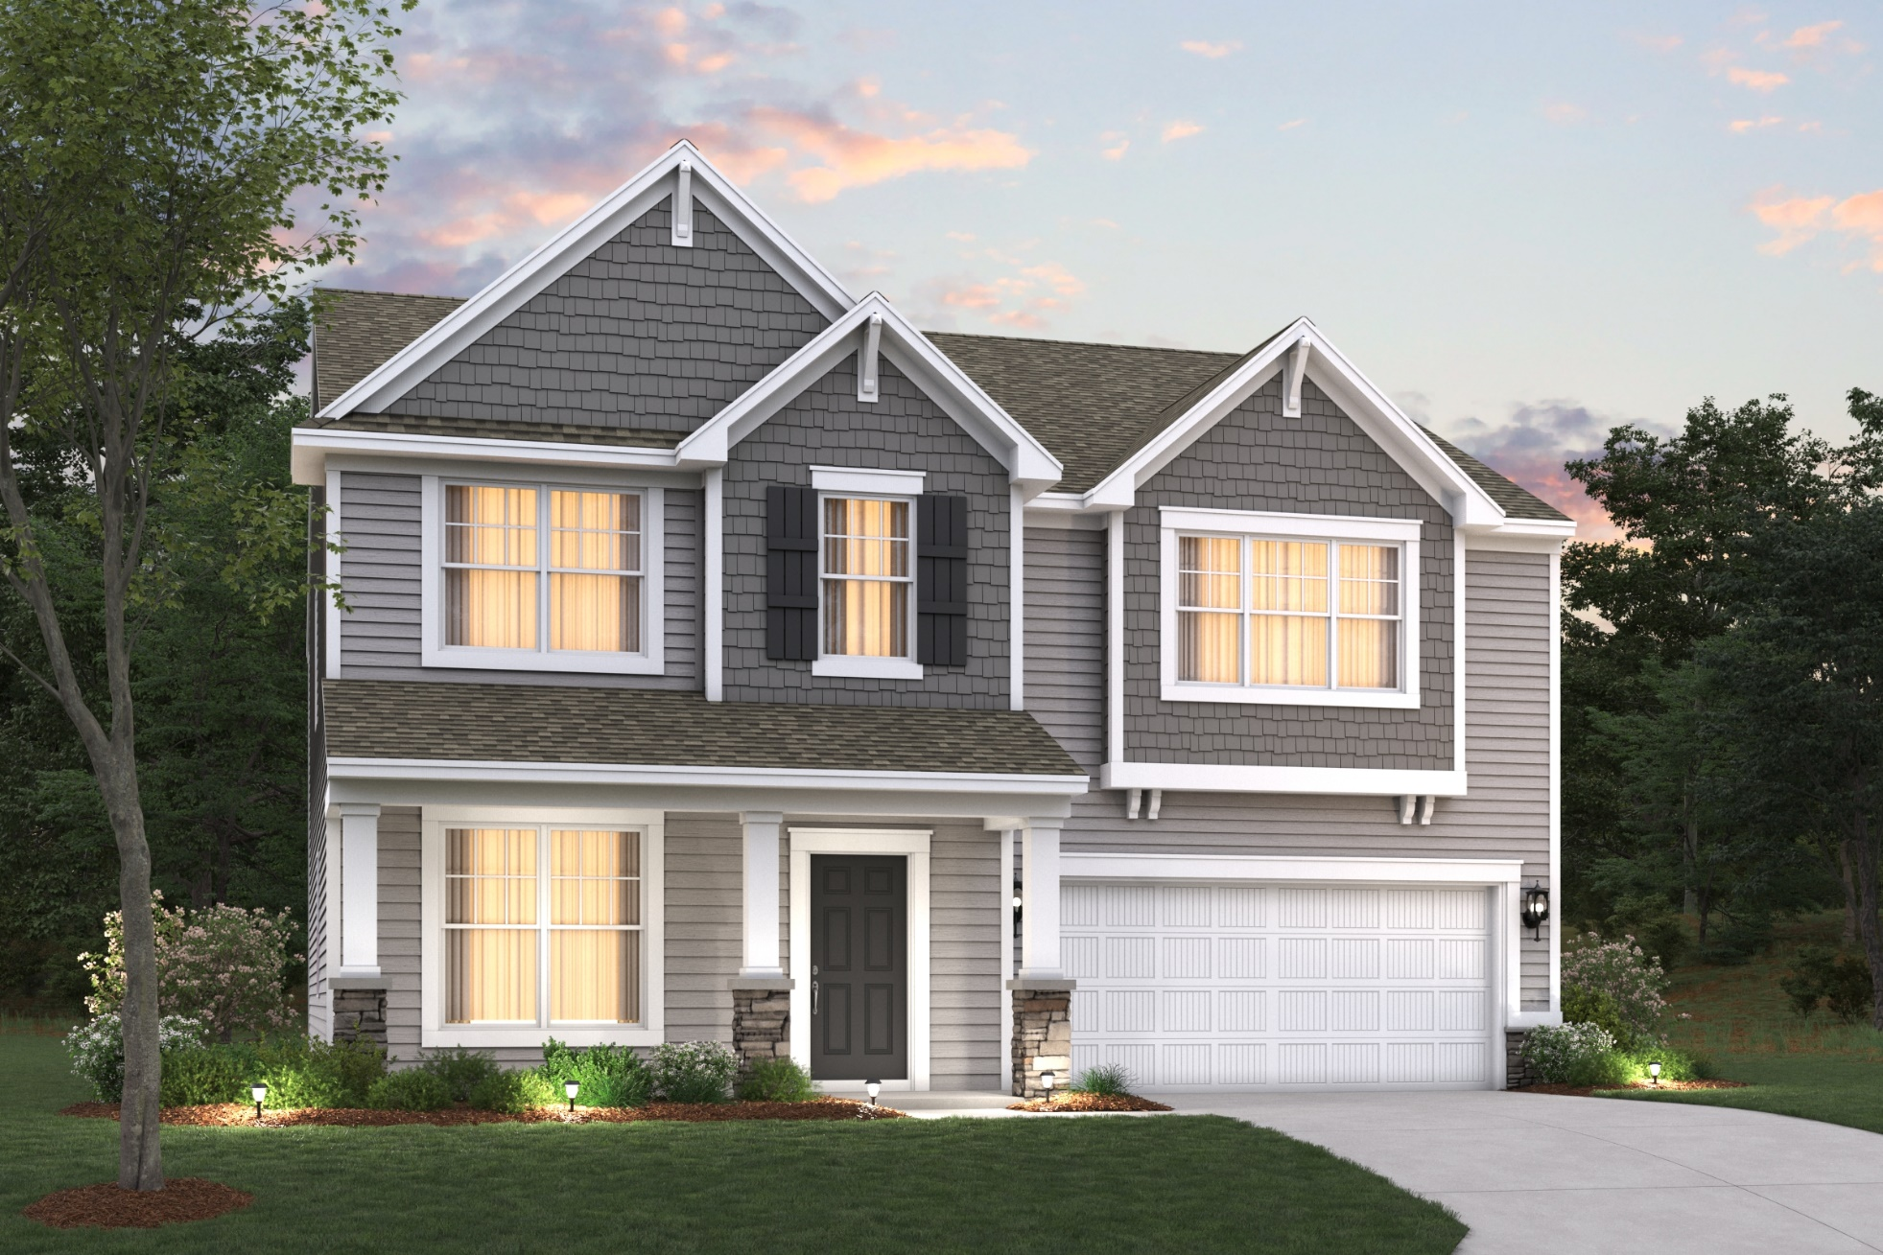
Fairbanks E

Slide 36
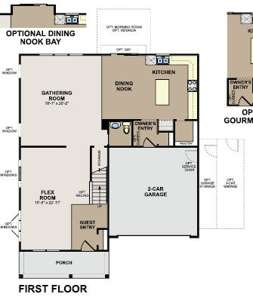
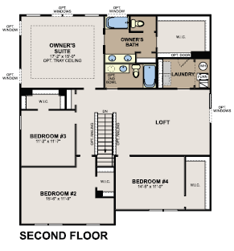
Fairbanks Floorplan

